Slide 1

Data-Intensive Distributed Computing
CS 451/651 431/631 (Winter 2018)
Part 6: Data Mining (3/4)
March 6, 2018
Jimmy Lin
David R. Cheriton School of Computer Science
University of Waterloo
These slides are available at http://lintool.github.io/bigdata-2018w/
This work is licensed under a Creative Commons Attribution-Noncommercial-Share Alike 3.0 United States
See http://creativecommons.org/licenses/by-nc-sa/3.0/us/ for details

Slide 2
Structure of the Course
Analyzing Text
Analyzing Relational Data
Analyzing Graphs
Data Mining
“Core” framework features
and algorithm design

Slide 3
Theme: Similarity
How similar are two items? How “close” are two items?
Equivalent formulations: large distance = low similarity
Lots of applications!
Problem: find similar items
Offline variant: extract all similar pairs of objects from a large collection
Online variant: is this object similar to something I’ve seen before?
Today!
Problem: arrange similar items into clusters
Offline variant: entire static collection available at once
Online variant: objects incrementally available
Next time!

Slide 4
Literature Note
Many communities have tackled similar problems:
Theoretical computer science
Information retrieval
Data mining
Databases
…
Issues
Slightly different terminology
Results not easy to compare

Slide 5
Four Steps
Specify distance metric
Jaccard, Euclidean, cosine, etc.
Compute representation
Shingling, tf.idf, etc.
“Project”
Minhash, random projections, etc.
Extract
Bucketing, sliding windows, etc.

Slide 6

Distance Metrics
Source: www.flickr.com/photos/thiagoalmeida/250190676/

Slide 7
Distance Metrics
Non-negativity:
Identity:
Symmetry:
Triangle Inequality

Slide 8
Distance: Jaccard
Given two sets A, B
Jaccard similarity:

Slide 9
Distance: Norms
Given
Euclidean distance (L₂-norm)
Manhattan distance (L₁-norm)
L_{r}-norm

Slide 10
Distance: Cosine
Given
Idea: measure distance between the vectors
Thus:

Slide 11
Distance: Hamming
Given two bit vectors
Hamming distance: number of elements which differ

Slide 12
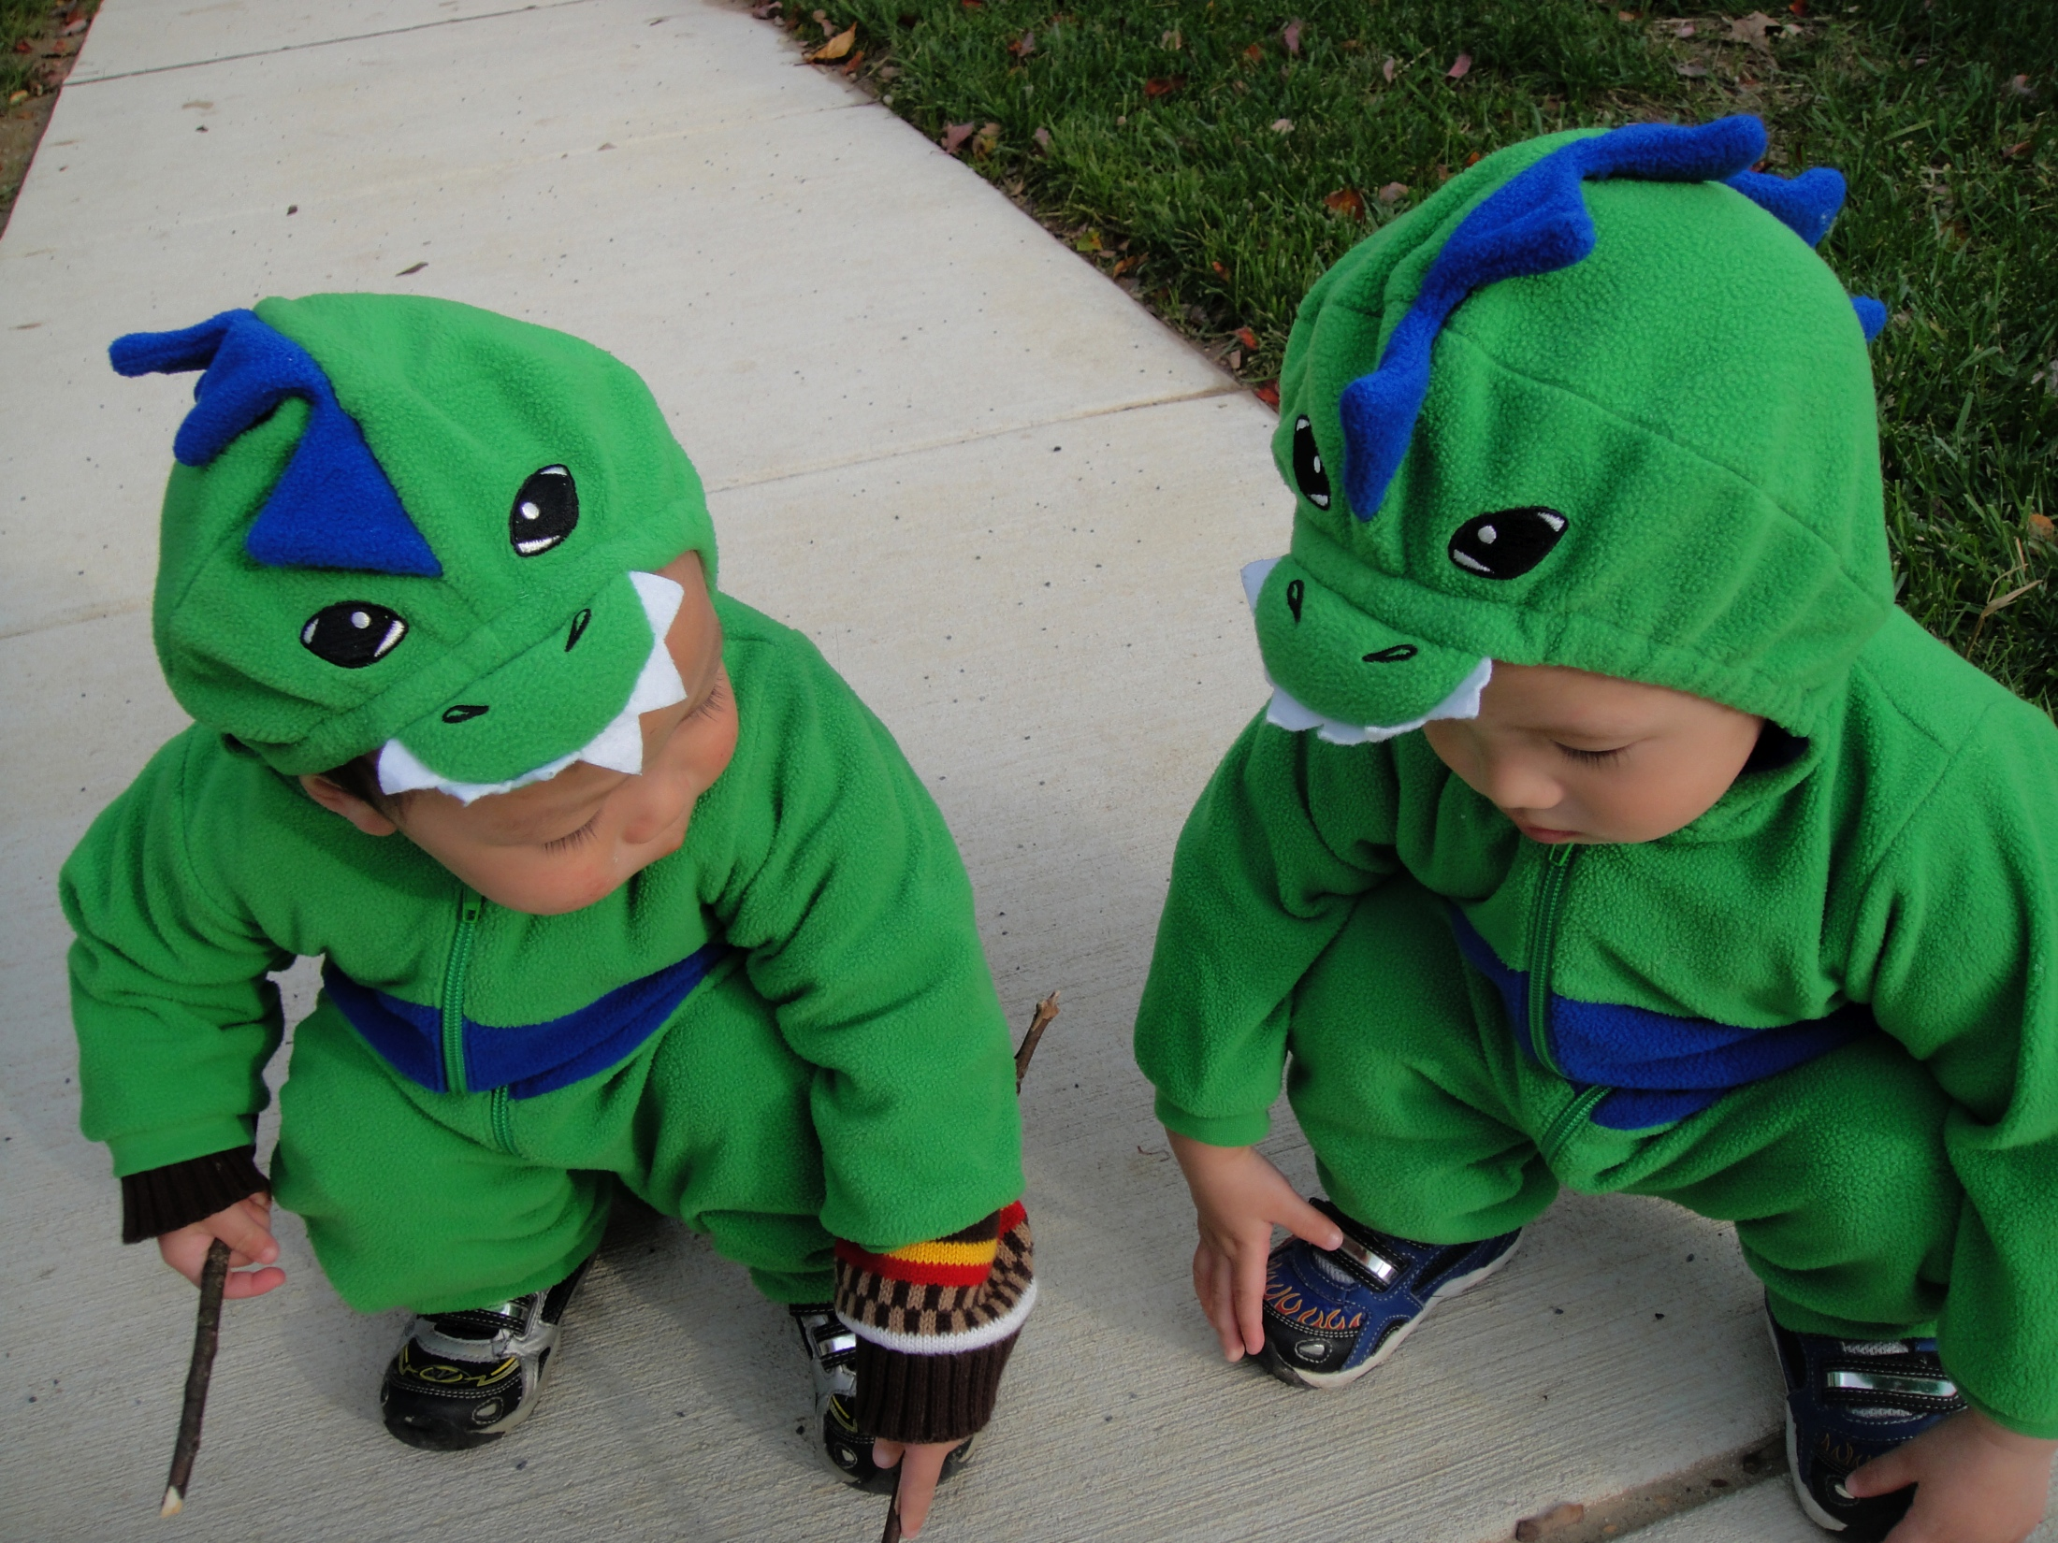
Representations

Slide 13
Representations
(Text)
Unigrams (i.e., words)
Shingles = n-grams
At the word level
At the character level
Feature weights
boolean
tf.idf
BM25
…

Slide 14
Representations
(Beyond Text)
For recommender systems:
Items as features for users
Users as features for items
For graphs:
Adjacency lists as features for vertices
For log data:
Behaviors (clicks) as features

Slide 15
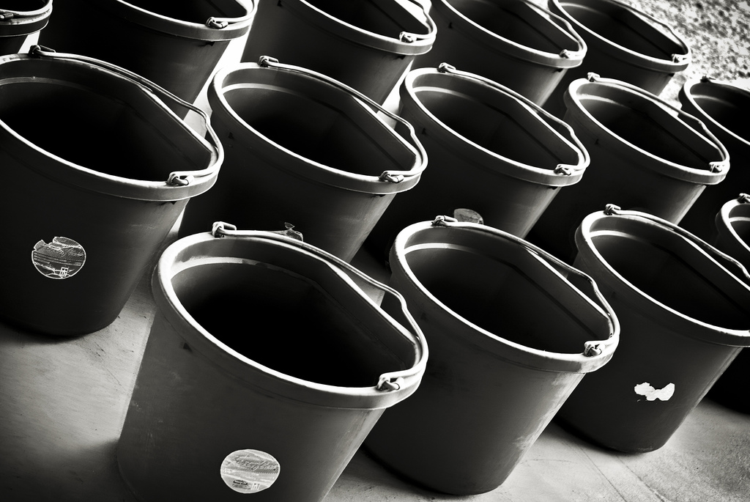
Minhash
Source: www.flickr.com/photos/rheinitz/6158837748/

Slide 16
Near-Duplicate Detection of Webpages
What’s the source of the problem?
Mirror pages (legit)
Spam farms (non-legit)
Additional complications (e.g., nav bars)
Naïve algorithm:
Compute cryptographic hash for webpage (e.g., MD5)
Insert hash values into a big hash table
Compute hash for new webpage: collision implies duplicate
What’s the issue?
Intuition:
Hash function needs to be tolerant of minor differences
High similarity implies higher probability of hash collision

Slide 17
Minhash
Naïve approach: N² comparisons: Can we do better?
Seminal algorithm for near-duplicate detection of webpages
Used by AltaVista
Setup:
Documents (HTML pages) represented by shingles (n-grams)
Jaccard similarity: dups are pairs with high similarity

Slide 18
Preliminaries: Representation
Sets:
  A = {e₁, e₃, e₇}
  B = {e₃, e₅, e₇}
Can be equivalently expressed as matrices:
Element | A | B
e₁ | 1 | 0
e₂ | 0 | 0
e₃ | 1 | 1
e₄ | 0 | 0
e₅ | 0 | 1
e₆ | 0 | 0
e₇ | 1 | 1

Slide 19
Preliminaries: Jaccard
Element | A | B
e₁ | 1 | 0
e₂ | 0 | 0
e₃ | 1 | 1
e₄ | 0 | 0
e₅ | 0 | 1
e₆ | 0 | 0
e₇ | 1 | 1
Let:
M₀₀ = # rows where both elements are 0
M₁₁ = # rows where both elements are 1
M₀₁ = # rows where A=0, B=1
M₁₀ = # rows where A=1, B=0

Slide 20
Minhash
Computing minhash
Start with the matrix representation of the set
Randomly permute the rows of the matrix
minhash is the first row with a “one”
Example
h(A) = e₃
h(B) = e₅
Element | A | B
e₁ | 1 | 0
e₂ | 0 | 0
e₃ | 1 | 1
e₄ | 0 | 0
e₅ | 0 | 1
e₆ | 0 | 0
e₇ | 1 | 1
Element | A | B
e₆ | 0 | 0
e₂ | 0 | 0
e₅ | 0 | 1
e₃ | 1 | 1
e₇ | 1 | 1
e₄ | 0 | 0
e₁ | 1 | 0

Slide 21
Minhash and Jaccard
Element | A | B
e₆ | 0 | 0
e₂ | 0 | 0
e₅ | 0 | 1
e₃ | 1 | 1
e₇ | 1 | 1
e₄ | 0 | 0
e₁ | 1 | 0
M₀₀
M₀₀
M₀₁
M₁₁
M₁₁
M₀₀
M₁₀
Woah!

Slide 22
To Permute or Not to Permute?
Problem: Permutations are expensive
Solution: Interpret the hash value as the permutation
Only need to keep track of the minimum hash value
Can keep track of multiple minhash values at once

Slide 23
Extracting Similar Pairs
Task: discover all pairs with similarity greater than s
Naïve approach: N² comparisons: Can we do better?
Tradeoffs:
False positives: discovered pairs that have similarity less than s
False negatives: pairs with similarity greater than s not discovered
The errors (and costs) are asymmetric!

Slide 24
Extracting Similar Pairs (LSH)
We know:
Task: discover all pairs with similarity greater than s
Algorithm:
For each object, compute its minhash value
Group objects by their hash values
Output all pairs within each group
Analysis:
If J(A,B) = s, then probability we detect it is s

Slide 26
False Negatives
What’s the issue?
False Positives
Threshold = 0.8

Slide 27
2 Minhash Signatures
We know:
Task: discover all pairs with similarity greater than s
Algorithm:
For each object, compute 2 minhash values and concatenate = signature
Group objects by their signatures
Output all pairs within each group
Analysis:
If J(A,B) = s, then probability we detect it is s²

Slide 28
3 Minhash Signatures
We know:
Task: discover all pairs with similarity greater than s
Algorithm:
For each object, compute 3 minhash values and concatenate = signature
Group objects by their signatures
Output all pairs within each group
Analysis:
If J(A,B) = s, then probability we detect it is s³

Slide 29
k Minhash Signatures
We know:
Task: discover all pairs with similarity greater than s
Algorithm:
For each object, compute k minhash values and concatenate = signature
Group objects by their signatures
Output all pairs within each group
Analysis:
If J(A,B) = s, then probability we detect it is s^{k}

Slide 30
k Minhash Signatures concatenated together
False Negatives
What’s the issue now?
False Positives
Threshold = 0.8

Slide 31
n different k Minhash Signatures
We know:
Task: discover all pairs with similarity greater than s
Algorithm:
For each object, compute n sets k minhash values
For each set, concatenate k minhash values together
In each set: group objects by signatures, output all pairs in each group
De-dup pairs
Analysis:
If J(A,B) = s, P(none of the n collide) = (1 – s^{k})^{n}
If J(A,B) = s, then probability we detect it is 1 – (1 – s^{k})^{n}

Slide 32
k Minhash Signatures concatenated together
False Negatives
False Positives
Threshold = 0.8

Slide 33
6 Minhash Signatures concatenated together
False Negatives
False Positives
Threshold = 0.8

Slide 34
n different sets of 6 Minhash Signatures
False Negatives
False Positives
Threshold = 0.8

Slide 35
n different k Minhash Signatures
Example: J(A,B) = 0.8, 10 sets of 6 minhash signatures
  P(k minhash signatures match) = (0.8)⁶ = 0.262
  P(k minhash signature doesn’t match in any of the 10 sets) =
  (1 – (0.8)⁶)¹⁰ = 0.0478
  Thus, we should find 1 – (1 – (0.8)⁶)¹⁰ = 0.952 of all similar pairs
Example: J(A,B) = 0.4, 10 sets of 6 minhash signatures
  P(k minhash signatures match) = (0.4)⁶ = 0.0041
  P(k minhash signature doesn’t match in any of the 10 sets) =
  (1 – (0.4)⁶)¹⁰ = 0.9598
  Thus, we should find 1 – (1 – 0.262144)¹⁰ = 0.040 of all similar pairs

Slide 36
n different k Minhash Signatures
s | 1 – (1 – s⁶)¹⁰
0.2 | 0.0006
0.3 | 0.0073
0.4 | 0.040
0.5 | 0.146
0.6 | 0.380
0.7 | 0.714
0.8 | 0.952
0.9 | 0.999
What’s the issue?

Slide 37
Practical Notes
Common implementation:
Generate M minhash values, select k of them n times
Reduces amount of hash computations needed
Determining “authoritative” version is non-trivial

Slide 38
MapReduce/Spark Implementation
Map over objects:
Generate M minhash values, select k of them n times
Each draw yields a signature, emit:
key = (p, signature), where p = [ 1 … n ] and value = object id
Shuffle/Sort
Reduce
Receive all object ids with same (n, signature), emit clusters
Second pass to de-dup and group clusters
(Optional) Third pass to eliminate false positives

Slide 39
Offline Extraction vs. Online Querying
Batch formulation of the problem:
Discover all pairs with similarity greater than s
Useful for post-hoc batch processing of web crawl
Online formulation of the problem:
Given new webpage, is it similar to one I’ve seen before?
Useful for incremental web crawl processing

Slide 40
Online Similarity Querying
Preparing the existing collection:
For each object, compute n sets of k minhash values
For each set, concatenate k minhash values together
Keep each signature in hash table (in memory)
Note: can parallelize across multiple machines
Querying and updating:
For new webpage, compute signatures and check for collisions
Collisions imply duplicate (determine which version to keep)
Update hash tables

Slide 41
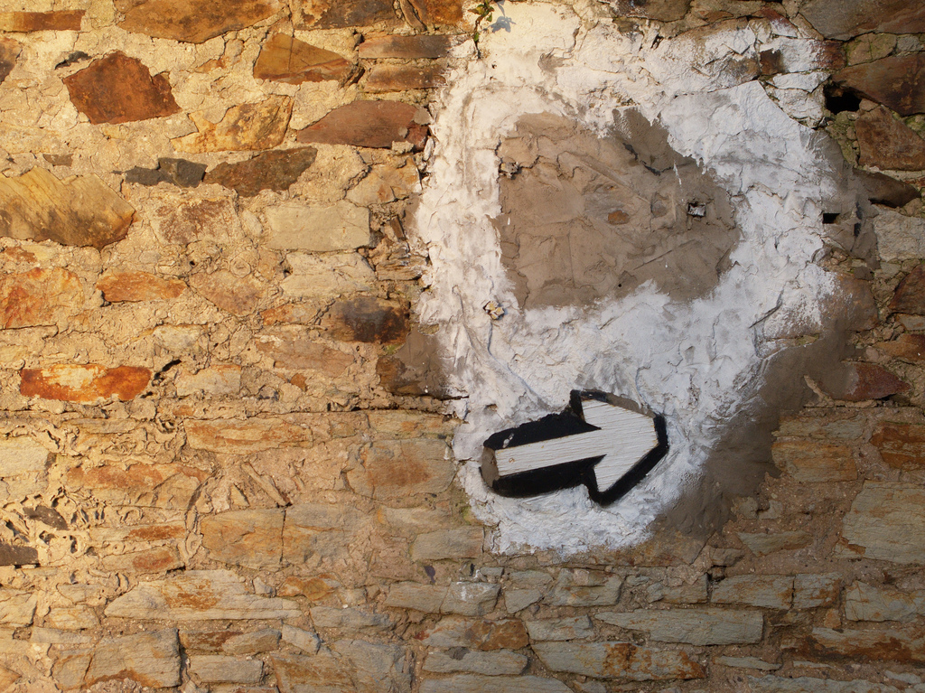
Random Projections
Source: www.flickr.com/photos/roj/4179478228/

Slide 42
Limitations of Minhash
Minhash is great for near-duplicate detection
Set high threshold for Jaccard similarity
Limitations:
Jaccard similarity only
Set-based representation, no way to assign weights to features
Random projections:
Works with arbitrary vectors using cosine similarity
Same basic idea, but details differ
Slower but more accurate: no free lunch!

Slide 43
Random Projection Hashing
Generate a random vector r of unit length
Draw from univariate Gaussian for each component
Normalize length
Define:
Physical intuition?

Slide 44
RP Hash Collisions
It can be shown that:
Proof in (Goemans and Williamson, 1995)
Thus:
Physical intuition?

Slide 45
Random Projection Signature
Given D random vectors:
Convert each object into a D bit signature:
Since:
We can derive:
Insight: similarity boils down to comparison of
hamming distances between signatures

Slide 46
One-RP Signature
Task: discover all pairs with cosine similarity greater than s
Algorithm:
Compute D-bit RP signature for every object
Take first bit, bucket objects into two sets
Perform brute force pairwise (hamming distance) comparison
in each bucket, retain those below hamming distance threshold
Analysis:
Probability we will discover all pairs:
*
Efficiency
* Note, this is actually a simplification: see Ture et al. (SIGIR 2011) for details.

Slide 47
Two-RP Signature
Task: discover all pairs with cosine similarity greater than s
Algorithm:
Compute D-bit RP signature for every object
Take first two bits, bucket objects into four sets
Perform brute force pairwise (hamming distance) comparison
in each bucket, retain those below hamming distance threshold
Analysis:
Probability we will discover all pairs:
Efficiency

Slide 48
k-RP Signature
Task: discover all pairs with cosine similarity greater than s
Algorithm:
Compute D-bit RP signature for every object
Take first k bits, bucket objects into 2^{k} sets
Perform brute force pairwise (hamming distance) comparison
in each bucket, retain those below hamming distance threshold
Analysis:
Probability we will discover all pairs:
Efficiency

Slide 49
m Sets of k-RP Signature
Task: discover all pairs with cosine similarity greater than s
Algorithm:
Compute D-bit RP signature for every object
Choose m sets of k bits; for each, use k selected bits to bucket objects into 2^{k} sets
Perform brute force pairwise (hamming distance) comparison
in each bucket, retain those below hamming distance threshold
Analysis:
Probability we will discover all pairs:
Efficiency

Slide 50
MapReduce/Spark Implementation
Map over objects:
Compute D-bit RP signature for every object
Choose m sets of k bits and use to bucket; for each, emit:
key = (p, k bits), where p = [ 1 … m ], value = (object id, rest of signature bits)
Shuffle/Sort
Reduce
Receive (p, k bits)
Perform brute force pairwise (hamming distance) comparison for each key,
retain those below hamming distance threshold
Second pass to de-dup and group clusters
(Optional) Third pass to eliminate false positives

Slide 51
Online Querying
Preparing the existing collection:
Compute D-bit RP signature for every object
Choose m sets of k bits and use to bucket
Store signatures in memory (across multiple machines)
Querying:
Compute D-bit signature of query object, choose m sets of k bits in same way
Perform brute-force scan of correct bucket (in parallel)

Slide 52
Additional Issues to Consider
Emphasis on recall, not precision
Two sources of error:
From LSH
From using hamming distance as proxy for cosine similarity
Load imbalance
Parameter tuning

Slide 53
“Sliding Window” Algorithm
Compute D-bit RP signature for every object
For each object, permute bit signature m times
For each permutation, sort bit signatures
Apply sliding window of width B over sorted
Compute hamming distances of bit signatures within window

Slide 54
MapReduce/Spark Implementation
Mapper:
Compute D-bit RP signature for every object
Permute m times, for each emit:
key = (p, signature), where p = [ 1 … m ], value = object id
Shuffle/Sort
Reduce
Keep FIFO queue of B bit signatures
For each new bit signature, compute hamming distance wrt all in queue
Add new bit signature to end of queue, displacing oldest

Slide 55
Four Steps to Finding Similar Items
Specify distance metric
Jaccard, Euclidean, cosine, etc.
Compute representation
Shingling, tf.idf, etc.
“Project”
Minhash, random projections, etc.
Extract
Bucketing, sliding windows, etc.

Slide 56

Questions?
Source: Wikipedia (Japanese rock garden)

