Slide 1

Big Data Infrastructure
CS 489/698 Big Data Infrastructure (Winter 2016)
Week 8: Data Mining (1/4)
March 1, 2016
Jimmy Lin
David R. Cheriton School of Computer Science
University of Waterloo
These slides are available at http://lintool.github.io/bigdata-2016w/
This work is licensed under a Creative Commons Attribution-Noncommercial-Share Alike 3.0 United States
See http://creativecommons.org/licenses/by-nc-sa/3.0/us/ for details

Slide 2
Structure of the Course
Analyzing Text
Analyzing Relational Data
Analyzing Graphs
Data Mining
“Core” framework features
and algorithm design

Slide 3
Supervised Machine Learning
The generic problem of function induction given sample instances of input and output
Focus today
Classification: output draws from finite discrete labels
Regression: output is a continuous value
This is not meant to be an exhaustive treatment of machine learning!

Slide 4

Classification
Source: Wikipedia (Sorting)

Slide 5
Applications
Spam detection
Sentiment analysis
Content (e.g., genre) classification
Link prediction
Document ranking
Object recognition
Fraud detection
And much much more!

Slide 6



Supervised Machine Learning
training
testing/deployment
training data
Model
?
Machine Learning Algorithm

Slide 7
Feature Representations
Who comes up with the features?
How?
Objects are represented in terms of features:
“Dense” features: sender IP, timestamp, # of recipients, length of message, etc.
“Sparse” features: contains the term “viagra” in message, contains “URGENT” in subject, etc.

Slide 8
Applications
Spam detection
Sentiment analysis
Content (e.g., genre) classification
Link prediction
Document ranking
Object recognition
Fraud detection
And much much more!
Features are highly application-specific!

Slide 9
Components of a ML Solution
Data
logistic regression, naïve Bayes, SVM, random forests, perceptrons, neural network, etc.
Features
Model
gradient descent, stochastic gradient descent, L-BFGS, etc.
Optimization
What “matters” the most?

Slide 10
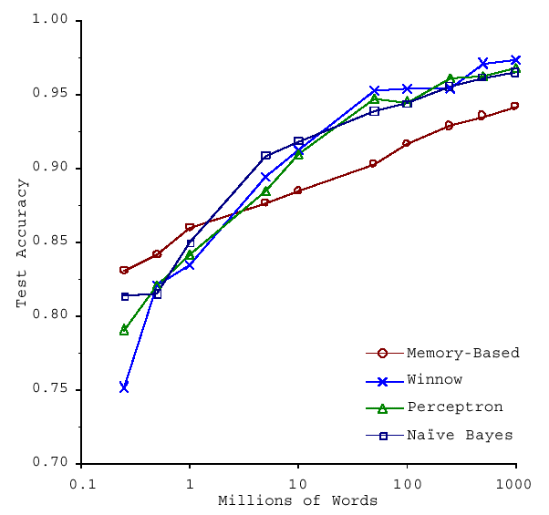
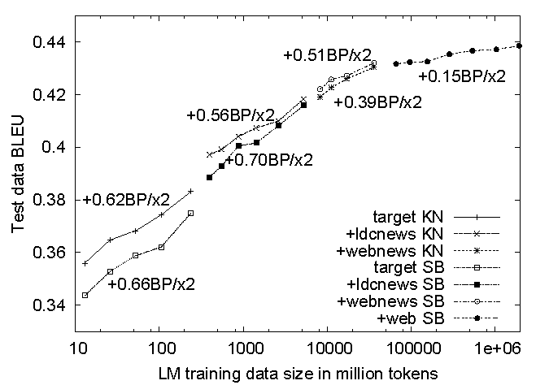
No data like more data!
s/knowledge/data/g;
(Banko and Brill, ACL 2001)
(Brants et al., EMNLP 2007)

Slide 11
Limits of Supervised Classification?
Why is this a big data problem?
  Isn’t gathering labels a serious bottleneck?
Solution: crowdsourcing
Solution: bootstrapping, semi-supervised techniques
Solution: user behavior logs
  Learning to rank
  Computational advertising
  Link recommendation
The virtuous cycle of data-driven products

Slide 12
Supervised Binary Classification
Restrict output label to be binary
  Yes/No
  1/0
Binary classifiers form a primitive building block for multi-class problems
  One vs. rest classifier ensembles
  Classifier cascades

Slide 13
The Task
label
Given
(sparse) feature vector
Induce
  Such that loss is minimized
loss function
Typically, consider functions of a parametric form:
model parameters

Slide 14
Key insight: machine learning as an optimization problem!
(closed form solutions generally not possible)

Slide 15
Gradient Descent: Preliminaries
Rewrite:
Compute gradient:
  “Points” to fastest increasing “direction”
So, at any point:
*
* caveats

Slide 16
Gradient Descent: Iterative Update
Start at an arbitrary point, iteratively update:
We have:
Lots of details:
  Figuring out the step size
  Getting stuck in local minima
  Convergence rate
  …

Slide 17
Gradient Descent
Repeat until convergence:

Slide 18
Intuition behind the math…
New weights
Old weights
Update based on gradient

Slide 19
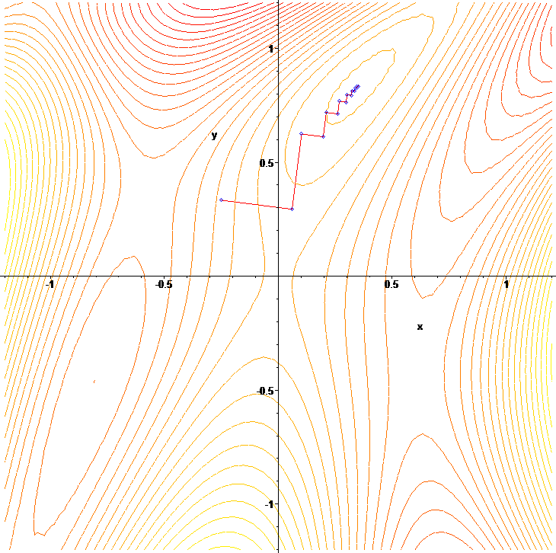
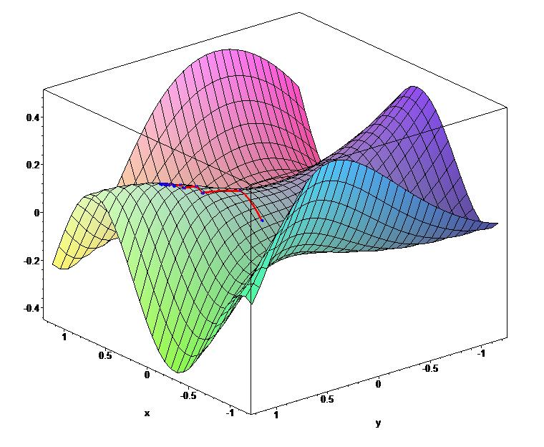

Slide 20

Gradient Descent
Source: Wikipedia (Hills)

Slide 21
Lots More Details…
Gradient descent is a “first order” optimization technique
  Often, slow convergence
  Conjugate techniques accelerate convergence
Newton and quasi-Newton methods:
  Intuition: Taylor expansion
  Requires the Hessian (square matrix of second order partial derivatives): impractical to fully compute

Slide 22

Logistic Regression
Source: Wikipedia (Hammer)

Slide 23
Logistic Regression: Preliminaries
Given
Let’s define:
Interpretation:

Slide 24
Relation to the Logistic Function
After some algebra:
The logistic function:

Slide 25
Training an LR Classifier
Maximize the conditional likelihood:
Define the objective in terms of conditional log likelihood:
  We know so:
  Substituting:

Slide 26
LR Classifier Update Rule
Take the derivative:
General form for update rule:
Final update rule:

Slide 27
Lots more details…
Regularization
Different loss functions
…
Want more details?
Take a real machine-learning course!

Slide 28
MapReduce Implementation
mappers
single reducer
compute partial gradient
mapper
mapper
mapper
mapper
reducer
iterate until convergence
update model

Slide 29
Shortcomings
Hadoop is bad at iterative algorithms
  High job startup costs
  Awkward to retain state across iterations
High sensitivity to skew
  Iteration speed bounded by slowest task
Potentially poor cluster utilization
  Must shuffle all data to a single reducer
Some possible tradeoffs
  Number of iterations vs. complexity of computation per iteration
  E.g., L-BFGS: faster convergence, but more to compute

Slide 30
Spark Implementation
val points = spark.textFile(...).map(parsePoint).persist()
var w = // random initial vector
for (i <- 1 to ITERATIONS) {
val gradient = points.map{ p =>
p.x * (1/(1+exp(-p.y*(w dot p.x)))-1)*p.y
}.reduce((a,b) => a+b)
w -= gradient
}
What’s the difference?
compute partial gradient
mapper
mapper
mapper
mapper
reducer
update model

Slide 31

Questions?
Source: Wikipedia (Japanese rock garden)

