Slide 1

Big Data Infrastructure
CS 489/698 Big Data Infrastructure (Winter 2016)
Week 2: MapReduce Algorithm Design (1/2)
January 12, 2016
Jimmy Lin
David R. Cheriton School of Computer Science
University of Waterloo
These slides are available at http://lintool.github.io/bigdata-2016w/
This work is licensed under a Creative Commons Attribution-Noncommercial-Share Alike 3.0 United States
See http://creativecommons.org/licenses/by-nc-sa/3.0/us/ for details

Slide 2

Source: Wikipedia (The Scream)

Slide 3

Aside: Cloud Computing
Source: Wikipedia (Clouds)

Slide 4
The best thing since sliced bread?
Before clouds…
  Grids
  Connection machine
  Vector supercomputers
  …
Cloud computing means many different things:
  Big data
  Rebranding of web 2.0
  Utility computing
  Everything as a service

Slide 5
Rebranding of web 2.0
Rich, interactive web applications
  Clouds refer to the servers that run them
  AJAX as the de facto standard (for better or worse)
  Examples: Facebook, YouTube, Gmail, …
“The network is the computer”: take two
  User data is stored “in the clouds”
  Rise of the tablets, smartphones, etc. (“thin client”)
  Browser is the OS

Slide 6
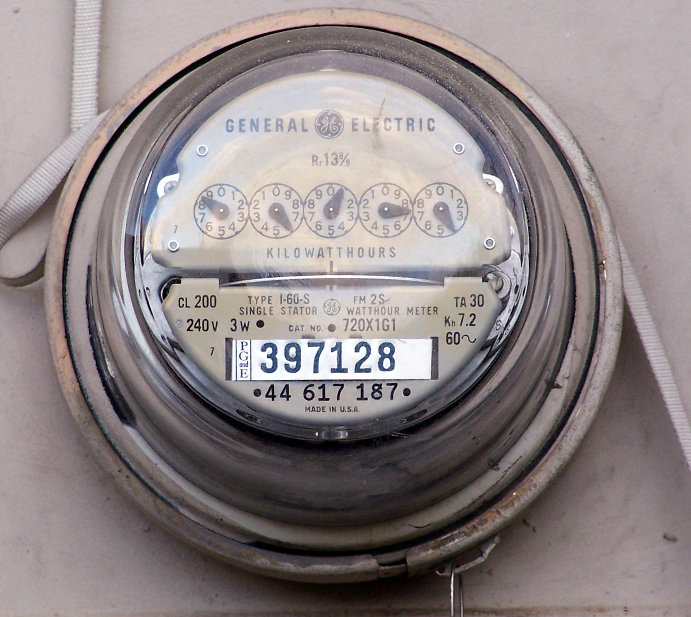
Source: Wikipedia (Electricity meter)

Slide 7
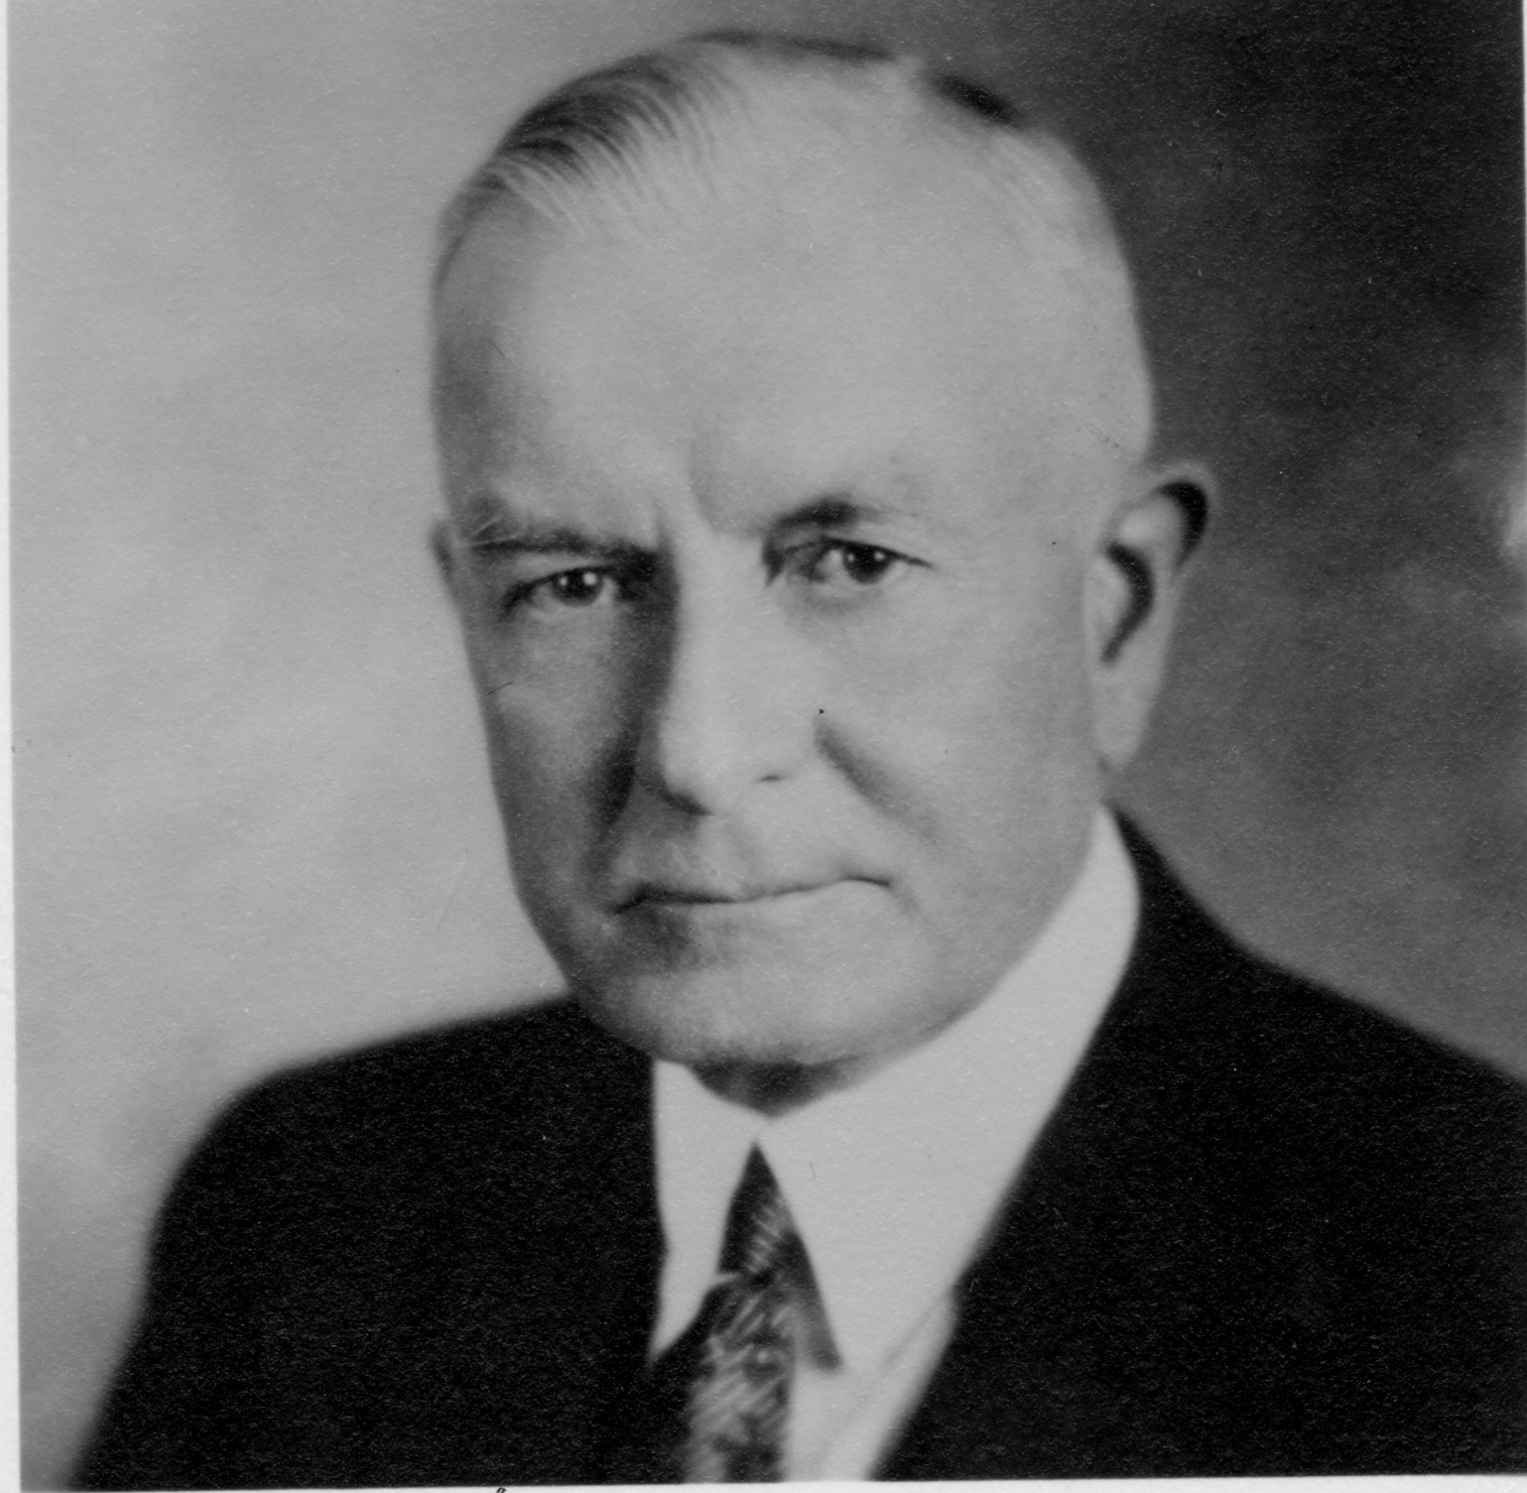
Utility Computing
What?
  Computing resources as a metered service (“pay as you go”)
  Ability to dynamically provision virtual machines
Why?
  Cost: capital vs. operating expenses
  Scalability: “infinite” capacity
  Elasticity: scale up or down on demand
Does it make sense?
  Benefits to cloud users
  Business case for cloud providers
I think there is a world market for about five computers.

Slide 8
Enabling Technology: Virtualization
App
App
App
App
App
App
OS
OS
OS
Operating System
Hypervisor
Hardware
Hardware
Traditional Stack
Virtualized Stack
Today’s buzzword: Docker

Slide 9
Everything as a Service
Utility computing = Infrastructure as a Service (IaaS)
  Why buy machines when you can rent cycles?
  Examples: Amazon’s EC2, Rackspace
Platform as a Service (PaaS)
  Give me nice API and take care of the maintenance, upgrades, …
  Example: Google App Engine, Altiscale
Software as a Service (SaaS)
  Just run it for me!
  Example: Gmail, Salesforce

Slide 10
Who cares?
A source of problems…
  Cloud-based services generate big data
  Clouds make it easier to start companies that generate big data
As well as a solution…
  Ability to provision analytics clusters on-demand in the cloud
  Commoditization and democratization of big data capabilities

Slide 11
So, what is the cloud?
Source: Wikipedia (Clouds)

Slide 12

What is the Matrix?
Source: The Matrix - PPC Wiki - Wikia

Slide 13

The datacenter is the computer!
Source: Google

Slide 14
k₁
v₁
k₂
v₂
k₃
v₃
k₄
v₄
k₅
v₅
k₆
v₆
map
map
map
map
a
1
b
2
c
3
c
6
a
5
c
2
b
7
c
8
combine
combine
combine
combine
a
1
b
2
c
9
a
5
c
2
b
7
c
8
partition
partition
partition
partition
Shuffle and Sort: aggregate values by keys
a
1
5
b
2
7
c
c
2
2
9
3
8
6
8
reduce
reduce
reduce
r₁
s₁
r₂
s₂
r₃
s₃

Slide 15
User
Program
(1) submit
Master
(2) schedule map
(2) schedule reduce
worker
split 0
(6) write
output
file 0
split 1
(5) remote read
worker
split 2
(3) read
(4) local write
split 3
worker
split 4
worker
output
file 1
worker
Input
files
Map
phase
Intermediate files
(on local disk)
Reduce
phase
Output
files
Adapted from (Dean and Ghemawat, OSDI 2004)

Slide 16
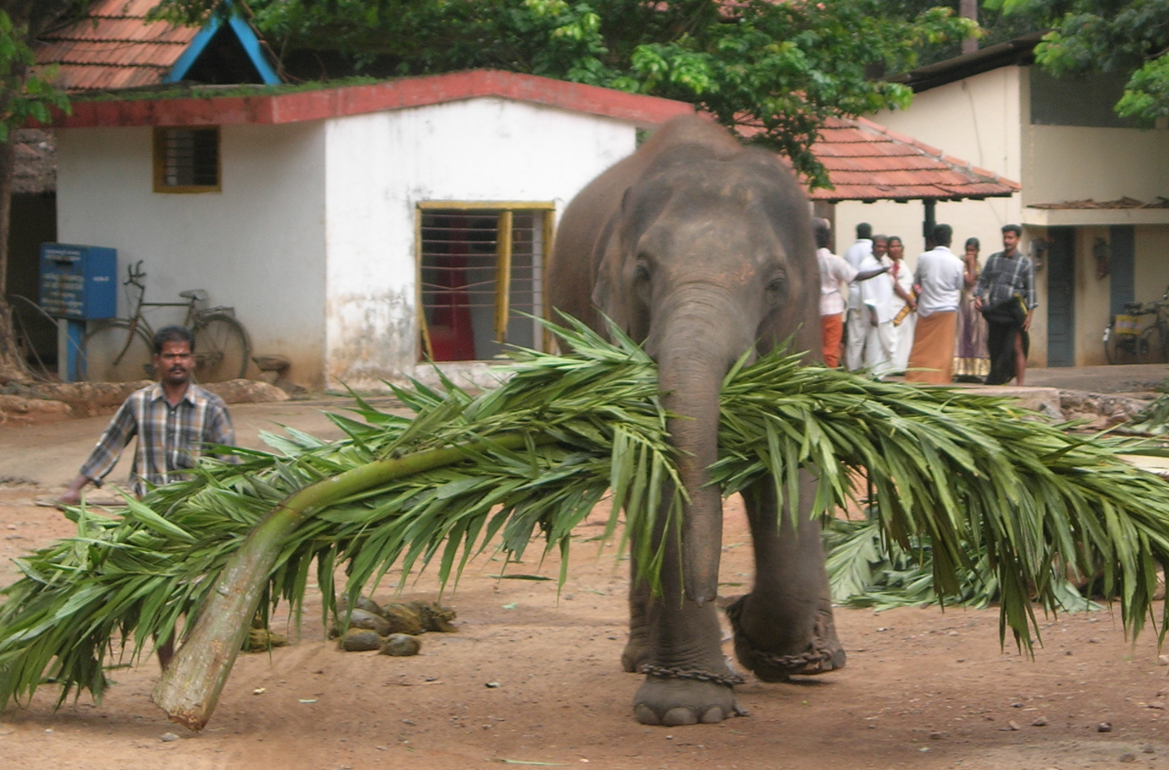

Aside, what about Spark?
Source: Wikipedia (Mahout)

Slide 17
MapReduce API*
Mapper<K_{in},V_{in},K_{out},V_{out}>
  void setup(Mapper.Context context)
  Called once at the beginning of the task
  void map(K_{in} key, V_{in} value, Mapper.Context context)
  Called once for each key/value pair in the input split
  void cleanup(Mapper.Context context)
  Called once at the end of the task
Reducer<K_{in},V_{in},K_{out},V_{out}>/Combiner<K_{in},V_{in},K_{out},V_{out}>
  void setup(Reducer.Context context)
  Called once at the start of the task
  void reduce(K_{in} key, Iterable<V_{in}> values, Reducer.Context context)
  Called once for each key
  void cleanup(Reducer.Context context)
  Called once at the end of the task
*Note that there are two versions of the API!

Slide 18
MapReduce API*
Partitioner
  int getPartition(K key, V value, int numPartitions)
  Get the partition number given total number of partitions
Job
  Represents a packaged Hadoop job for submission to cluster
  Need to specify input and output paths
  Need to specify input and output formats
  Need to specify mapper, reducer, combiner, partitioner classes
  Need to specify intermediate/final key/value classes
  Need to specify number of reducers (but not mappers, why?)
  Don’t depend of defaults!
*Note that there are two versions of the API!

Slide 19

A tale of two packages…
org.apache.hadoop.mapreduce
org.apache.hadoop.mapred
Source: Wikipedia (Budapest)

Slide 20
Data Types in Hadoop: Keys and Values
Writable
Defines a de/serialization protocol. Every data type in Hadoop is a Writable.
WritableComprable
Defines a sort order. All keys must be of this type (but not values).
IntWritable
LongWritable
Text
…
Concrete classes for different data types.
SequenceFiles
Binary encoded of a sequence of
key/value pairs

Slide 21
“Hello World”: Word Count
Map(String docid, String text):
for each word w in text:
Emit(w, 1);
Reduce(String term, Iterator<Int> values):
int sum = 0;
for each v in values:
sum += v;
Emit(term, sum);

Slide 22
“Hello World”: Word Count
private static class MyMapper
extends Mapper<LongWritable, Text, Text, IntWritable> {
private final static IntWritable ONE = new IntWritable(1);
private final static Text WORD = new Text();
@Override
public void map(LongWritable key, Text value, Context context)
throws IOException, InterruptedException {
String line = ((Text) value).toString();
StringTokenizer itr = new StringTokenizer(line);
while (itr.hasMoreTokens()) {
WORD.set(itr.nextToken());
context.write(WORD, ONE);
}
}
}

Slide 23
“Hello World”: Word Count
private static class MyReducer
extends Reducer<Text, IntWritable, Text, IntWritable> {
private final static IntWritable SUM = new IntWritable();
@Override
public void reduce(Text key, Iterable<IntWritable> values,
Context context) throws IOException, InterruptedException {
Iterator<IntWritable> iter = values.iterator();
int sum = 0;
while (iter.hasNext()) {
sum += iter.next().get();
}
SUM.set(sum);
context.write(key, SUM);
}
}

Slide 24
Three Gotchas
Avoid object creation if possible
  Reuse Writable objects, change the payload
Execution framework reuses value object in reducer
Passing parameters via class statics

Slide 25
Getting Data to Mappers and Reducers
Configuration parameters
  Directly in the Job object for parameters
“Side data”
  DistributedCache
  Mappers/reducers read from HDFS in setup method

Slide 26
Complex Data Types in Hadoop
How do you implement complex data types?
The easiest way:
  Encoded it as Text, e.g., (a, b) = “a:b”
  Use regular expressions to parse and extract data
  Works, but janky
The hard way:
  Define a custom implementation of Writable(Comprable)
  Must implement: readFields, write, (compareTo)
  Computationally efficient, but slow for rapid prototyping
  Implement WritableComparator hook for performance
Somewhere in the middle:
  Bespin (via lin.tl) offers JSON support and lots of useful Hadoop types

Slide 27
Basic Cluster Components*
One of each:
  Namenode (NN): master node for HDFS
  Jobtracker (JT): master node for job submission
Set of each per slave machine:
  Tasktracker (TT): contains multiple task slots
  Datanode (DN): serves HDFS data blocks
* Not quite… leaving aside YARN for now

Slide 28
Putting everything together…
namenode
job submission node
namenode daemon
jobtracker
tasktracker
tasktracker
tasktracker
datanode daemon
datanode daemon
datanode daemon
Linux file system
Linux file system
Linux file system
…
…
…
slave node
slave node
slave node

Slide 29
Anatomy of a Job
MapReduce program in Hadoop = Hadoop job
  Jobs are divided into map and reduce tasks
  An instance of running a task is called a task attempt (occupies a slot)
  Multiple jobs can be composed into a workflow
Job submission:
  Client (i.e., driver program) creates a job, configures it, and submits it to jobtracker
  That’s it! The Hadoop cluster takes over…

Slide 30
Anatomy of a Job
Behind the scenes:
  Input splits are computed (on client end)
  Job data (jar, configuration XML) are sent to JobTracker
  JobTracker puts job data in shared location, enqueues tasks
  TaskTrackers poll for tasks
  Off to the races…

Slide 31
Input File
Input File
InputSplit
InputSplit
InputSplit
InputSplit
InputSplit
InputFormat
RecordReader
RecordReader
RecordReader
RecordReader
RecordReader
Mapper
Mapper
Mapper
Mapper
Mapper
Intermediates
Intermediates
Intermediates
Intermediates
Intermediates
Source: redrawn from a slide by Cloduera, cc-licensed

Slide 32
Client
Records
…
…
InputSplit
InputSplit
InputSplit
RecordReader
RecordReader
RecordReader
Mapper
Mapper
Mapper

Slide 33
Mapper
Mapper
Mapper
Mapper
Mapper
Intermediates
Intermediates
Intermediates
Intermediates
Intermediates
Partitioner
Partitioner
Partitioner
Partitioner
Partitioner
(combiners omitted here)
Intermediates
Intermediates
Intermediates
Reducer
Reducer
Reduce
Source: redrawn from a slide by Cloduera, cc-licensed

Slide 34
Reducer
Reducer
Reduce
OutputFormat
RecordWriter
RecordWriter
RecordWriter
Output File
Output File
Output File
Source: redrawn from a slide by Cloduera, cc-licensed

Slide 35
Input and Output
InputFormat:
  TextInputFormat
  KeyValueTextInputFormat
  SequenceFileInputFormat
  …
OutputFormat:
  TextOutputFormat
  SequenceFileOutputFormat
  …

Slide 36
Shuffle and Sort in MapReduce
Probably the most complex aspect of MapReduce execution
Map side
  Map outputs are buffered in memory in a circular buffer
  When buffer reaches threshold, contents are “spilled” to disk
  Spills merged in a single, partitioned file (sorted within each partition): combiner runs during the merges
Reduce side
  First, map outputs are copied over to reducer machine
  “Sort” is a multi-pass merge of map outputs (happens in memory and on disk): combiner runs during the merges
  Final merge pass goes directly into reducer

Slide 37
Shuffle and Sort
Mapper
intermediate files
(on disk)
merged spills
(on disk)
Combiner
Reducer
circular buffer
(in memory)
Combiner
other reducers
spills (on disk)
other mappers

Slide 38

Hadoop Workflow
Submit node
(workspace)
Hadoop Cluster
You
Getting data in?
Writing code?
Getting data out?

Slide 39
Debugging Hadoop
First, take a deep breath
Start small, start locally
Build incrementally

Slide 40
Source: Wikipedia (The Scream)

Slide 41
Code Execution Environments
Different ways to run code:
  Local (standalone) mode
  Pseudo-distributed mode
  Fully-distributed mode
Learn what’s good for what

Slide 42
Hadoop Debugging Strategies
Good ol’ System.out.println
  Learn to use the webapp to access logs
  Logging preferred over System.out.println
  Be careful how much you log!
Fail on success
  Throw RuntimeExceptions and capture state
Programming is still programming
  Use Hadoop as the “glue”
  Implement core functionality outside mappers and reducers
  Independently test (e.g., unit testing)
  Compose (tested) components in mappers and reducers

Slide 43

Questions?
Source: Wikipedia (Japanese rock garden)

