Slide 1
Big Data Infrastructure
CS 489/698 Big Data Infrastructure (Winter 2016)
Week 1: Introduction (1/2)
January 5, 2016
Jimmy Lin
David R. Cheriton School of Computer Science
University of Waterloo
These slides are available at http://lintool.github.io/bigdata-2016w/
This work is licensed under a Creative Commons Attribution-Noncommercial-Share Alike 3.0 United States See http://creativecommons.org/licenses/by-nc-sa/3.0/us/ for details

Slide 2
Questions, questions, questions…
Who am I?
What is big data?
Why big data?
What is this course about?

Slide 3
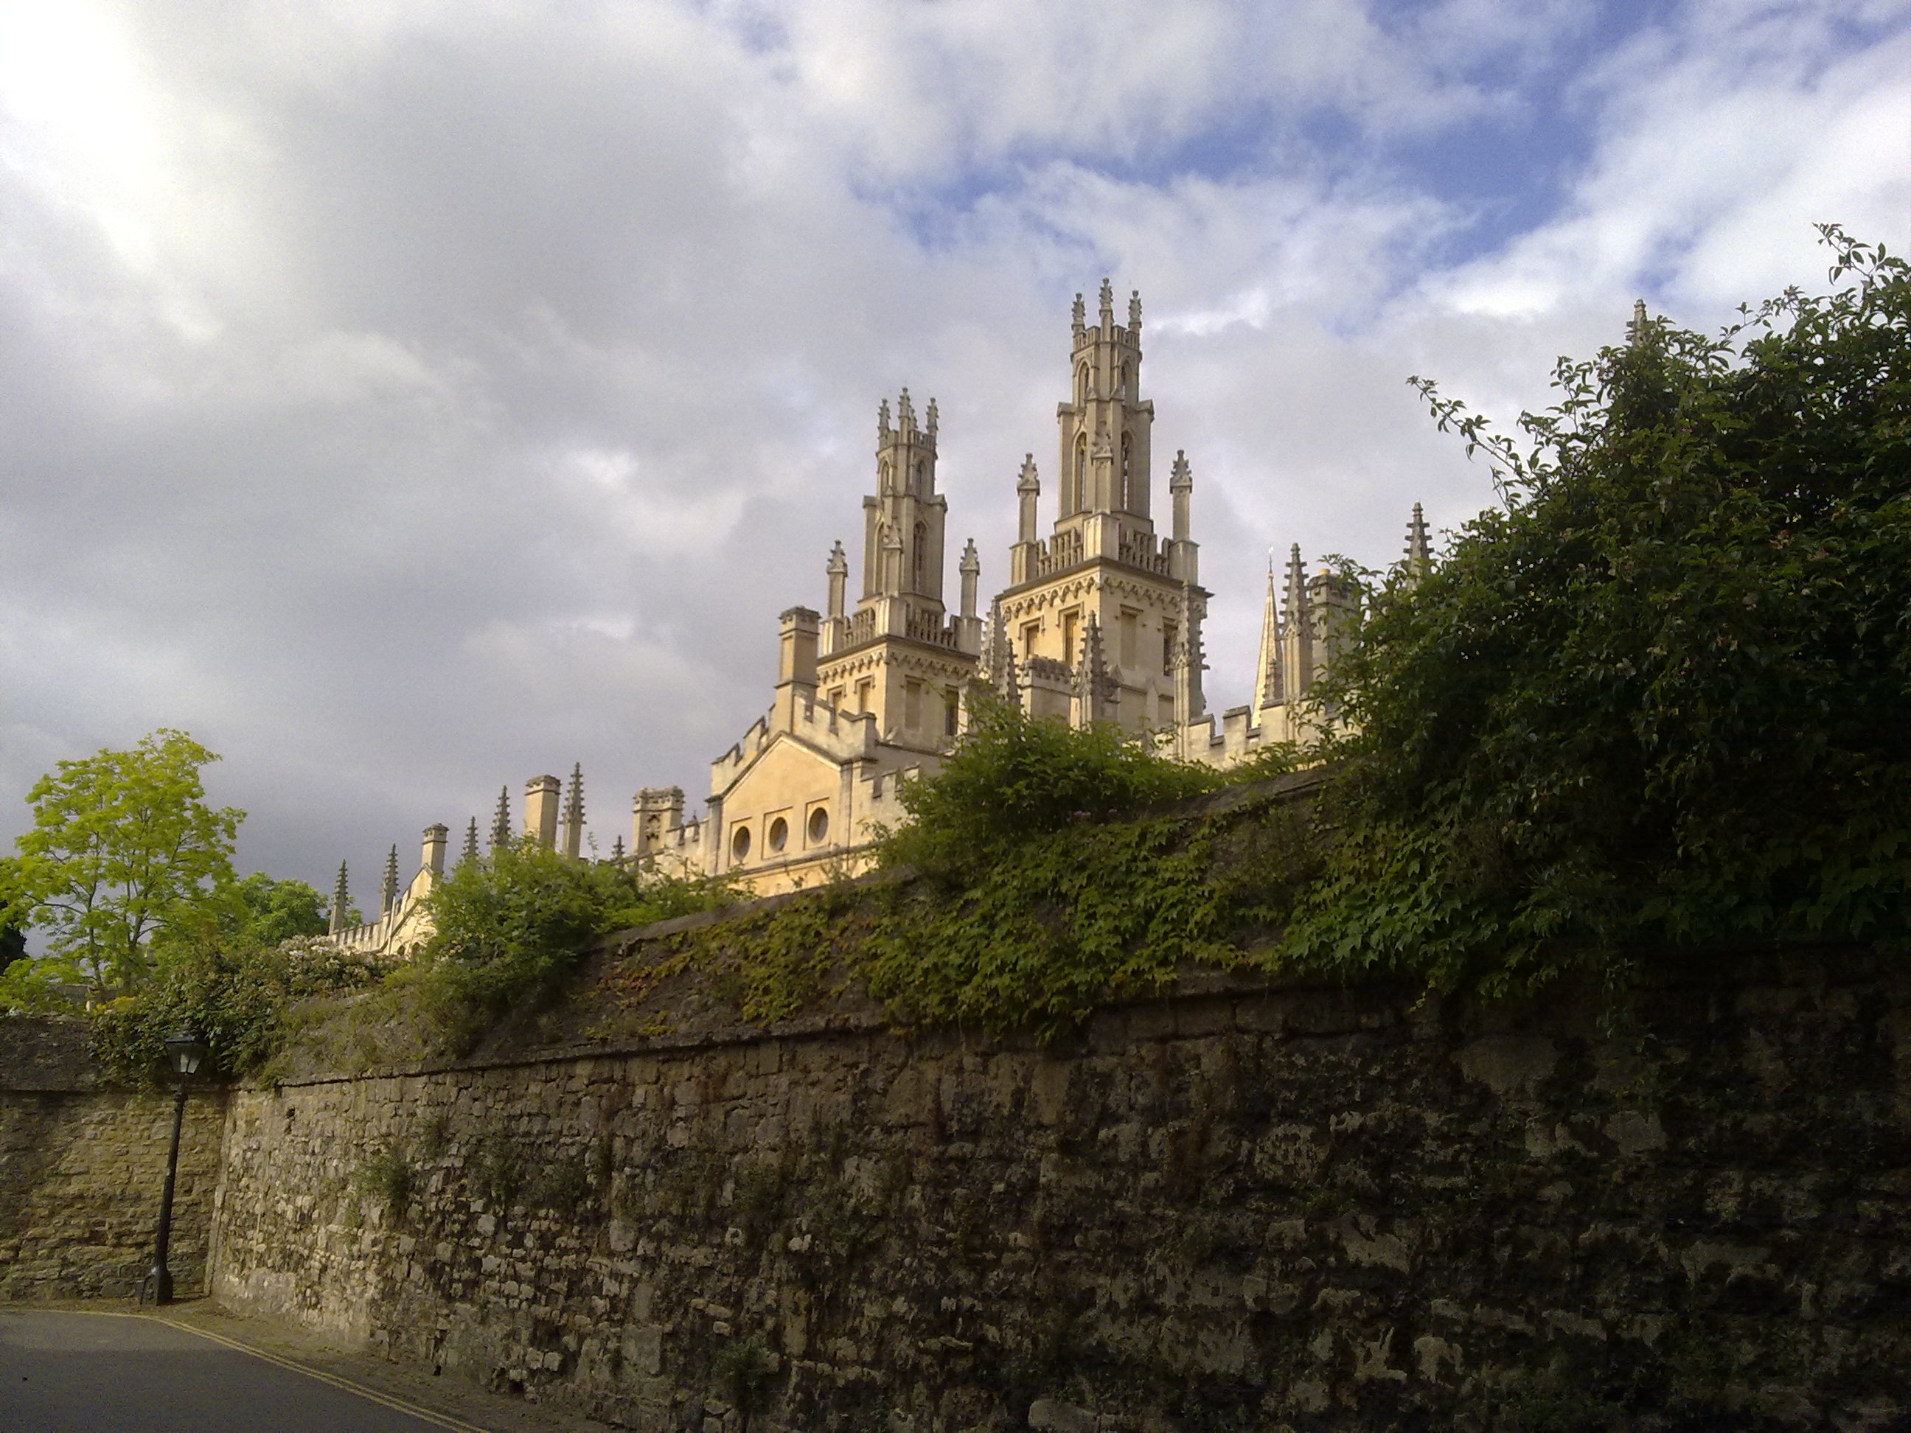
From the Ivory Tower…
Source: Wikipedia (All Souls College, Oxford)

Slide 4
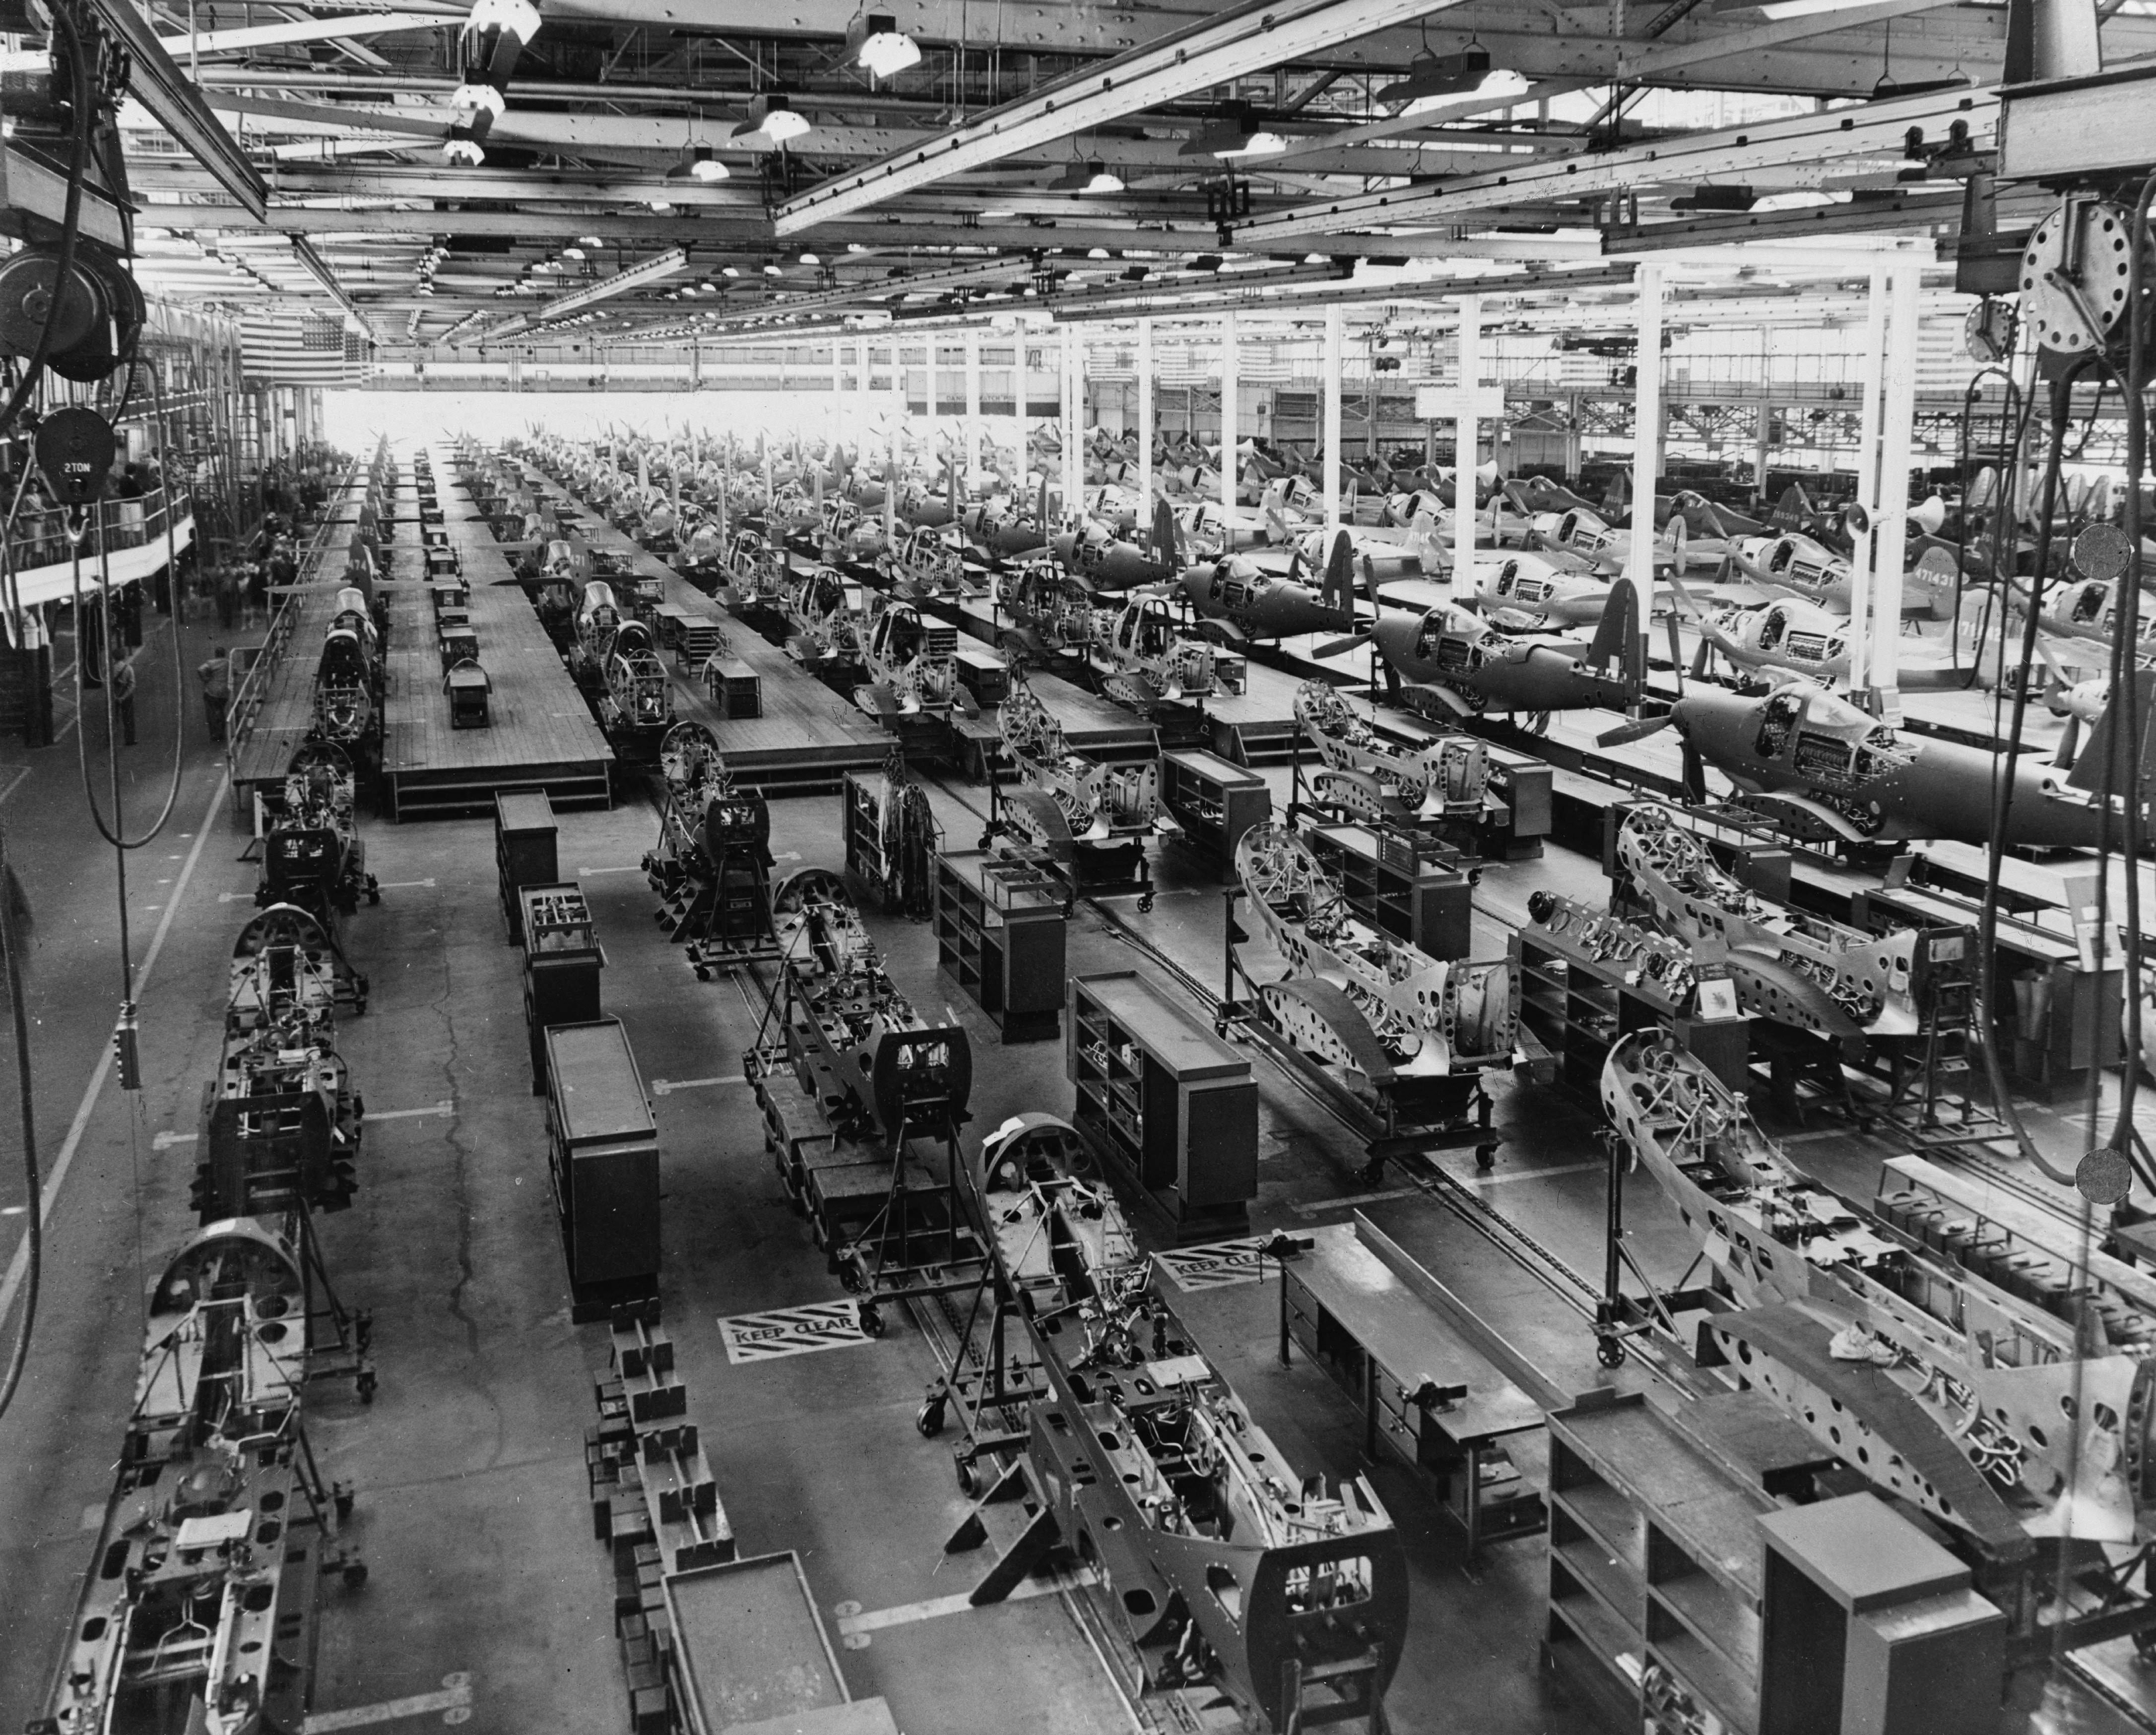
… to building sh*t that works
Source: Wikipedia (Factory)

Slide 5
… and back.
Source: Wikipedia (All Souls College, Oxford)

Slide 6
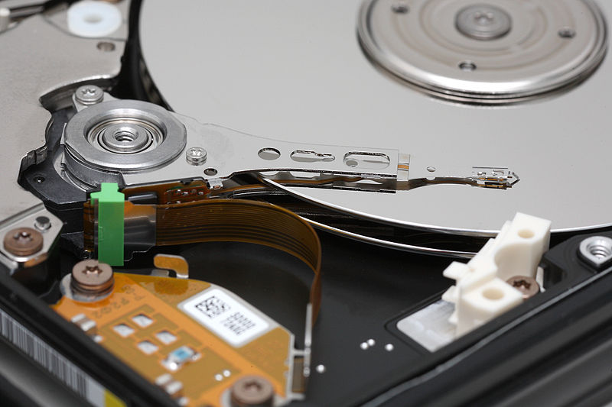
Big Data
Source: Wikipedia (Hard disk drive)

Slide 7
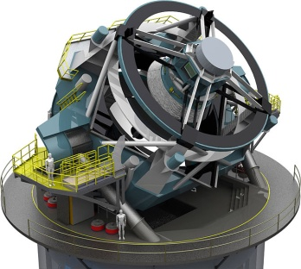
How much data?
Processes 20 PB a day (2008)
Crawls 20B web pages a day (2012)
Search index is 100+ PB (5/2014)
Bigtable serves 2+ EB, 600M QPS (5/2014)
400B pages, 10+ PB (2/2014)
19 Hadoop clusters: 600 PB, 40k servers (9/2015)
Hadoop: 10K nodes, 150K cores, 150 PB (4/2014)
150 PB on 50k+ servers running 15k apps (6/2011)
300 PB data in Hive + 600 TB/day (4/2014)
LHC: ~15 PB a year
S3: 2T objects, 1.1M request/second (4/2013)
640K ought to be enough for anybody.
LSST: 6-10 PB a year (~2020)
SKA: 0.3 – 1.5 EB per year (~2020)

Slide 8
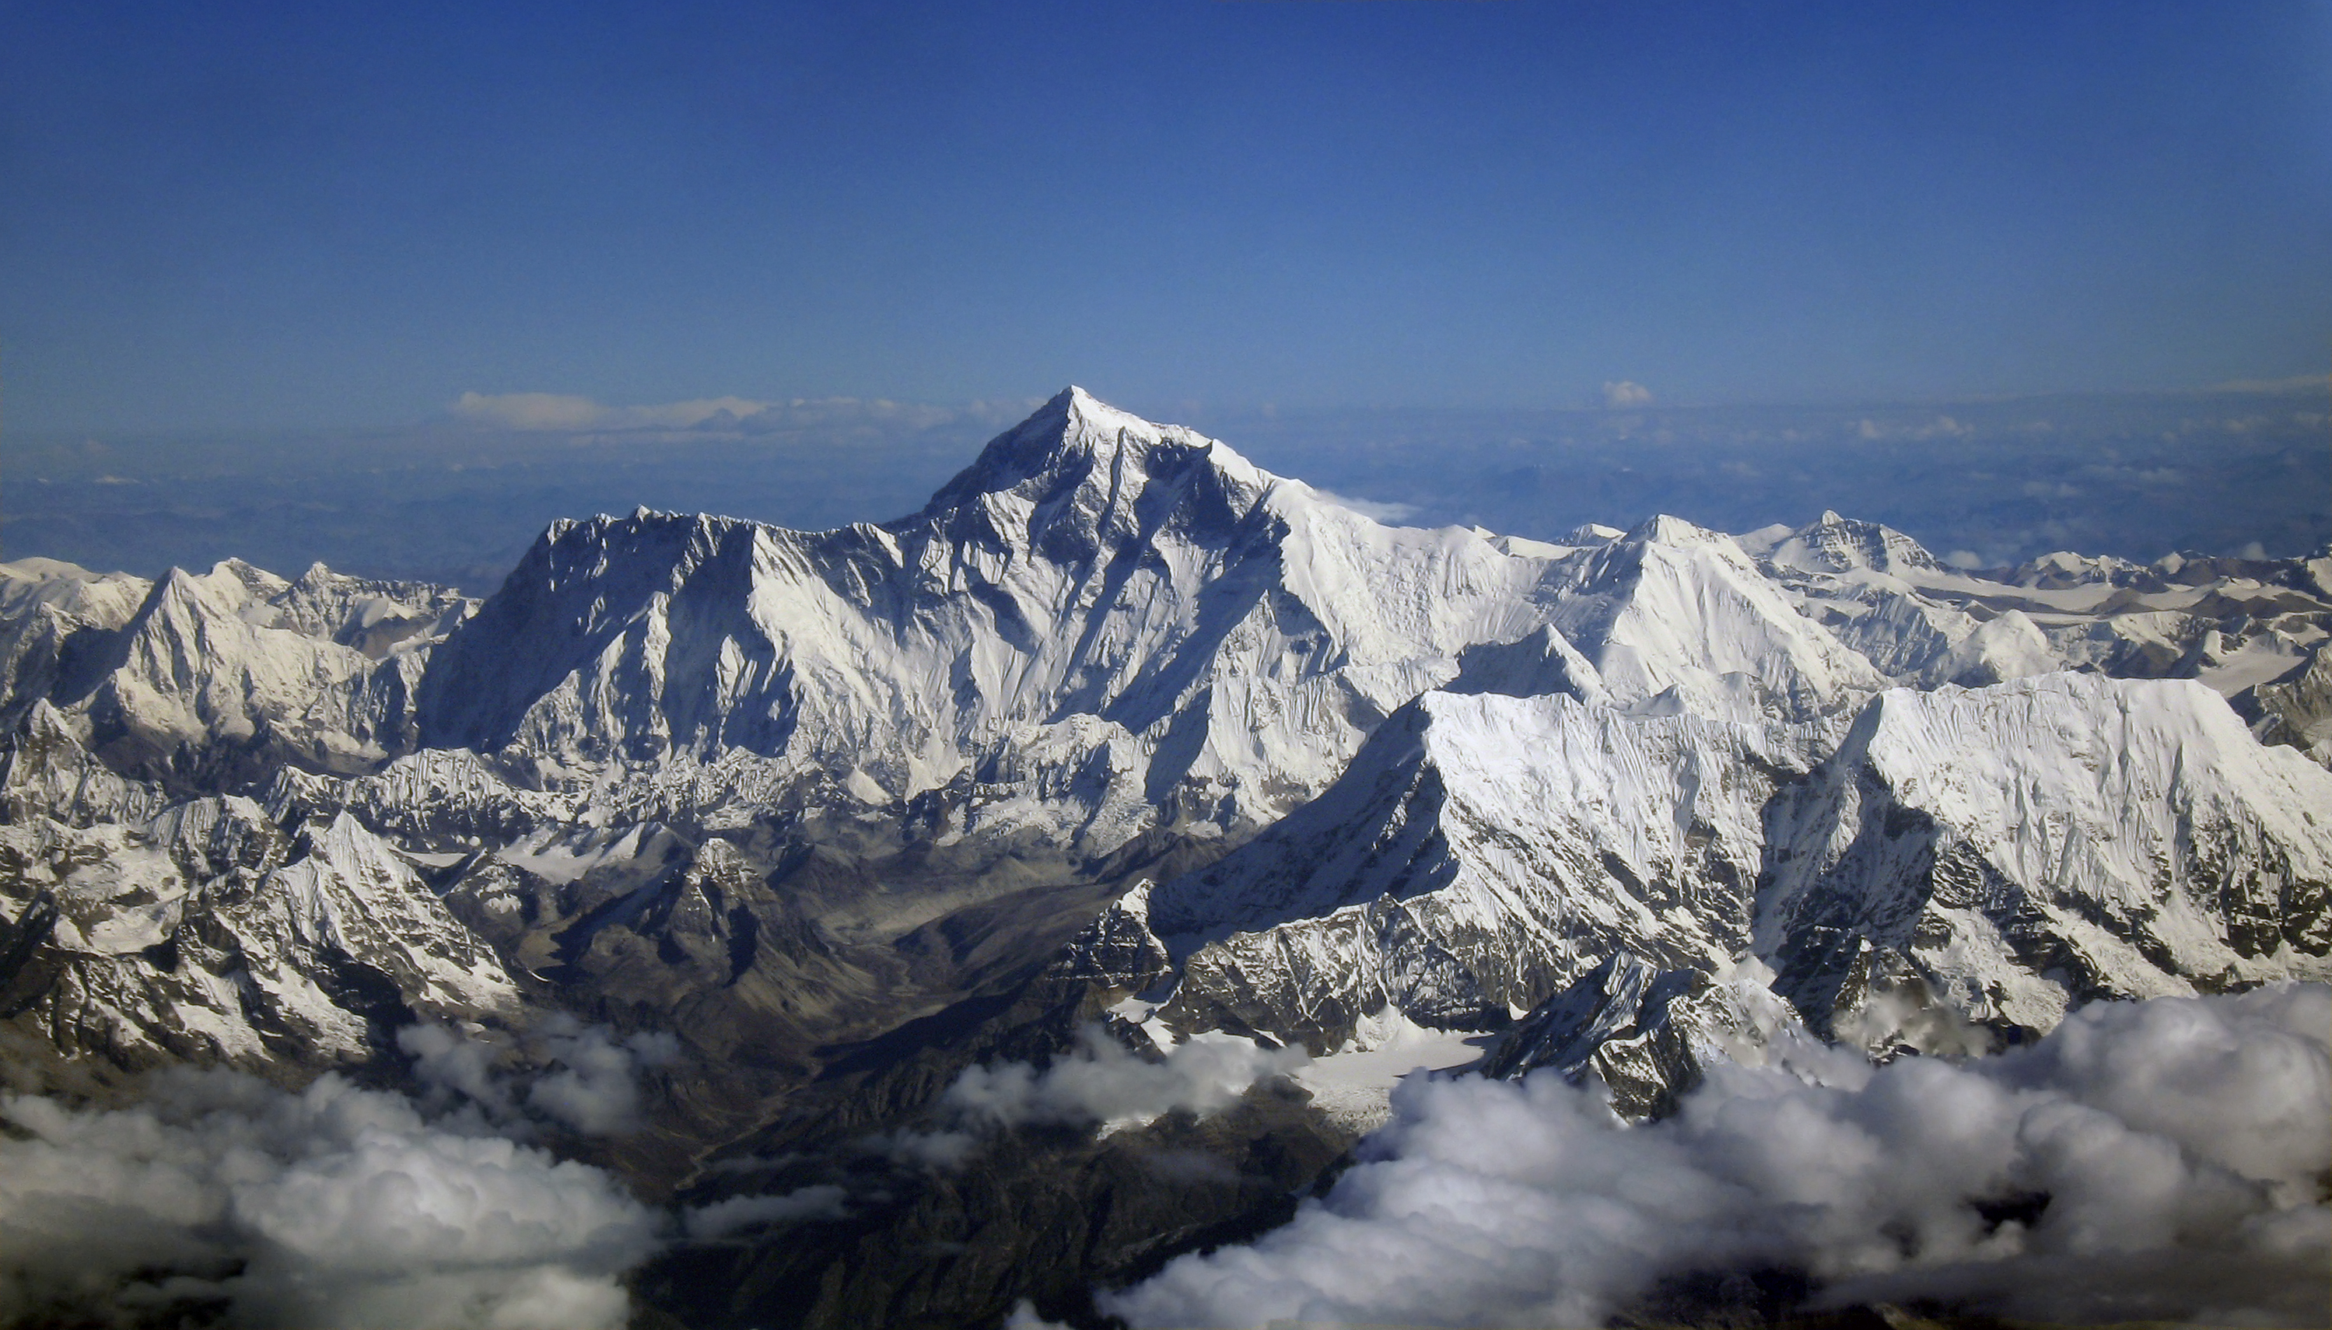
Why big data?
Science
Engineering
Commerce
Society
Source: Wikipedia (Everest)

Slide 9
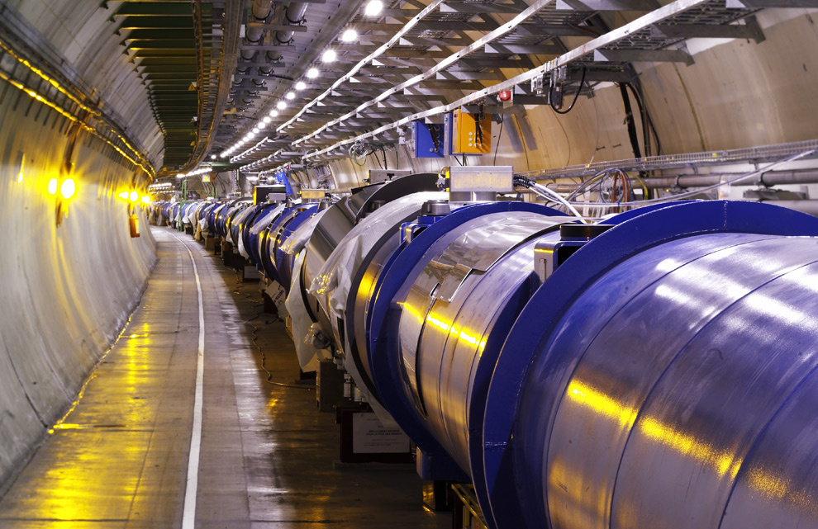
Science
Emergence of the 4th Paradigm
Data-intensive e-Science
Maximilien Brice, © CERN
Notes:
By the time it shuts down in 2011, the CERN collider should have amassed about 20 times as much data as it now has. (NYTimes article, “Trillions of Reasons to Be Excited”, 11/1/2010)

Slide 10
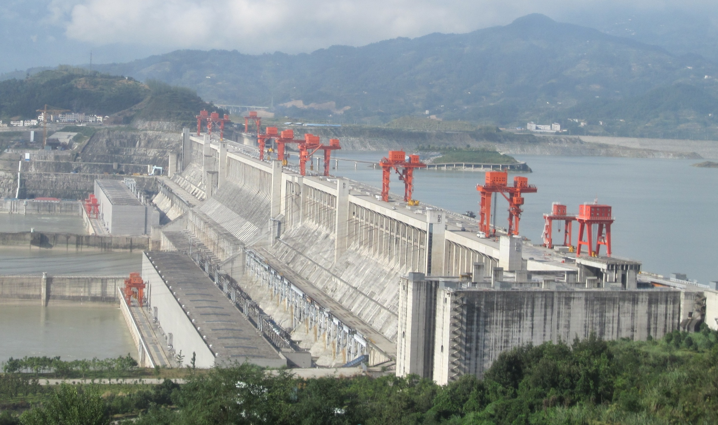
Engineering
The unreasonable effectiveness of data
Search, recommendation, prediction, …
Source: Wikipedia (Three Gorges Dam)

Slide 11
Know thy customers
Data → Insights → Competitive advantages
Commerce
Source: Wikiedia (Shinjuku, Tokyo)

Slide 12
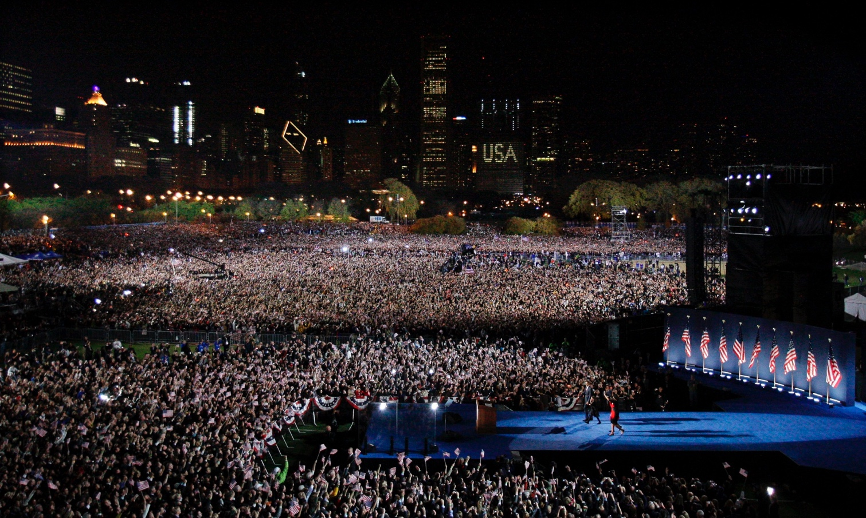
Society
Humans as social sensors
Computational social science
Source: Guardian

Slide 13
What is this course about?
Data Science
Tools
This Course
Analytics Infrastructure
Execution Infrastructure
“big data stack”

Slide 14
Buzzwords
Text: frequency estimation, language models, inverted indexes
Graphs: graph traversals, random walks (PageRank)
Relational data: SQL, joins, column stores
Data mining: hashing, clustering (k-means), classification, recommendations
Streams: probabilistic data structures (Bloom filters, CMS, HLL counters)
data analytics, business intelligence, OLAP, ETL, data warehouses and data lakes
Data Science
Tools
This Course
Analytics Infrastructure
MapReduce, Spark, noSQL, Flink, Pig, Hive, Dryad, Pregel, Giraph, Storm
Execution Infrastructure
“big data stack”
This course focuses on algorithm design and “thinking at scale”

Slide 15
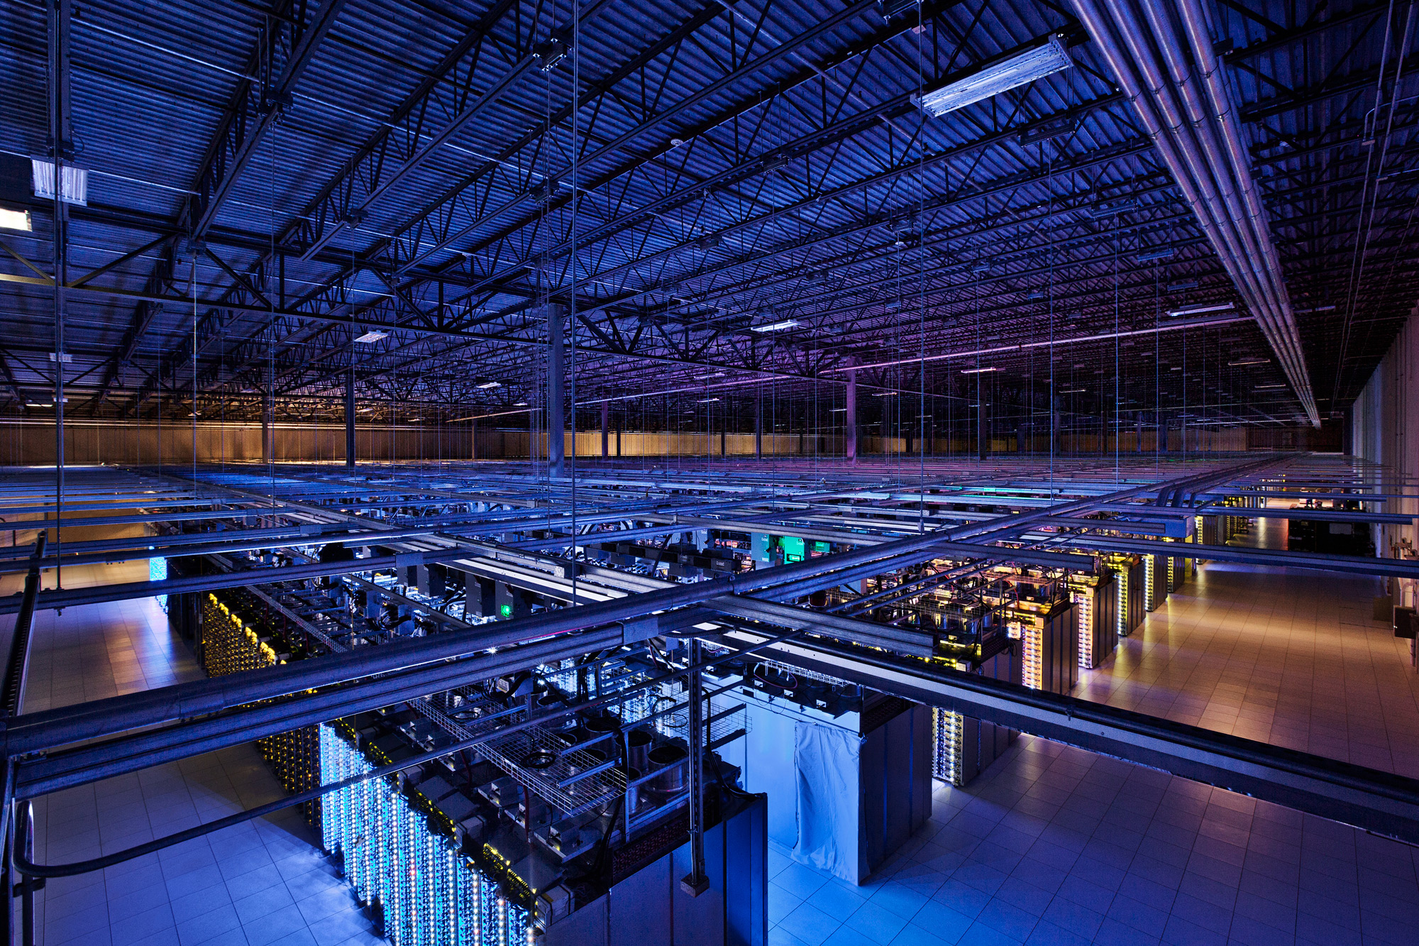
Tackling Big Data
Source: Google

Slide 16
Divide and Conquer
“Work”
Partition
w₁
w₂
w₃
worker
worker
worker
r₁
r₂
r₃
Combine
“Result”

Slide 17
Parallelization Challenges
How do we assign work units to workers?
What if we have more work units than workers?
What if workers need to share partial results?
How do we aggregate partial results?
How do we know all the workers have finished?
What if workers die?
What’s the common theme of all of these problems?

Slide 18
Common Theme?
Parallelization problems arise from:
Communication between workers (e.g., to exchange state)
Access to shared resources (e.g., data)
Thus, we need a synchronization mechanism

Slide 19
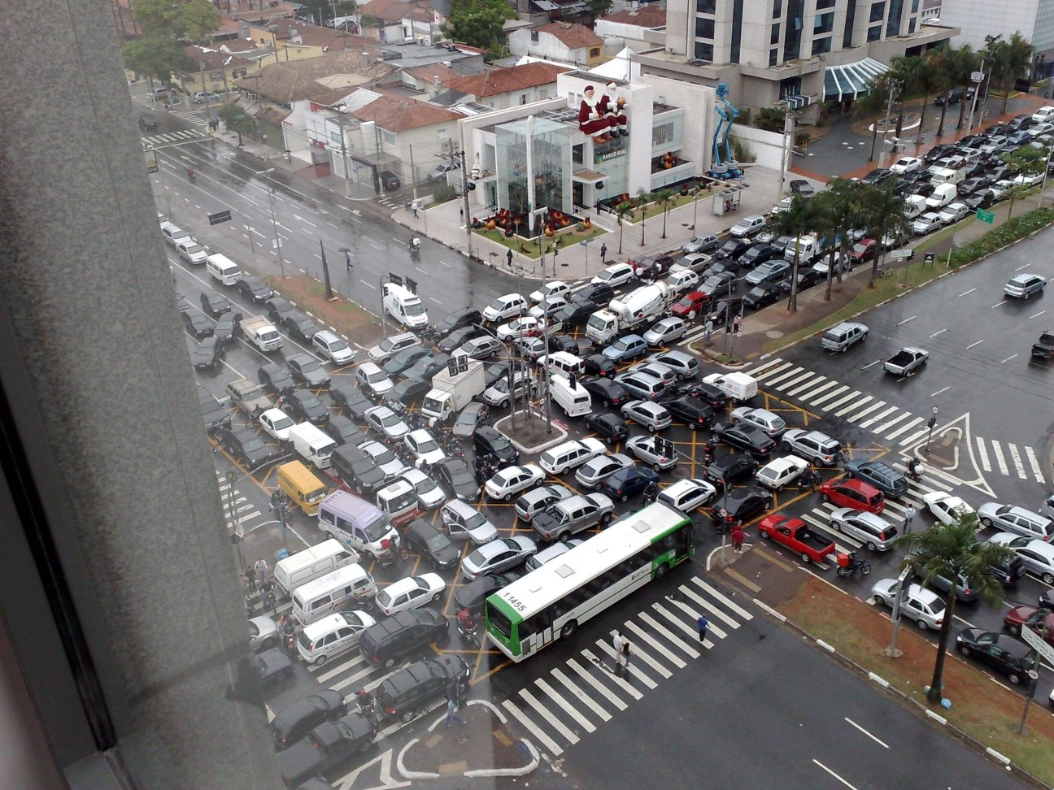
Source: Ricardo Guimarães Herrmann

Slide 20
Managing Multiple Workers
Difficult because
We don’t know the order in which workers run
We don’t know when workers interrupt each other
We don’t know when workers need to communicate partial results
We don’t know the order in which workers access shared data
Thus, we need:
Semaphores (lock, unlock)
Conditional variables (wait, notify, broadcast)
Barriers
Still, lots of problems:
Deadlock, livelock, race conditions...
Dining philosophers, sleeping barbers, cigarette smokers...
Moral of the story: be careful!

Slide 21
Current Tools
Shared Memory
Message Passing
Programming models
Shared memory (pthreads)
Message passing (MPI)
Design Patterns
Master-slaves
Producer-consumer flows
Shared work queues
Memory
P₁
P₂
P₃
P₄
P₅
P₁
P₂
P₃
P₄
P₅
producer
consumer
master
work queue
slaves
producer
consumer

Slide 22
Where the rubber meets the road
Concurrency is difficult to reason about
Concurrency is even more difficult to reason about
At the scale of datacenters and across datacenters
In the presence of failures
In terms of multiple interacting services
Not to mention debugging…
The reality:
Lots of one-off solutions, custom code
Write you own dedicated library, then program with it
Burden on the programmer to explicitly manage everything

Slide 23
Source: Wikipedia (Flat Tire)

Slide 24
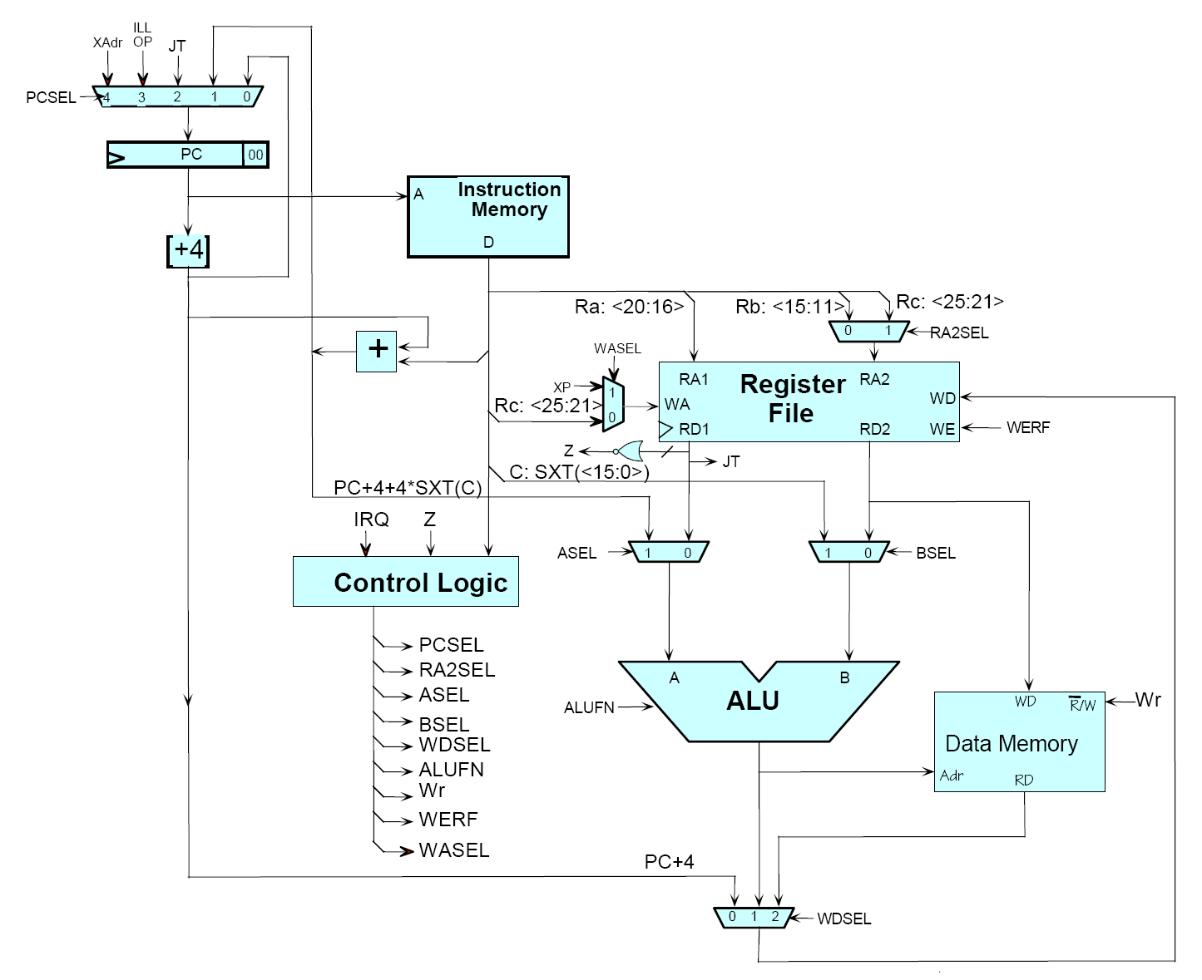
Source: MIT Open Courseware

Slide 25
Source: MIT Open Courseware

Slide 26
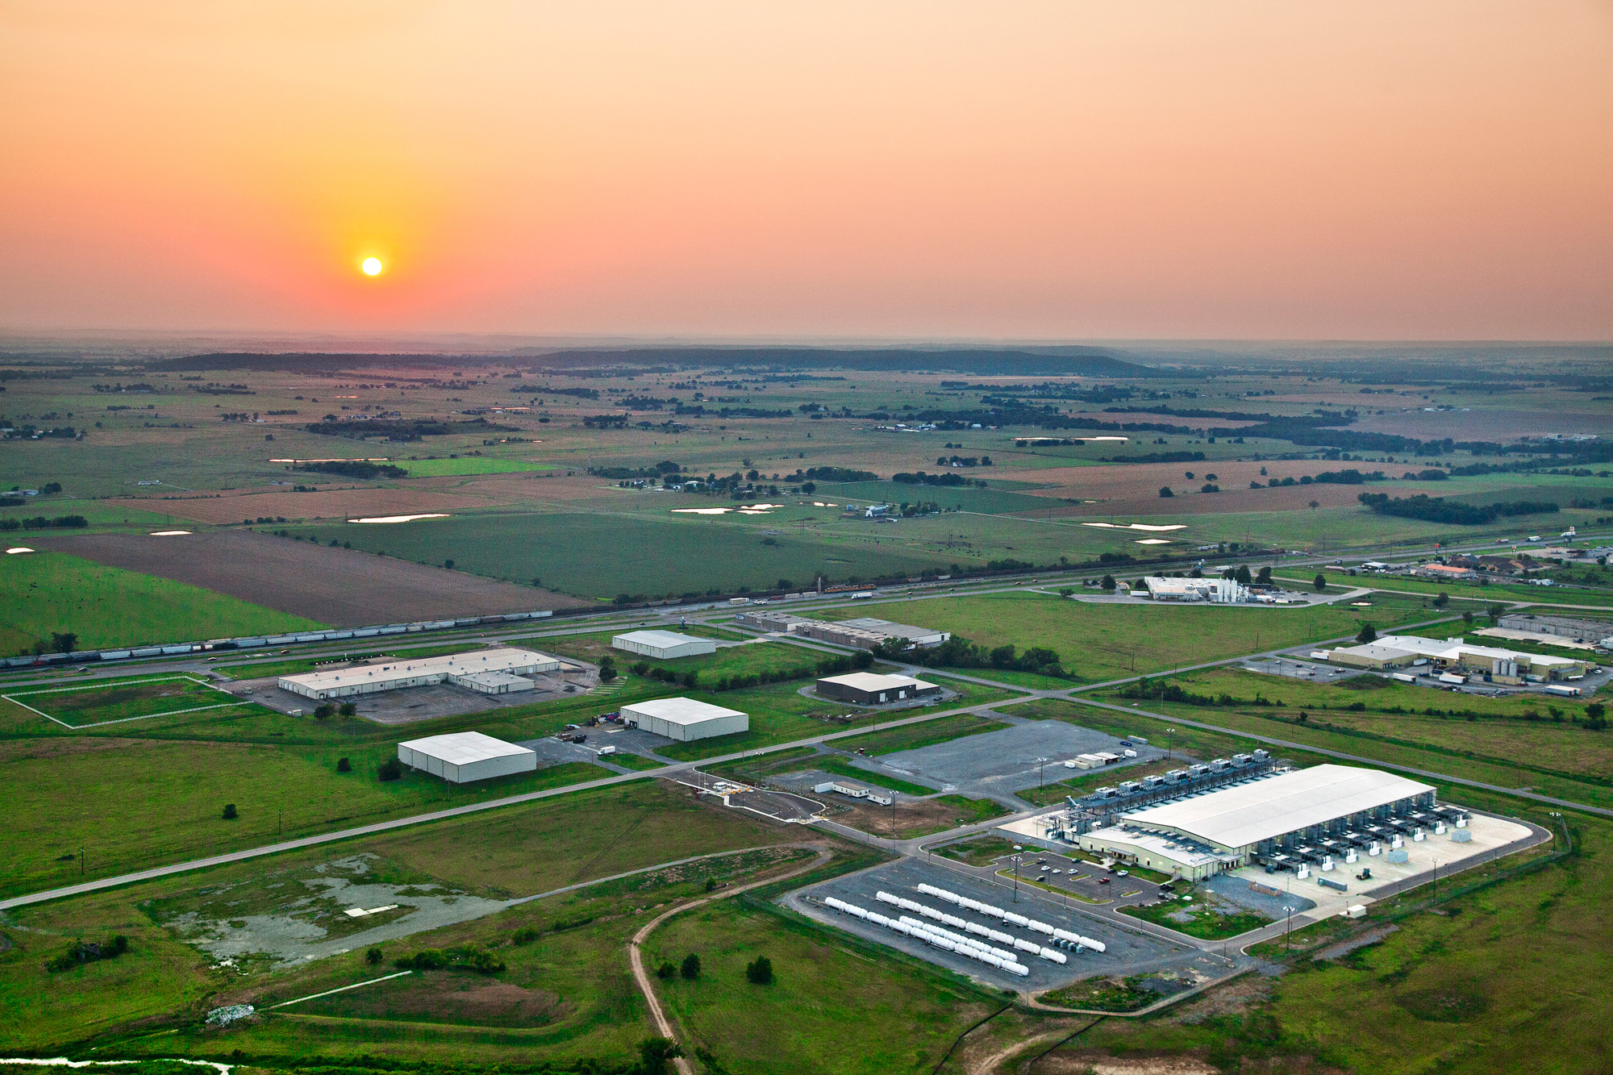
The datacenter is the computer!
Source: Google

Slide 27
The datacenter is the computer
It’s all about the right level of abstraction
Moving beyond the von Neumann architecture
What’s the “instruction set” of the datacenter computer?
Hide system-level details from the developers
No more race conditions, lock contention, etc.
No need to explicitly worry about reliability, fault tolerance, etc.
Separating the what from the how
Developer specifies the computation that needs to be performed
Execution framework (“runtime”) handles actual execution
MapReduce is the first instantiation of this idea…

Slide 28
MapReduce
Source: Google

Slide 29
Typical Big Data Problem
Iterate over a large number of records
Extract something of interest from each
Shuffle and sort intermediate results
Aggregate intermediate results
Generate final output
Map
Reduce
Key idea: provide a functional abstraction for these two operations
(Dean and Ghemawat, OSDI 2004)

Slide 30
Roots in Functional Programming
Map
f
f
f
f
f
Fold
g
g
g
g
g
Functional programming + distributed computing!
scala> val t = Array(1, 2, 3, 4, 5)
t: Array[Int] = Array(1, 2, 3, 4, 5)
scala> t.map(n => n*n)
res0: Array[Int] = Array(1, 4, 9, 16, 25)
scala> t.map(n => n*n).foldLeft(0)((m, n) => m + n)
res1: Int = 55

Slide 31
MapReduce
Programmers specify two functions:
map (k₁, v₁) → [<k₂, v₂>]
reduce (k₂, [v₂]) → [<k₃, v₃>]
All values with the same key are sent to the same reducer
The execution framework handles everything else…

Slide 32
k₁
v₁
k₂
v₂
k₃
v₃
k₄
v₄
k₅
v₅
k₆
v₆
map
map
map
map
a
1
b
2
c
3
c
6
a
5
c
2
b
7
c
8
Shuffle and Sort: aggregate values by keys
a
1
5
b
2
7
c
2
3
6
8
reduce
reduce
reduce
r₁
s₁
r₂
s₂
r₃
s₃

Slide 33
MapReduce
Programmers specify two functions:
map (k, v) → <k’, v’>*
reduce (k’, v’) → <k’, v’>*
All values with the same key are sent to the same reducer
The execution framework handles everything else…
What’s “everything else”?

Slide 34
MapReduce “Runtime”
Handles scheduling
Assigns workers to map and reduce tasks
Handles “data distribution”
Moves processes to data
Handles synchronization
Gathers, sorts, and shuffles intermediate data
Handles errors and faults
Detects worker failures and restarts
Everything happens on top of a distributed FS (later)

Slide 35
MapReduce
Programmers specify two functions:
map (k, v) → <k’, v’>*
reduce (k’, v’) → <k’, v’>*
All values with the same key are reduced together
The execution framework handles everything else…
Not quite…usually, programmers also specify:
partition (k’, number of partitions) → partition for k’
Often a simple hash of the key, e.g., hash(k’) mod n
Divides up key space for parallel reduce operations
combine (k’, v’) → <k’, v’>*
Mini-reducers that run in memory after the map phase
Used as an optimization to reduce network traffic

Slide 36
k₁
v₁
k₂
v₂
k₃
v₃
k₄
v₄
k₅
v₅
k₆
v₆
map
map
map
map
a
1
b
2
c
3
c
6
a
5
c
2
b
7
c
8
combine
combine
combine
combine
a
1
b
2
c
9
a
5
c
2
b
7
c
8
partition
partition
partition
partition
Shuffle and Sort: aggregate values by keys
a
1
5
b
2
7
c
c
2
2
9
3
8
6
8
reduce
reduce
reduce
r₁
s₁
r₂
s₂
r₃
s₃

Slide 37
Two more details…
Barrier between map and reduce phases
But we can begin copying intermediate data earlier
Keys arrive at each reducer in sorted order
No enforced ordering across reducers

Slide 38
“Hello World”: Word Count
Map(String docid, String text):
for each word w in text:
Emit(w, 1);
Reduce(String term, Iterator<Int> values):
int sum = 0;
for each v in values:
sum += v;
Emit(term, sum);

Slide 39
MapReduce can refer to…
The programming model
The execution framework (aka “runtime”)
The specific implementation
Usage is usually clear from context!

Slide 40
MapReduce Implementations
Google has a proprietary implementation in C++
Bindings in Java, Python
Hadoop provides an open-source implementation in Java
Development led by Yahoo, now an Apache project
Used in production at Yahoo, Facebook, Twitter, LinkedIn, Netflix, …
Large and expanding software ecosystem
Potential point of confusion: Hadoop is more than MapReduce today
Lots of custom research implementations

Slide 41
User Program
(1) submit
Master
(2) schedule map
(2) schedule reduce
worker
split 0
(6) write
output
file 0
split 1
(5) remote read
worker
split 2
(3) read
(4) local write
split 3
worker
split 4
worker
output
file 1
worker
Input
files
Map
phase
Intermediate files
(on local disk)
Reduce
phase
Output
files
We’ll discuss physical execution in detail later…
Adapted from (Dean and Ghemawat, OSDI 2004)

Slide 42
Course Administrivia
Source: http://www.flickr.com/photos/artmind_etcetera/6336693594/

Slide 43
My Expectations
Your background:
Pre-reqs: CS 341, CS 350, (CS 348)
Comfortable in Java and Scala
Know how to use Git
Reasonable “command-line”-fu skills
Experience in compiling, patching, and installing open source software
Good debugging skills
You are:
Genuinely interested in the topic
Be prepared to put in the time
Comfortable with the uncertainty and unpredictability that comes with cutting-edge, immature software

Slide 44
Course Design
Course website: https://www.student.cs.uwaterloo.ca/~cs489/ Redirects to: http://lintool.github.io/bigdata-2016w/
Piazza: https://piazza.com/uwaterloo.ca/winter2016/cs489698/
Bespin: http://bespin.io/
This course focuses on algorithm design and “thinking at scale”
Not the “mechanics” (API, command-line invocations, et.)
You’re expected to pick up MapReduce/Spark with minimal help
Components of the final grade:
Eight individual assignments: mix of MapReduce (Java) and Spark (Scala)
Final exam
CS 698: additional final project

Slide 45
Assignment Mechanics
We’ll be using private GitHub repos for assignments
Complete your assignments, push to GitHub
We’ll pull your repos at the deadline and grade
Note late policy (details on course homepage)
Late by up to 24 hours: 25% reduction in grade
Late 24-48 hours: 50% reduction in grade
Late by more the 48 hours: not accepted
By assumption, we’ll pull and grade at deadline – if you want us to hold off, you must let us know
Important: Register for (free) GitHub educational account!
https://education.github.com/discount_requests/new

Slide 46
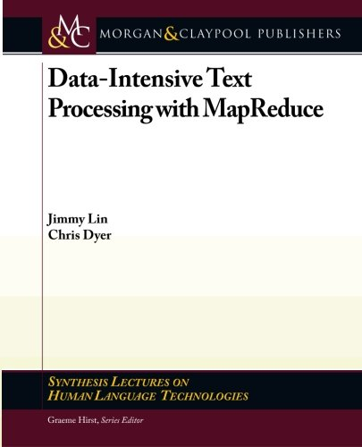
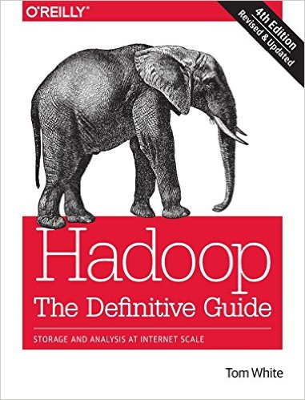
Course Materials
One (required) textbook +
Two (optional but recommended) books +
Additional readings from research papers as appropriate
Note: 4th Edition
(optional but recommended)

Slide 47
MapReduce/Spark Environments
Linux Student CS Environment
Everything is set up for you, just follow instructions
We’ll make sure everything works
Local installations
Install all software components on your own machine
Requires at least 4GB RAM + 10s GB disk for a good experience
Works fine on Mac and Linux, YMMV on Windows
We’ll provide basic instructions, but not technical support
Altiscale: Hadoop-as-a-Service
You’ll be provided an account later
See “Software” page in course homepage for details:
http://lintool.github.io/bigdata-2016w/software.html

Slide 48
Be Prepared…
Source: Wikipedia (The Scream)

Slide 49
“Hadoop Zen”
Parts of the ecosystem are still immature
We’ve come a long way since 2007, but still far to go…
Bugs, undocumented “features”, inexplicable behavior, etc.
Different versions = major pain
Don’t get frustrated (take a deep breath)…
Those W$*#T@F! moments
Be patient…
We will inevitably encounter “situations” along the way
Be flexible…
We will have to be creative in workarounds
Be constructive…
Tell me how I can make everyone’s experience better

Slide 50
“Hadoop Zen”
Source: Wikipedia (Japanese rock garden)

Slide 51
Questions?
To Do:
1. Bookmark course homepage
2. Get on Piazza
3. Register for GitHub educational account
Source: Wikipedia (Japanese rock garden)

