Slide 1
INFM 603: Information Technology and Organizational Context
Session 12: Cloud Computing and Big Data
Jimmy Lin
The iSchool University of Maryland
Wednesday, April 23, 2014

Slide 2
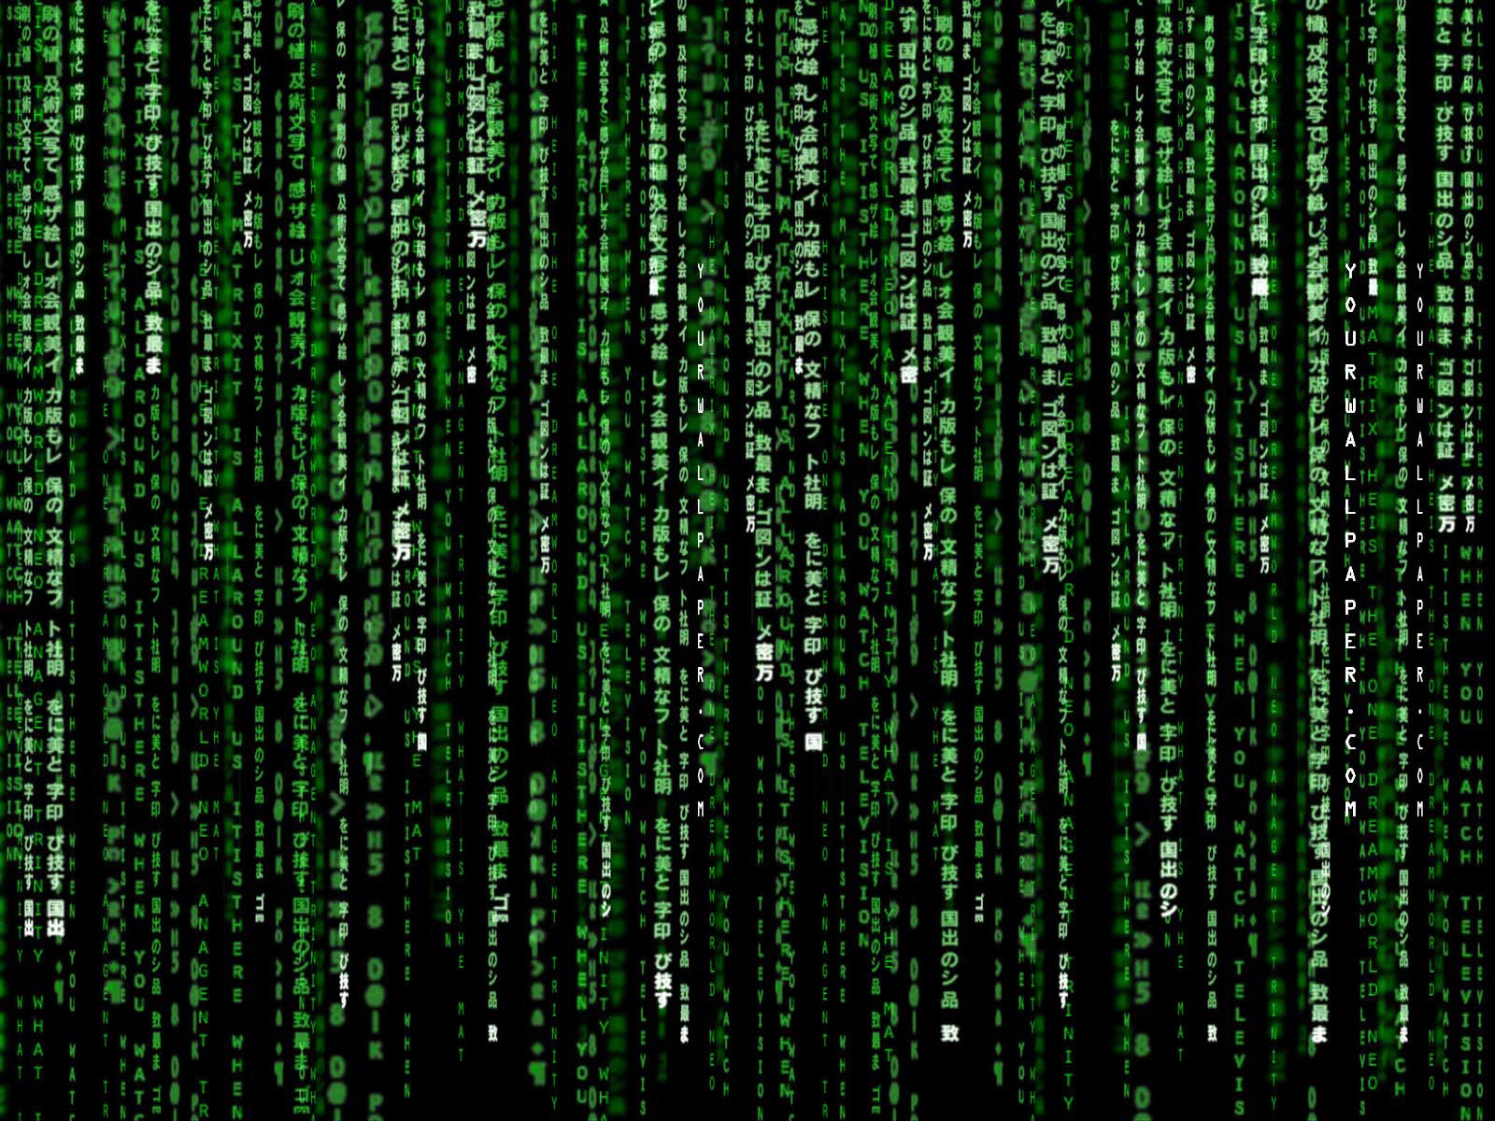
What is the Matrix?

Slide 3
What is cloud computing?
Source: Wikipedia (Clouds)

Slide 4
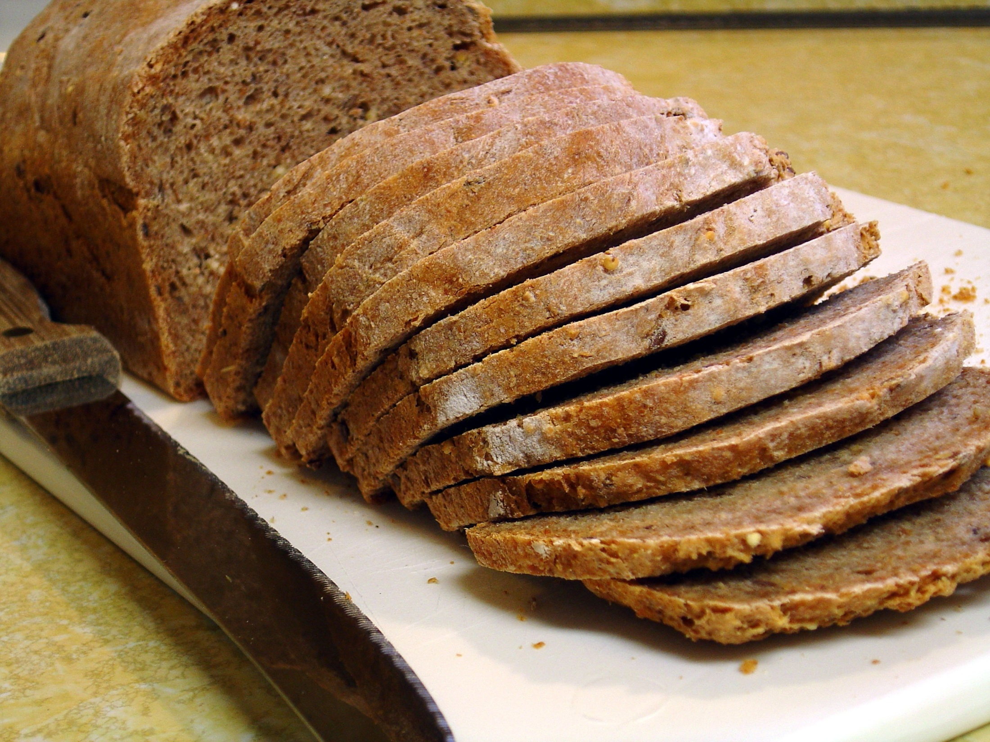
Source: flickr (60in3/2338247189)

Slide 5
The best thing since sliced bread?
Before clouds…
Grids
Connection machines
Vector supercomputers
…
Cloud computing means many different things:
Large-data processing
Rebranding of web 2.0
Utility computing
Everything as a service

Slide 6
Rebranding of web 2.0
Rich, interactive web applications
Clouds refer to the servers that run them
AJAX as the de facto standard (for better or worse)
Examples: Facebook, YouTube, Gmail, …
“The network is the computer”: take two
User data is stored “in the clouds”
Rise of the tablets, smartphones, etc.
Browser is the OS

Slide 7
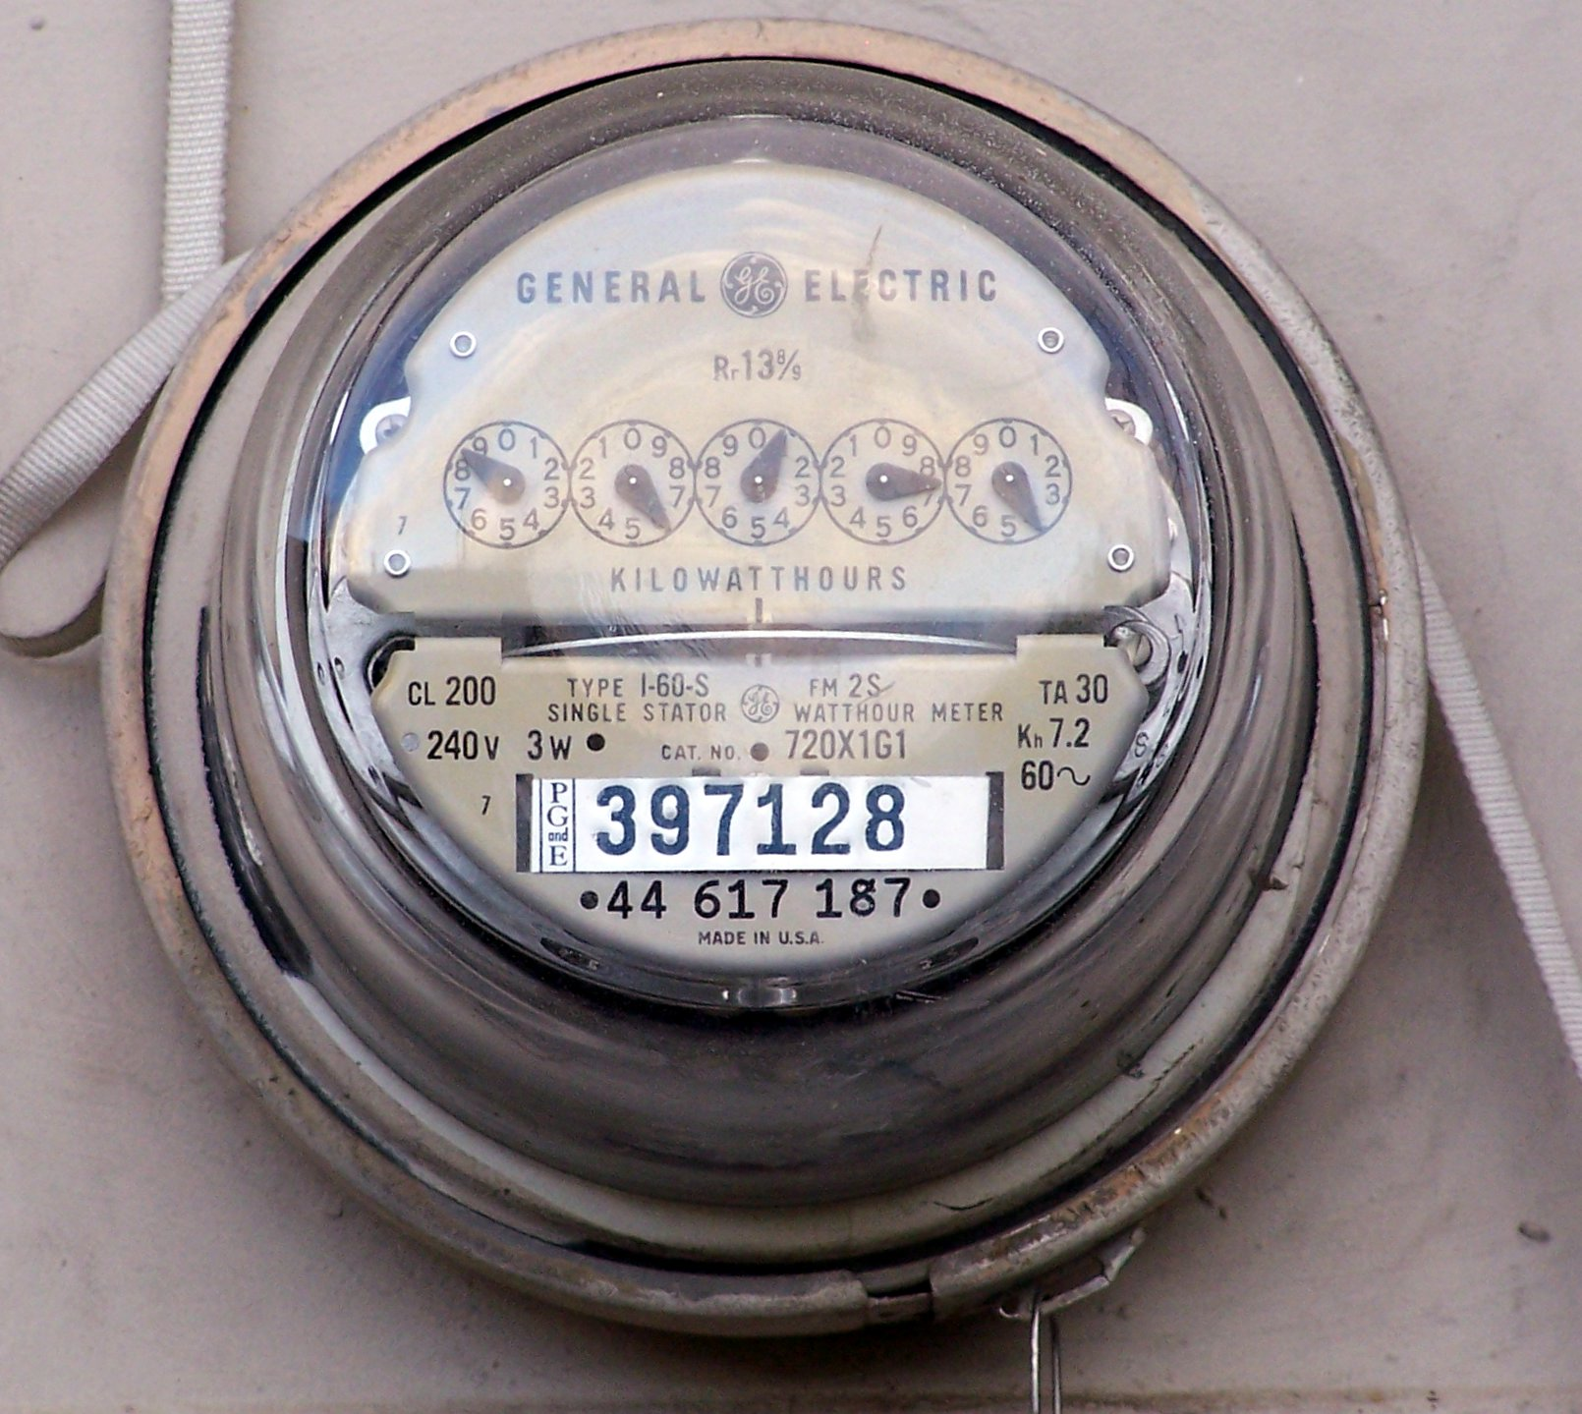
Source: Wikipedia (Electricity meter)

Slide 8
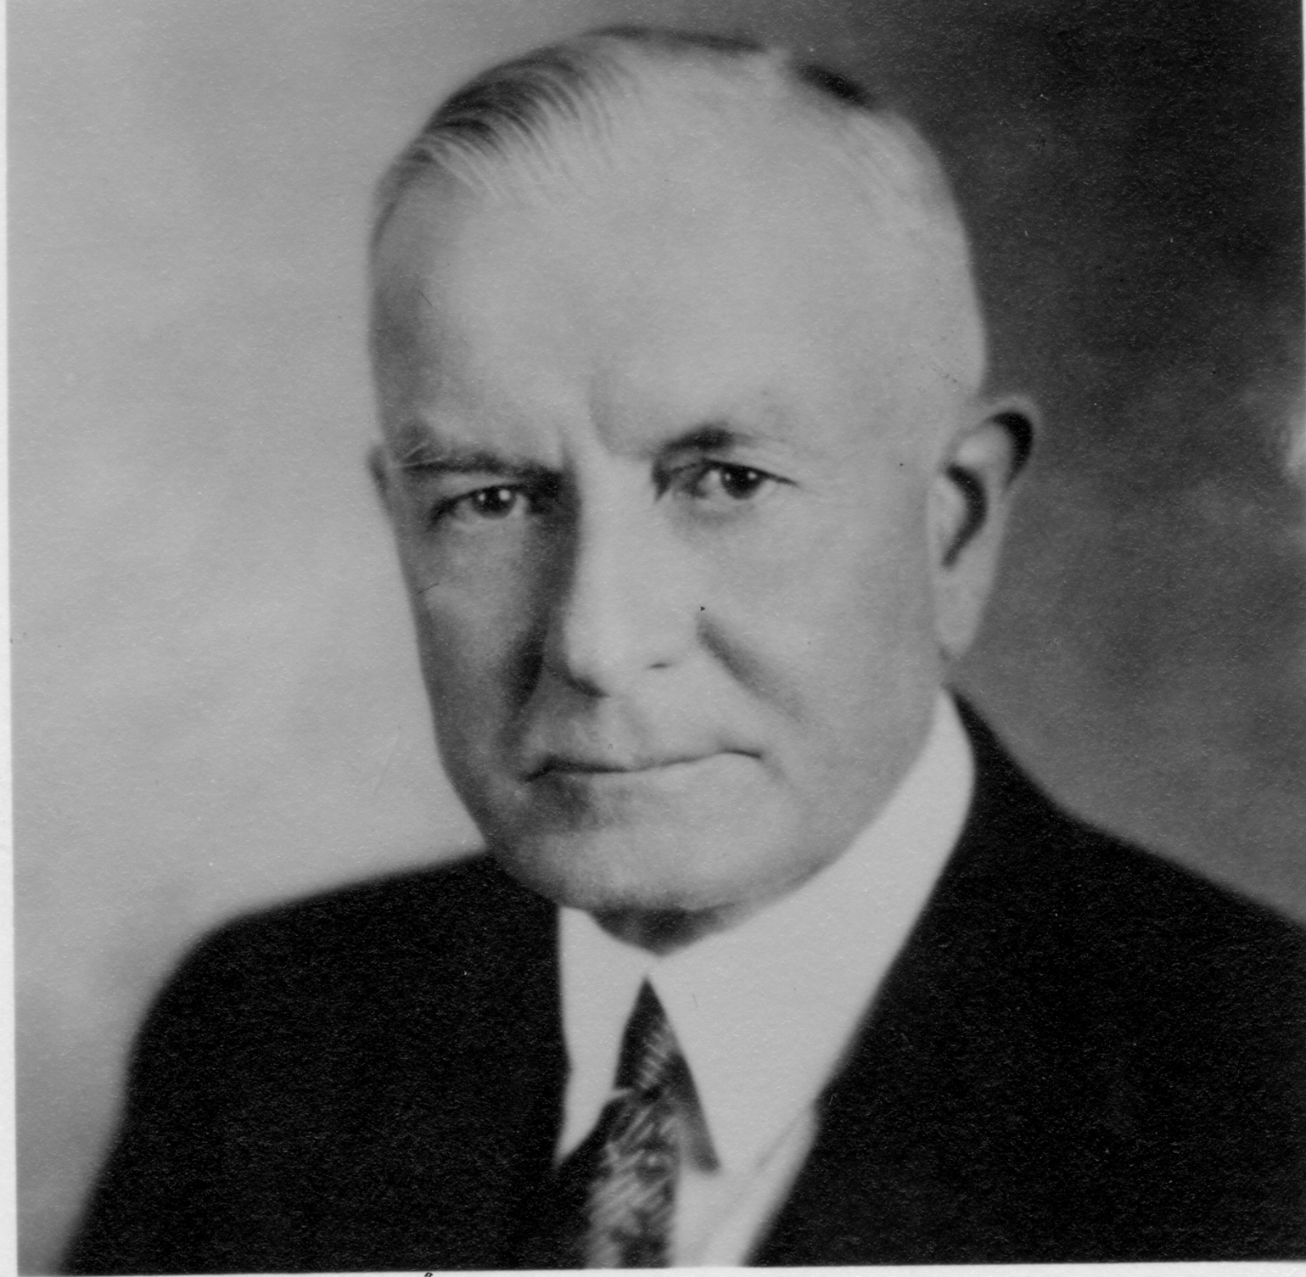
Utility Computing
What?
Computing resources as a metered service (“pay as you go”)
Ability to dynamically provision virtual machines
Why?
Cost: capital vs. operating expenses
Scalability: “infinite” capacity
Elasticity: scale up or down on demand
Does it make sense?
Benefits to cloud users
Business case for cloud providers
I think there is a world market for about five computers.

Slide 9
Enabling Technology: Virtualization
App
App
App
App
App
App
OS
OS
OS
Operating System
Hypervisor
Hardware
Hardware
Traditional Stack
Virtualized Stack

Slide 10
Everything as a Service
Utility computing = Infrastructure as a Service (IaaS)
Why buy machines when you can rent them?
Examples: Amazon’s EC2, Rackspace
Platform as a Service (PaaS)
Give me nice API and take care of the maintenance, upgrades, …
Example: Google App Engine
Software as a Service (SaaS)
Just run it for me!
Example: Gmail, Salesforce

Slide 11
Different Types of Clouds
Public clouds
Private clouds
Hybrid clouds

Slide 12
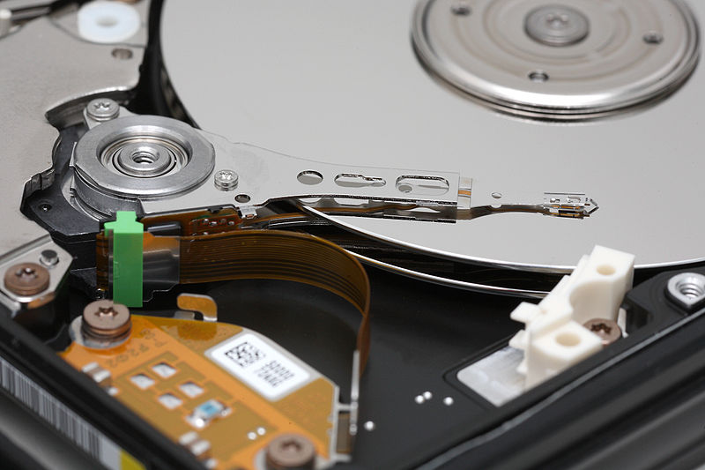
Our World: Large Data
Source: Wikipedia (Hard disk drive)

Slide 13
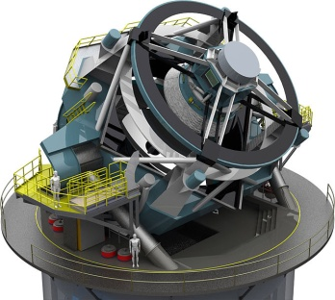
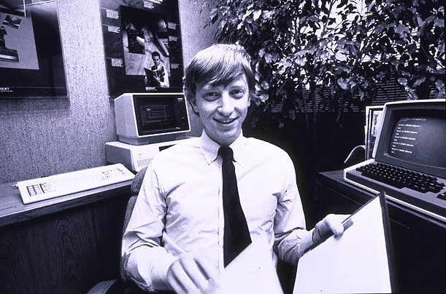
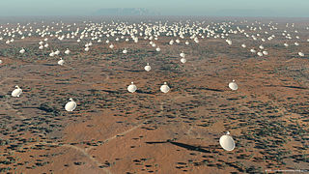
How much data?
processes 20 PB a day (2008)
crawls 20B web pages a day (2012)
150 PB on 50k+ servers running 15k apps (6/2011)
>10 PB data, 75B DB calls per day (6/2012)
Wayback Machine: 240B web pages archived, 5 PB (1/2013)
>300 PB data (10/2013)
+500 TB/day (8/2012)
LHC: ~15 PB a year
S3: 1.1M request/second,
2T objects (4/2013)
640K ought to be enough for anybody.
LSST: 6-10 PB a year (~2015)
SKA: 0.3 – 1.5 EB per year (~2020)

Slide 14
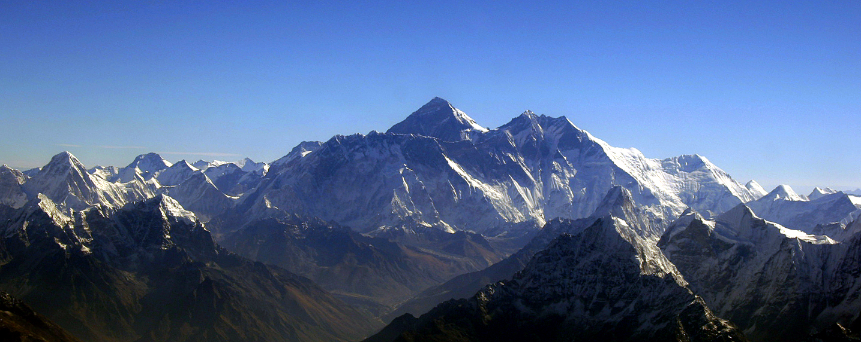
Why large data?
Science
Engineering
Commerce
Source: Wikipedia (Everest)

Slide 15
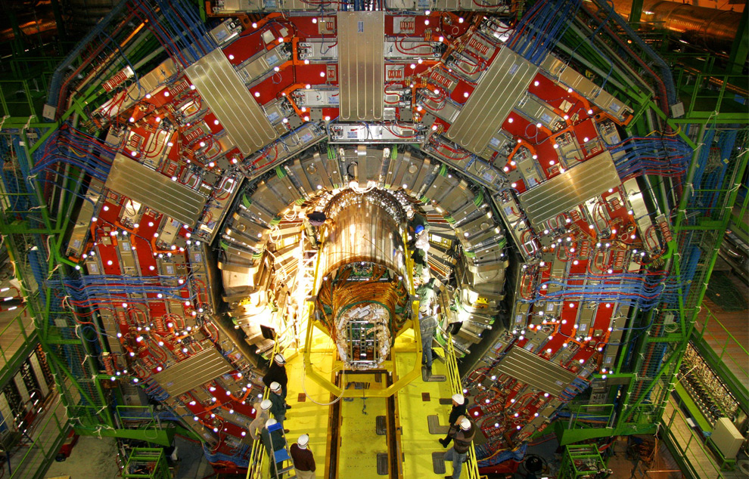
Science
Emergence of the 4th Paradigm
Data-intensive e-Science
Maximilien Brice, © CERN
Notes:
By the time it shuts down in 2011, the CERN collider should have amassed about 20 times as much data as it now has. (NYTimes article, “Trillions of Reasons to Be Excited”, 11/1/2010)

Slide 16
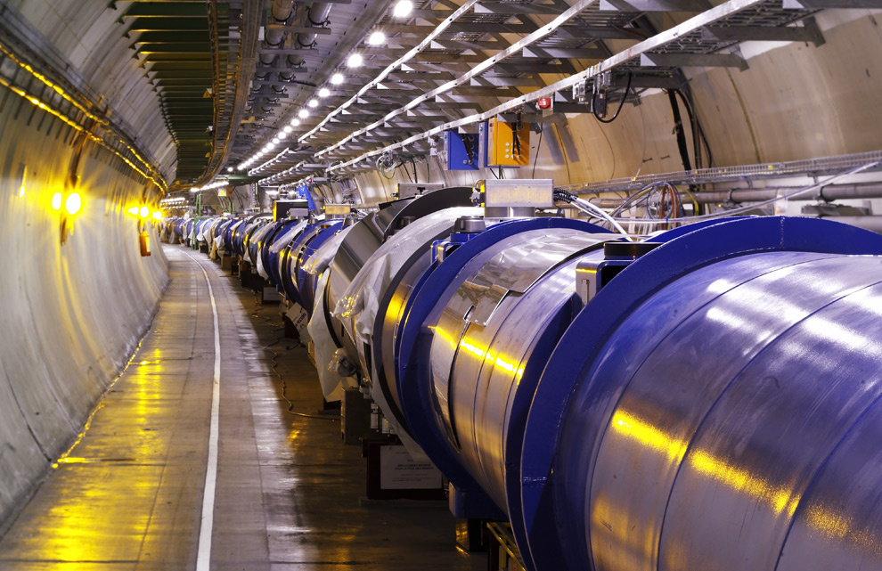
Maximilien Brice, © CERN
Notes:
By the time it shuts down in 2011, the CERN collider should have amassed about 20 times as much data as it now has. (NYTimes article, “Trillions of Reasons to Be Excited”, 11/1/2010)

Slide 17
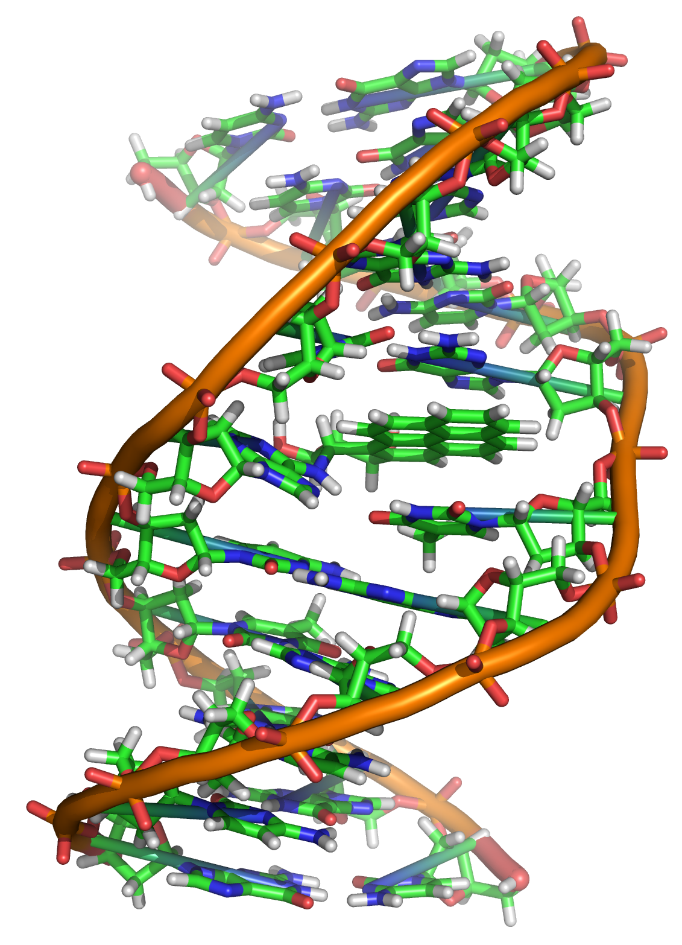
Source: Wikipedia (DNA)

Slide 18
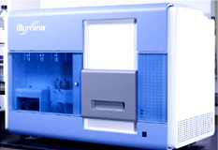
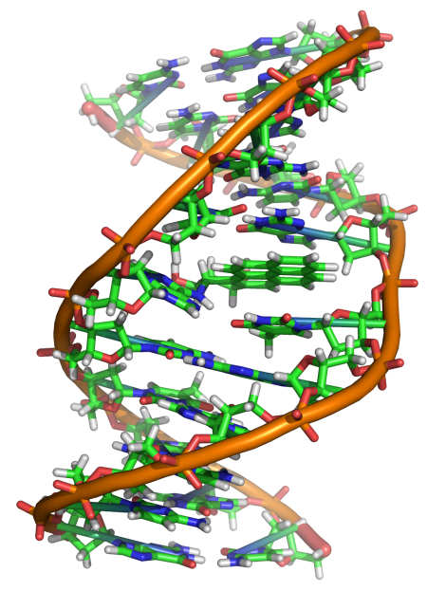
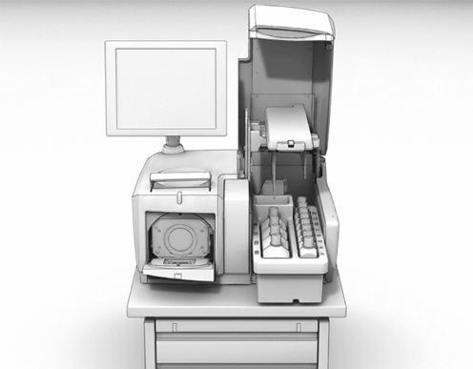
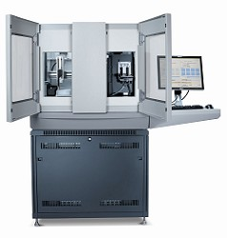
GATGCTTACTATGCGGGCCCC
CGGTCTAATGCTTACTATGC
GCTTACTATGCGGGCCCCTT
?
AATGCTTACTATGCGGGCCCCTT
TAATGCTTACTATGC
AATGCTTAGCTATGCGGGC
AATGCTTACTATGCGGGCCCCTT
AATGCTTACTATGCGGGCCCCTT
CGGTCTAGATGCTTACTATGC
AATGCTTACTATGCGGGCCCCTT
CGGTCTAATGCTTAGCTATGC
ATGCTTACTATGCGGGCCCCTT
Reads
Subject genome
Human genome: 3 gbp
A few billion short reads (~100 GB compressed data)
Sequencer

Slide 19
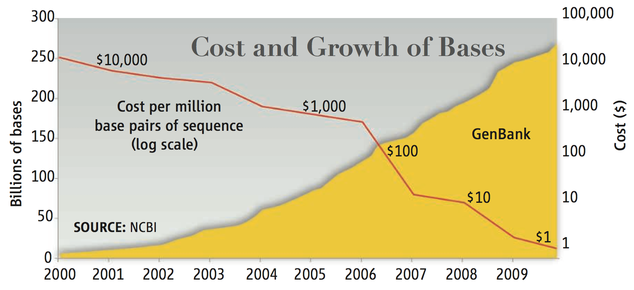
DNA Data Tsunami
Current world-wide sequencing capacity exceeds 13 Pbp/year
and is growing at 5x per year!
“Will Computers Crash Genomics?”
Elizabeth Pennisi (2011) Science. 331(6018): 666-668.
Notes:
1608 NGS Sequencers

Slide 20
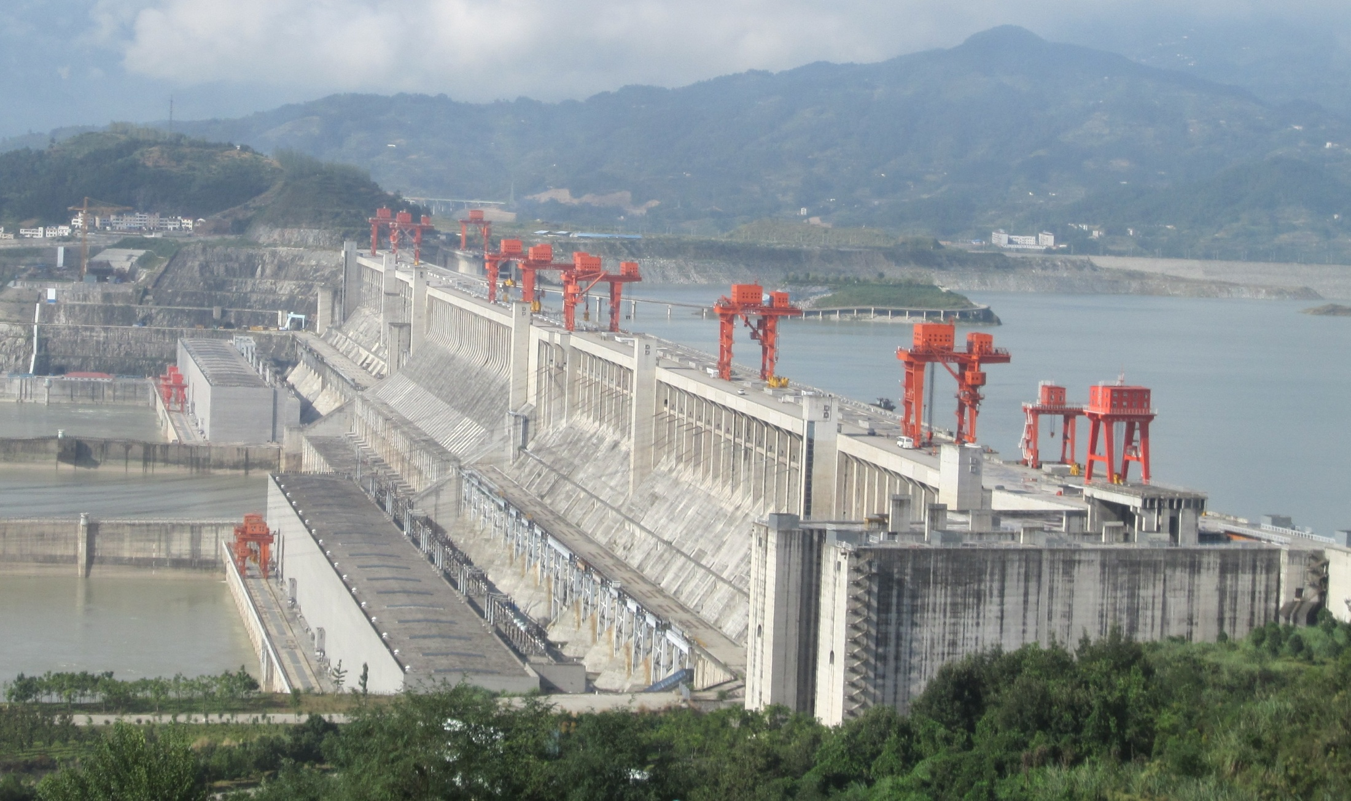
Engineering
The unreasonable effectiveness of data
Count and normalize!
Source: Wikipedia (Three Gorges Dam)

Slide 21
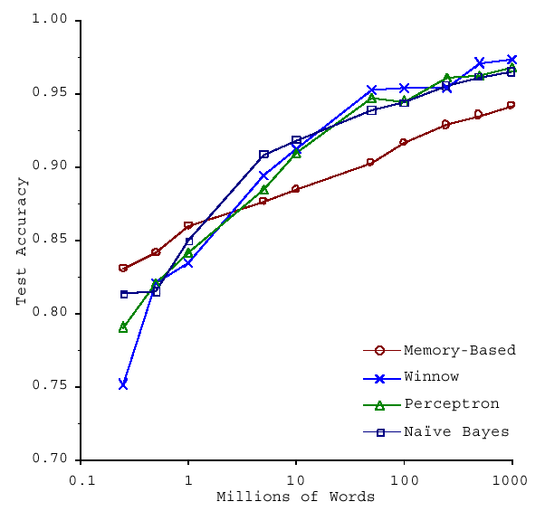
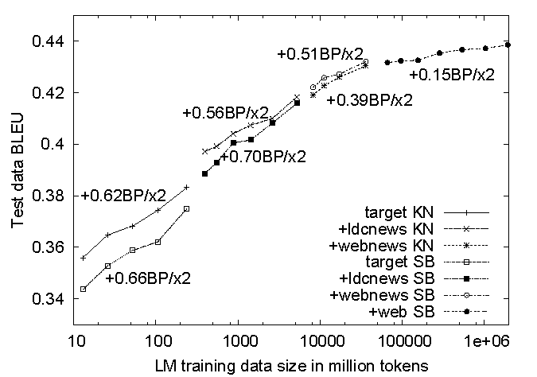
No data like more data!
(Banko and Brill, ACL 2001)
(Brants et al., EMNLP 2007)

Slide 22
What to do with more data?
Answering factoid questions
Pattern matching on the Web
Works amazingly well
Learning relations
Start with seed instances
Search for patterns on the Web
Using patterns to find more instances
Who shot Abraham Lincoln? → X shot Abraham Lincoln
Wolfgang Amadeus Mozart (1756 - 1791)
Einstein was born in 1879
Birthday-of(Mozart, 1756)
Birthday-of(Einstein, 1879)
PERSON (DATE –
PERSON was born in DATE
(Brill et al., TREC 2001; Lin, ACM TOIS 2007)
(Agichtein and Gravano, DL 2000; Ravichandran and Hovy, ACL 2002; … )

Slide 23
Commerce
Know thy customers
Data → Insights → Competitive advantages
Source: Wikiedia (Shinjuku, Tokyo)

Slide 24
Business Intelligence
Premise: more data leads to better business decisions
Periodic reporting as well as ad hoc queries
Rise of the data scientist
Listen to your customers, not the HiPPO
Examples:
Slicing-and-dicing activity by different dimensions to better understand the marketplace
Analyzing log data to improve front-end experience
Analyzing log data to better optimize ad placement
Analyzing purchasing trends for better supply-chain management
Mining for correlations between otherwise unrelated activities

Slide 25
Database Workloads
OLTP (online transaction processing)
Typical applications: e-commerce, banking, airline reservations
User facing: real-time, low latency, highly-concurrent
Tasks: relatively small set of “standard” transactional queries
Data access pattern: random reads, updates, writes (involving relatively small amounts of data)
OLAP (online analytical processing)
Typical applications: business intelligence, data mining
Back-end processing: batch workloads, less concurrency
Tasks: complex analytical queries, often ad hoc
Data access pattern: table scans (involving large amounts of data)

Slide 26
One Database or Two?
Downsides of co-existing OLTP and OLAP workloads
Poor memory management
Conflicting data access patterns
Variable latency
Solution: separate databases
User-facing OLTP database for high-volume transactions
Data warehouse for OLAP workloads
How do we connect the two?

Slide 27
OLTP/OLAP Architecture
OLTP
OLAP
ETL (Extract, Transform, and Load)

Slide 28
OLTP/OLAP Integration
OLTP database for user-facing transactions
Retain records of all activity
Periodic ETL (e.g., nightly)
Extract-Transform-Load (ETL)
Extract records from source
Transform: clean data, check integrity, aggregate, etc.
Load into OLAP database
OLAP database for data warehousing
Business intelligence: reporting, ad hoc queries, data mining, etc.
Feedback to improve OLTP services

Slide 29
Challenge of Big Data
Volume
Cost
ETL Latency

Slide 30
cloud computing meets big data
Source: Wikipedia (Clouds)

Slide 31
Cloud Computing Meets Big Data
Rise of social media and user-generated content
Cloud services exacerbates big data problems
Utility computing democratizes big data capabilities
Efficient dynamic allocation of large-scale computing resources

Slide 32
What really is the cloud?
Source: Wikipedia (Clouds)

Slide 33
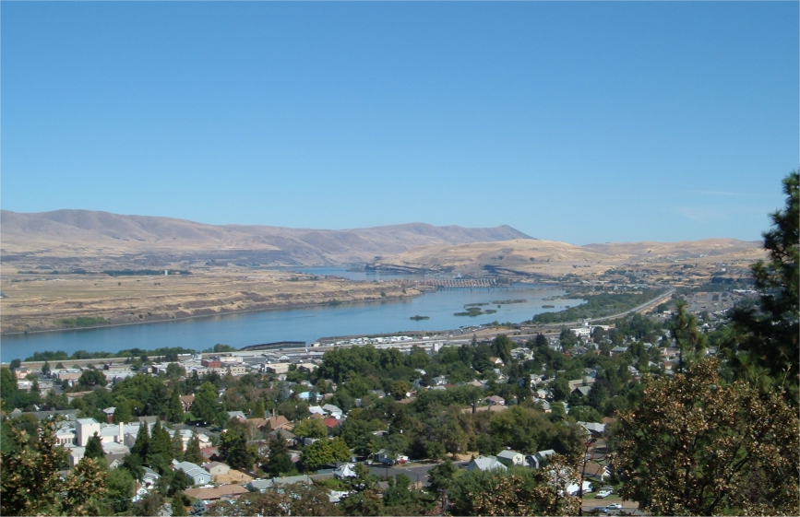
Source: Wikipedia (The Dalles, Oregon)

Slide 34
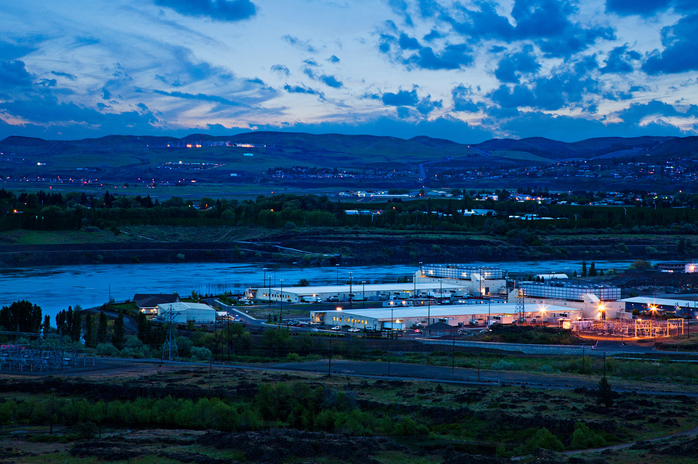
Source: Google

Slide 35
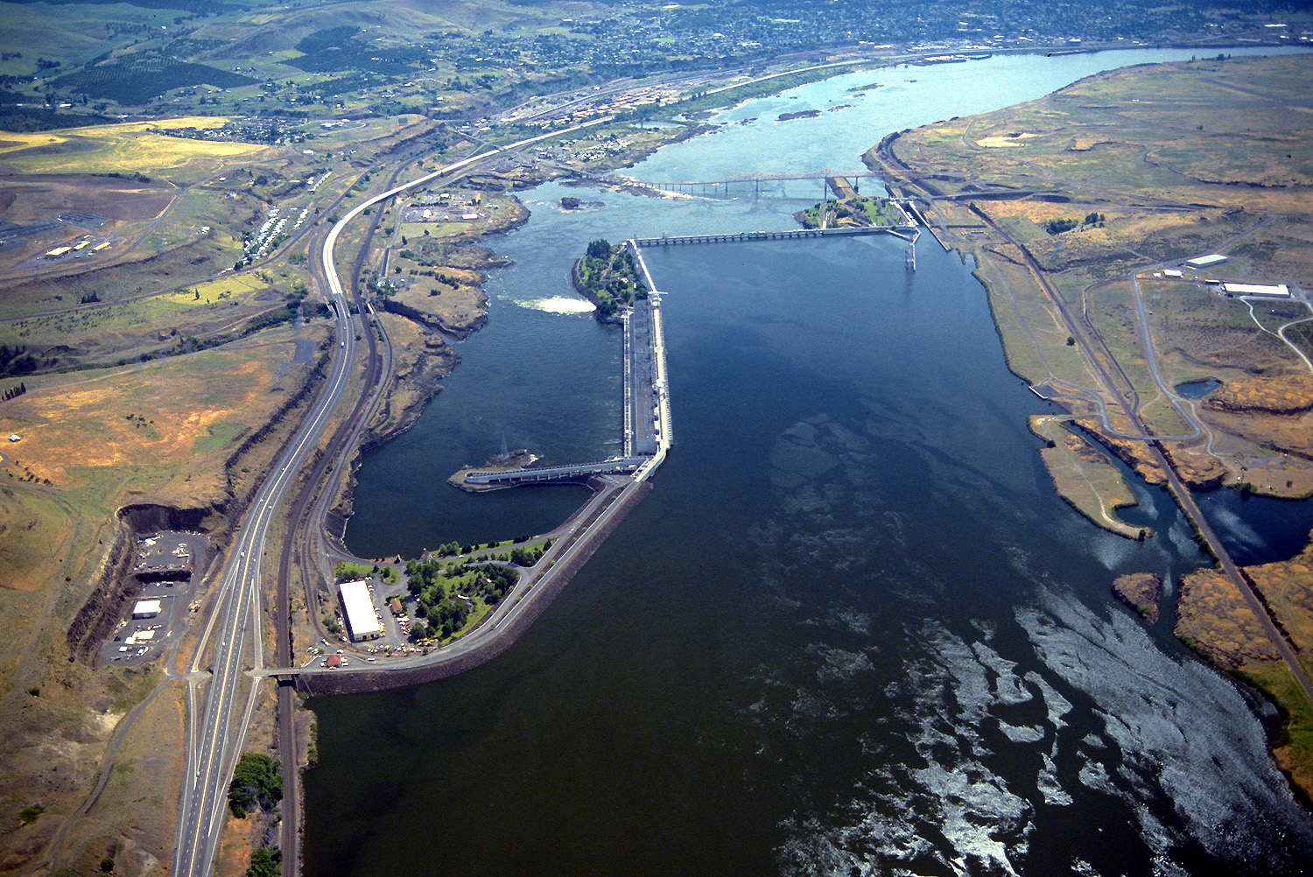
Source: Bonneville Power Administration

Slide 36
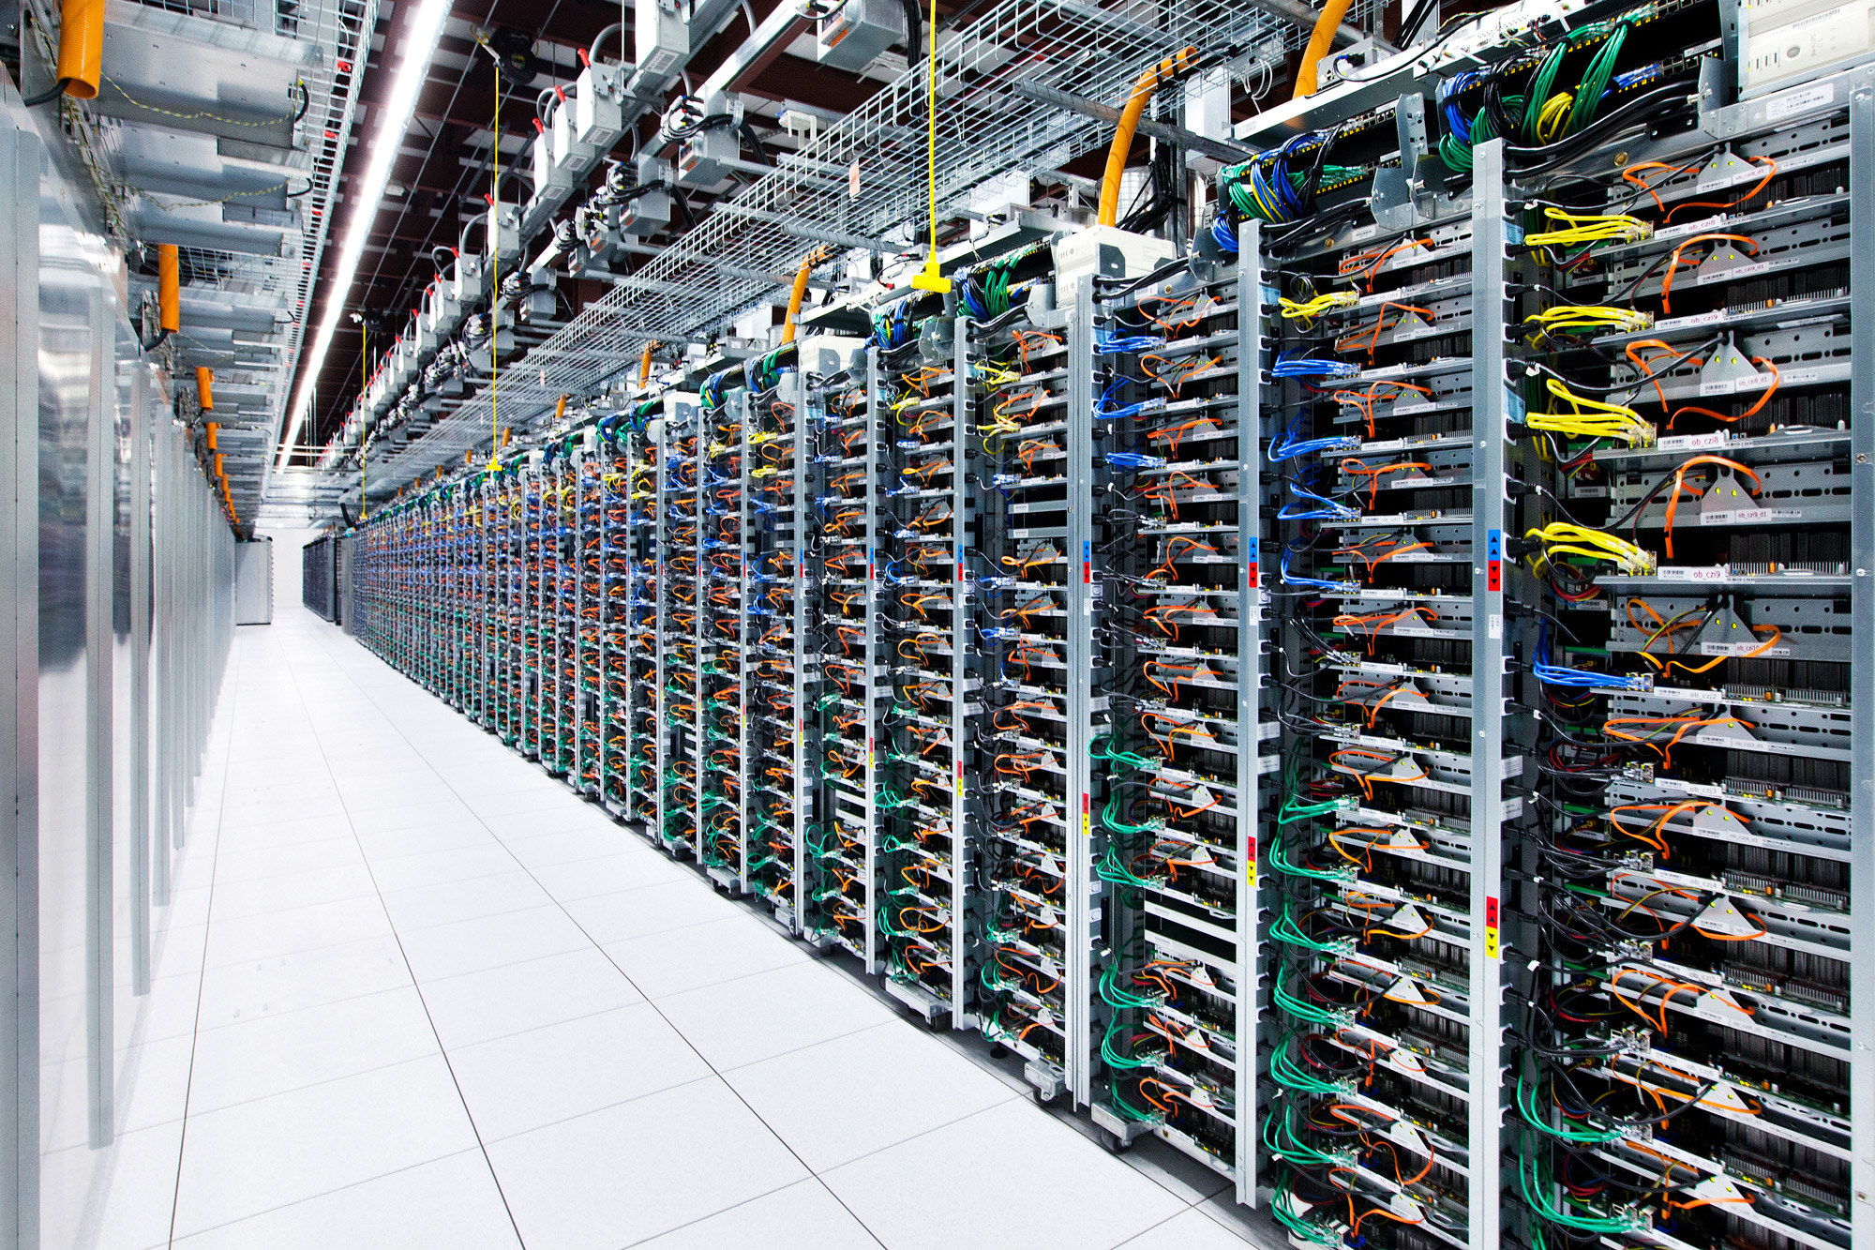
Source: Google

Slide 37
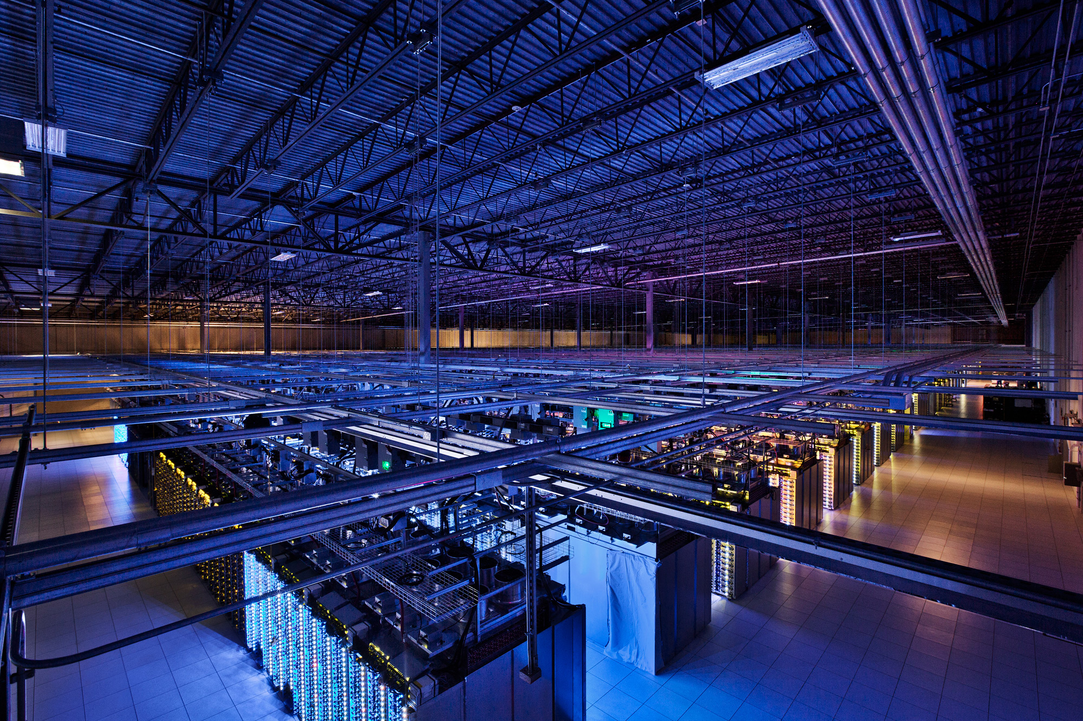
Source: Google

Slide 38
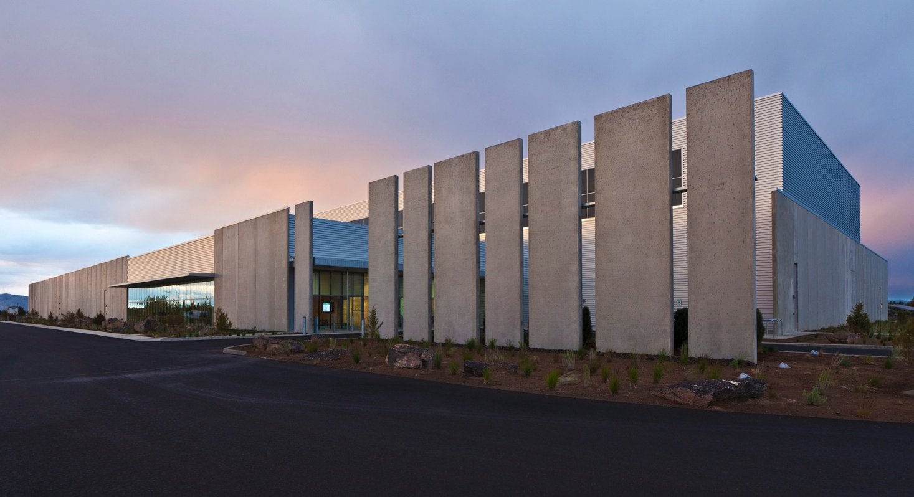
Source: Facebook

Slide 39
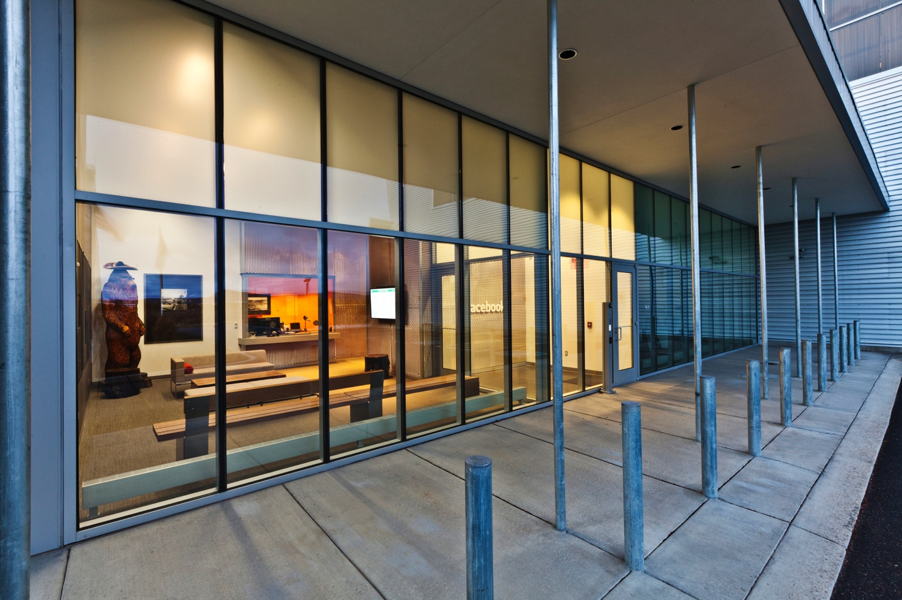
Source: Facebook

Slide 40
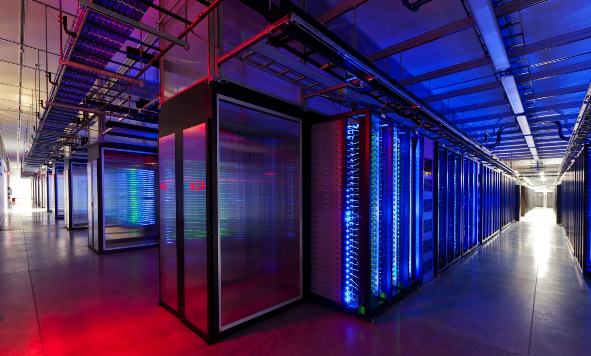
Source: Facebook

Slide 41
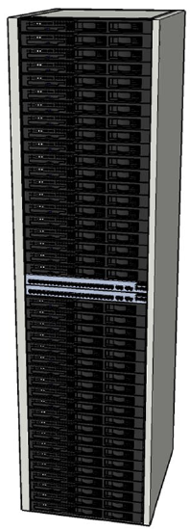
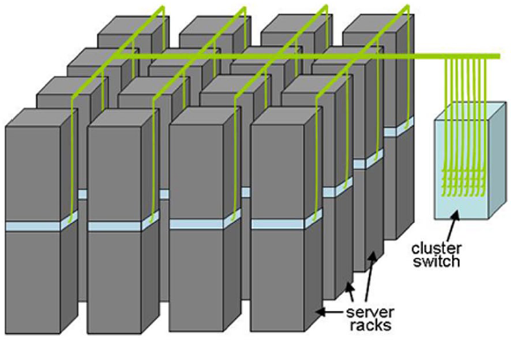
Building Blocks
Source: Barroso and Urs Hölzle (2009)

Slide 42
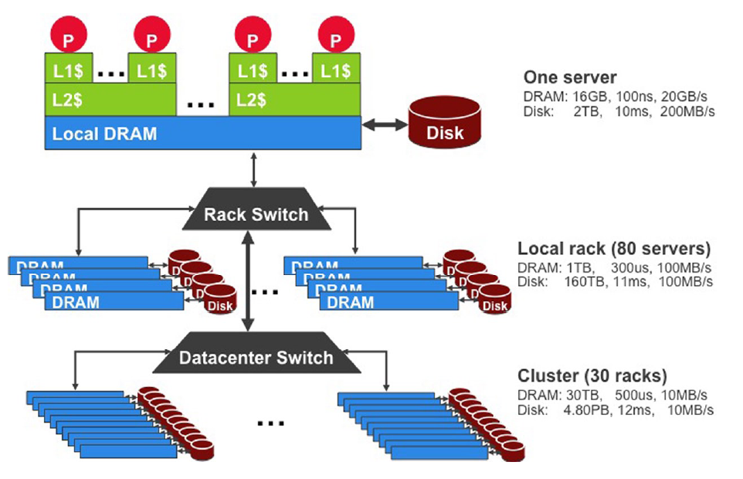
Storage Hierarchy
Funny story about sense of scale…
Source: Barroso and Urs Hölzle (2009)

Slide 43
Anatomy of a Datacenter
Source: Barroso and Urs Hölzle (2009)

Slide 44
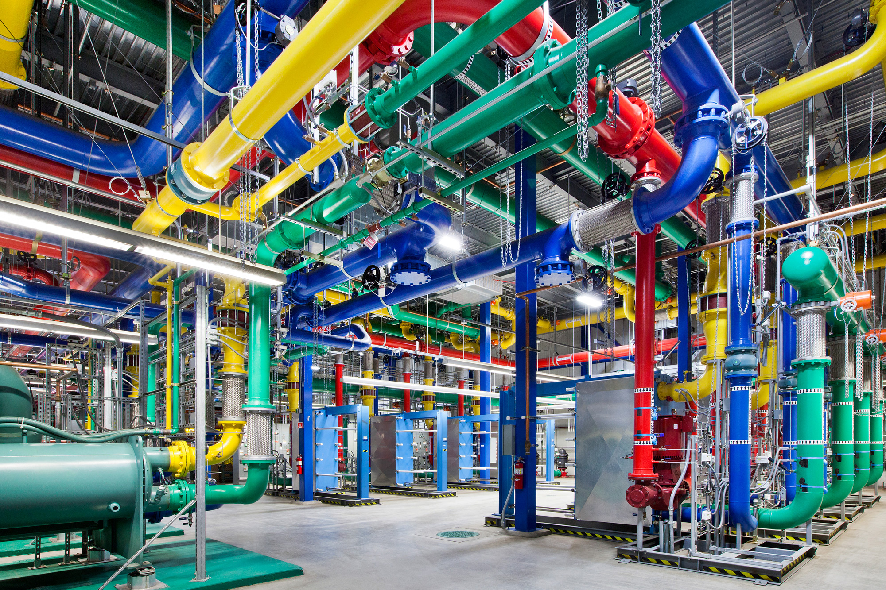
Source: Google

Slide 45
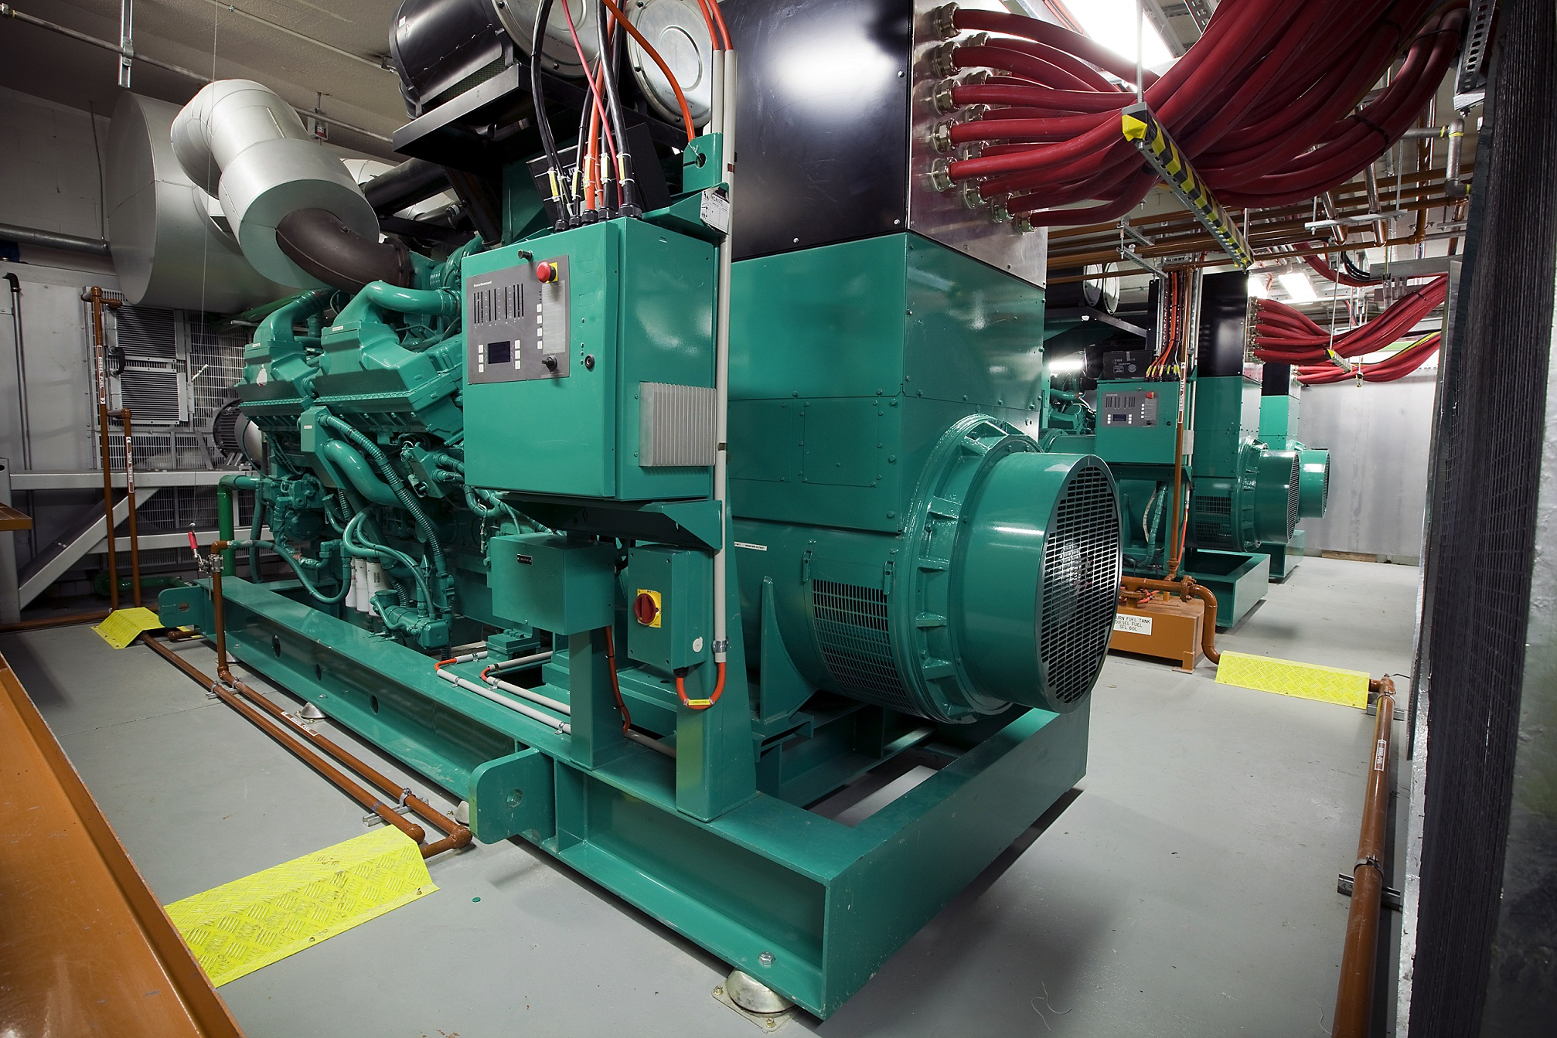
Source: CumminsPower

Slide 46
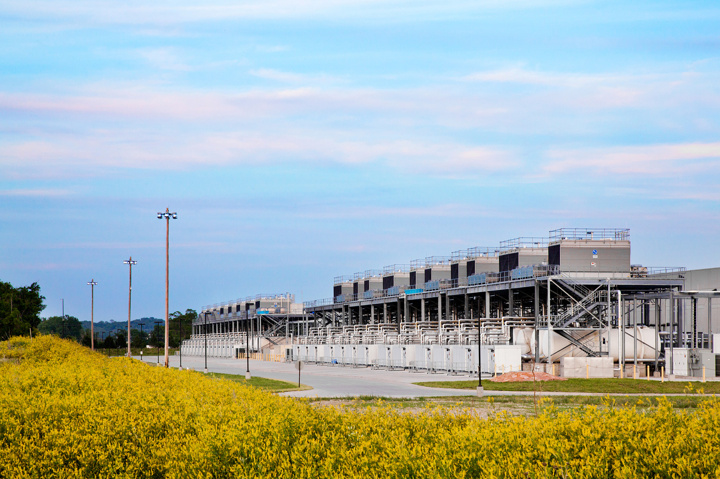
Source: Google

Slide 47
How large data?
Source: Wikipedia (Everest)

Slide 48
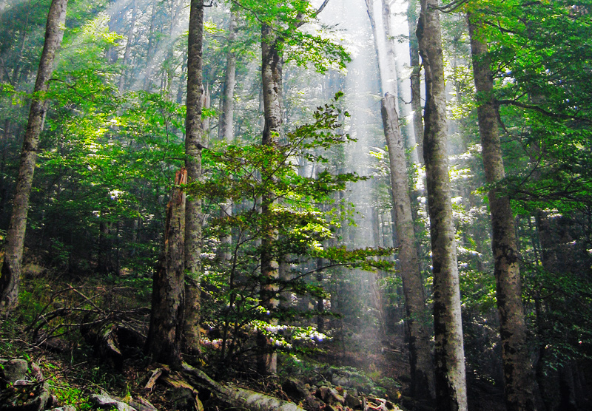
Divide et impera
Chop problem into smaller parts
Combine partial results
w₁
“Work”
w₂
w₃
r₁
r₂
r₃
“Result”
Source: Wikiedia (Forest)

Slide 49
Synchronization Challenges
How to split large chunks up into smaller ones
How to integrate results from each chunk
How to distribute shared data
How to update shared data
How to coordinate access to shared resources
How to schedule different processing chunks
How to cope of machine failure

Slide 50
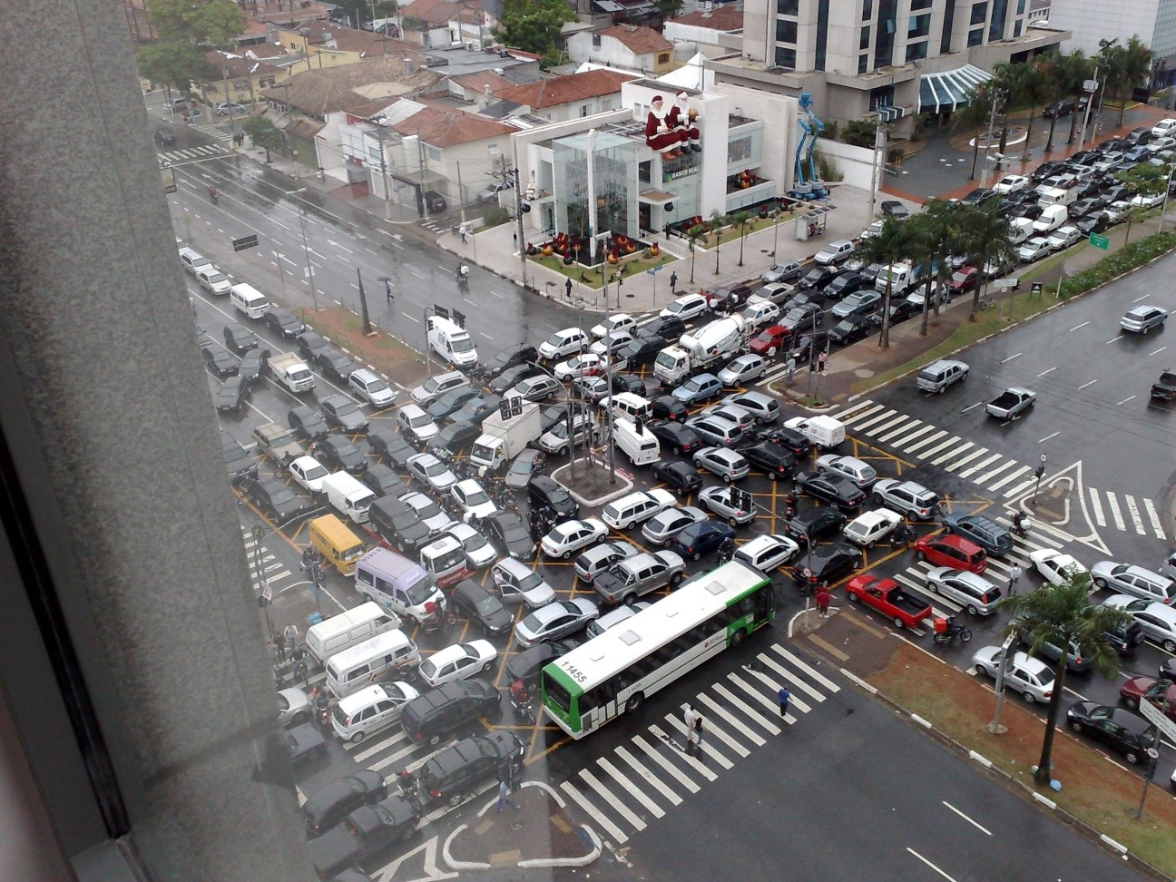
Source: Ricardo Guimarães Herrmann

Slide 51
Typical Large-Data Problem
Iterate over a large number of records
Extract something of interest from each
Shuffle and sort intermediate results
Aggregate intermediate results
Generate final output
Map
Reduce
(Dean and Ghemawat, OSDI 2004)

Slide 52
MapReduce
Programmers specify two functions:
map (k, v) → <k’, v’>*
reduce (k’, v’) → <k’, v’>*
All values with the same key are sent to the same reducer
The execution framework handles everything else…

Slide 53
k₁
v₁
k₂
v₂
k₃
v₃
k₄
v₄
k₅
v₅
k₆
v₆
map
map
map
map
a
1
b
2
c
3
c
6
a
5
c
2
b
7
c
8
Shuffle and Sort: aggregate values by keys
a
1
5
b
2
7
c
2
3
6
8
reduce
reduce
reduce
r₁
s₁
r₂
s₂
r₃
s₃

Slide 54
MapReduce
Programmers specify two functions:
map (k, v) → <k’, v’>*
reduce (k’, v’) → <k’, v’>*
All values with the same key are sent to the same reducer
The execution framework handles everything else…
What’s “everything else”?

Slide 55
MapReduce “Runtime”
Handles scheduling
Assigns workers to map and reduce tasks
Handles “data distribution”
Moves processes to data
Handles synchronization
Gathers, sorts, and shuffles intermediate data
Handles errors and faults
Detects worker failures and restarts

Slide 56
MapReduce Word Count
Map(String docid, String text):
for each word w in text:
Emit(w, 1);
Reduce(String term, Iterator<Int> values):
int sum = 0;
for each v in values:
sum += v;
Emit(term, value);

Slide 57
MapReduce Implementations
Google has a proprietary implementation
Hadoop is an open-source implementation in Java
Originally developed by Yahoo, now an Apache project
Center of a rapidly expanding software ecosystem

Slide 58
Now you know…
Cloud computing
Big data
Relationship between the two
Challenges with big data processing
MapReduce/Hadoop

Slide 59
Questions?
Source: Wikipedia (Clouds)

