Slide 1
INFM 603: Information Technology and Organizational Context
Session 9: Visualization
Jimmy Lin
The iSchool University of Maryland
Thursday, November 6, 2014
Material borrowed from slides by Ben Shneiderman for his visualization course

Slide 2
Visualization
Why visualizations?
Human perceptual skills are remarkable
Human image storage storage is fast and vast
What are visualizations for?
A good visualization tells a story
A great visualization delivers insight
Science as well as an art…

Slide 3
Raw Ingredients
Types of data
Categorical data
Ordinal data
Numerical data
Ways of representing data
Height
Width
Thickness
Area
Angles
Size
Shape
Color

Slide 4
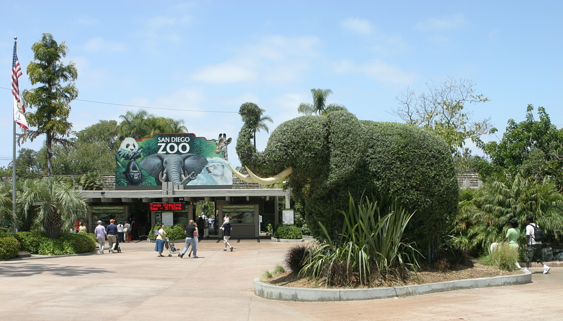

Slide 5
Static vs. Interactive
Interactive visualizations allow users to “explore” the data
Overview
Zoom and filter
Details-on-demand
Brushing and linking is a powerful technique

Slide 6
Info Porn
Informative visualizations vs. info porn
Beware of infographics and chart junk

Slide 7
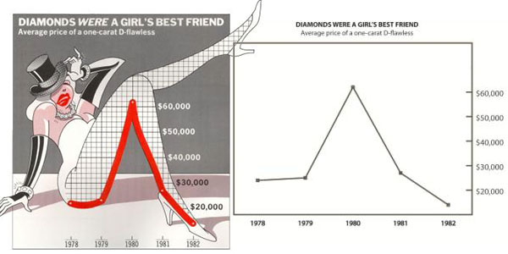
http://infosthetics.com/archives/chart_junk_effective.jpg

Slide 8
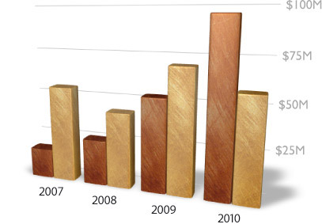
http://thedoublethink.com/wp-content/uploads/2009/07/keynote-chartjunk.jpg

Slide 9
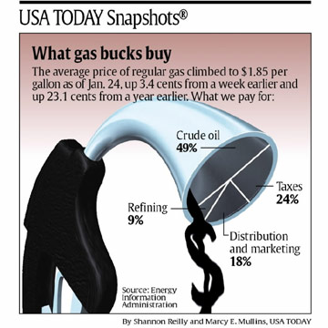
http://www.captech.org/vcp/mathmania/February/images/GasGraph.jpg

Slide 10
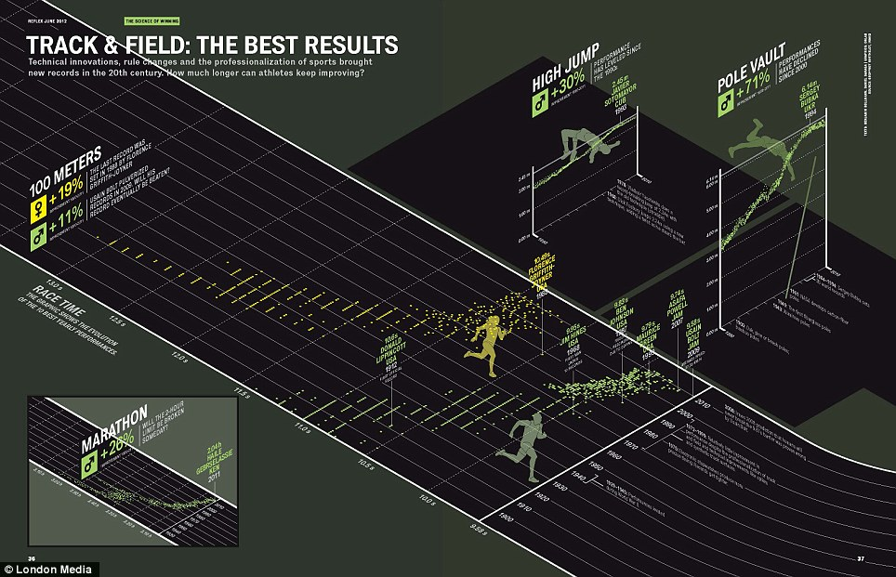
http://junkcharts.typepad.com/junk_charts/music/
Compare: New York Times interactive visualization

Slide 11
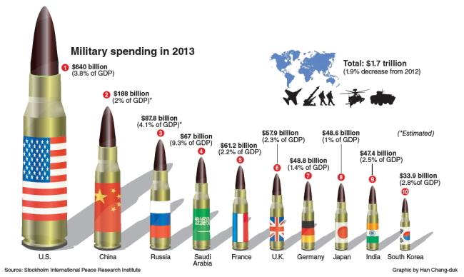
http://junkcharts.typepad.com/junk_charts/2014/10/misguided-warheads-in-the-classroom.html

Slide 12
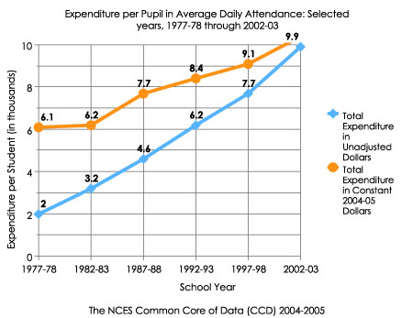
Line Graphs (+ Variants)
Suitable for what types of data?
What makes a good line graph?
http://nces.ed.gov/nceskids/help/user_guide/graph/images/line.jpg

Slide 13
Stacked Graphs
Multiple time-series data “stacked” on top of each other
Useful for showing aggregates
Sometimes called “stream graphs”

Slide 14
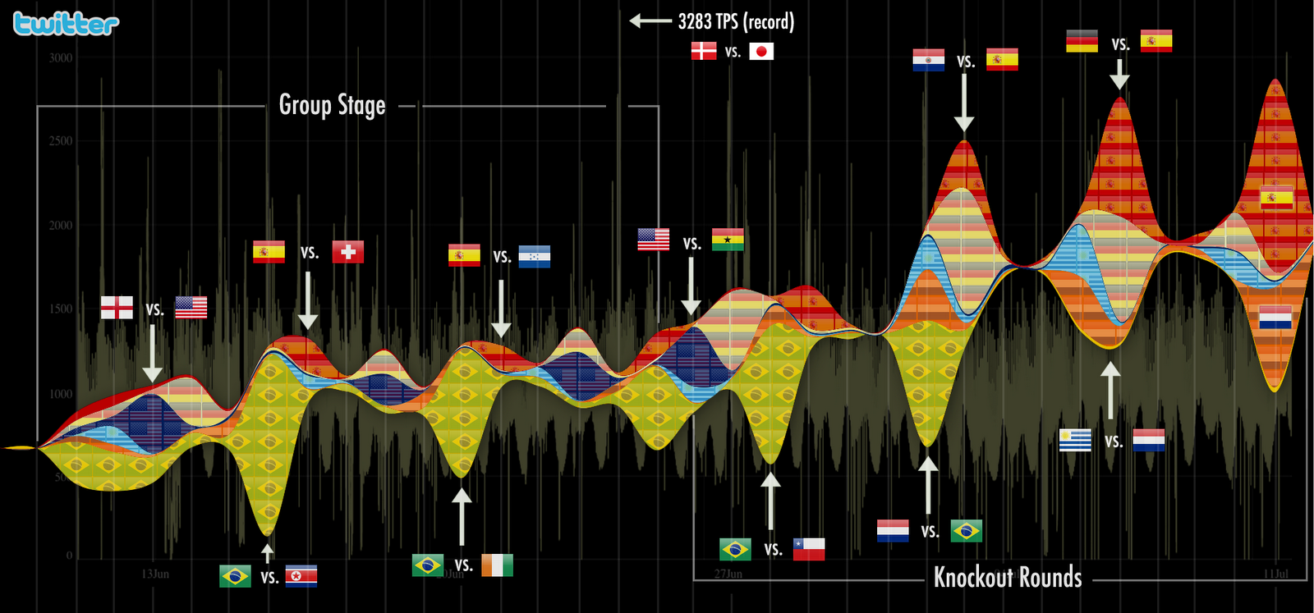

Slide 15
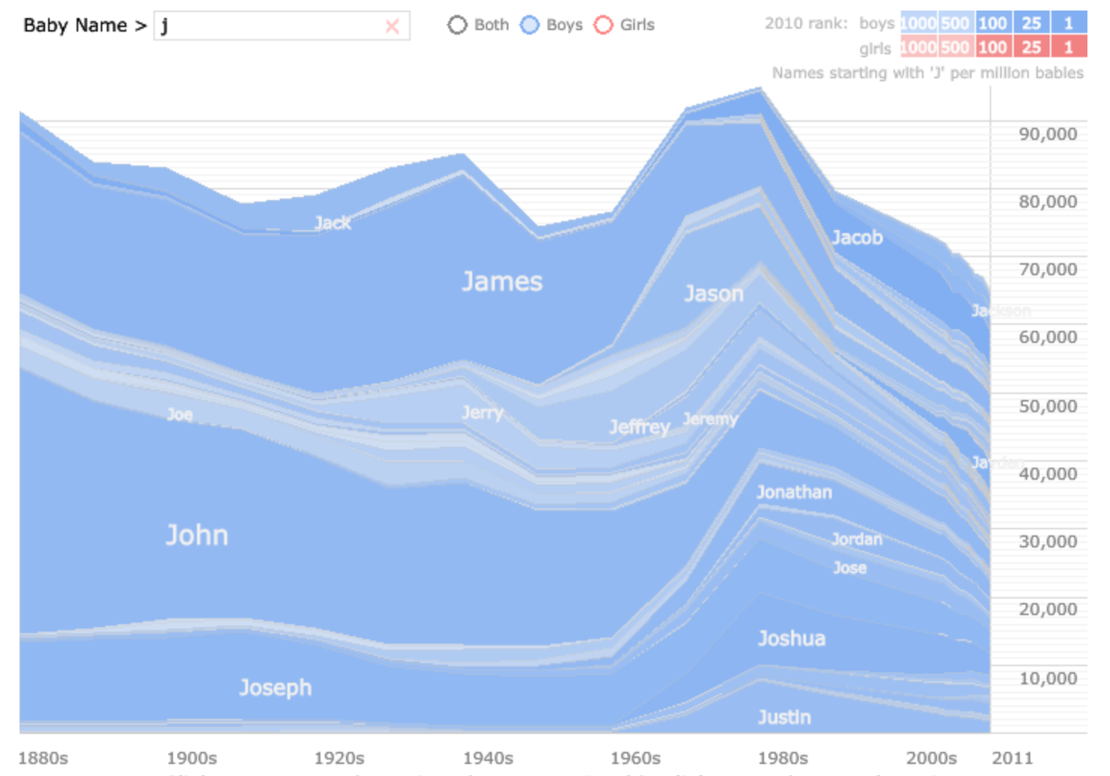
http://www.babynamewizard.com/voyager#

Slide 16
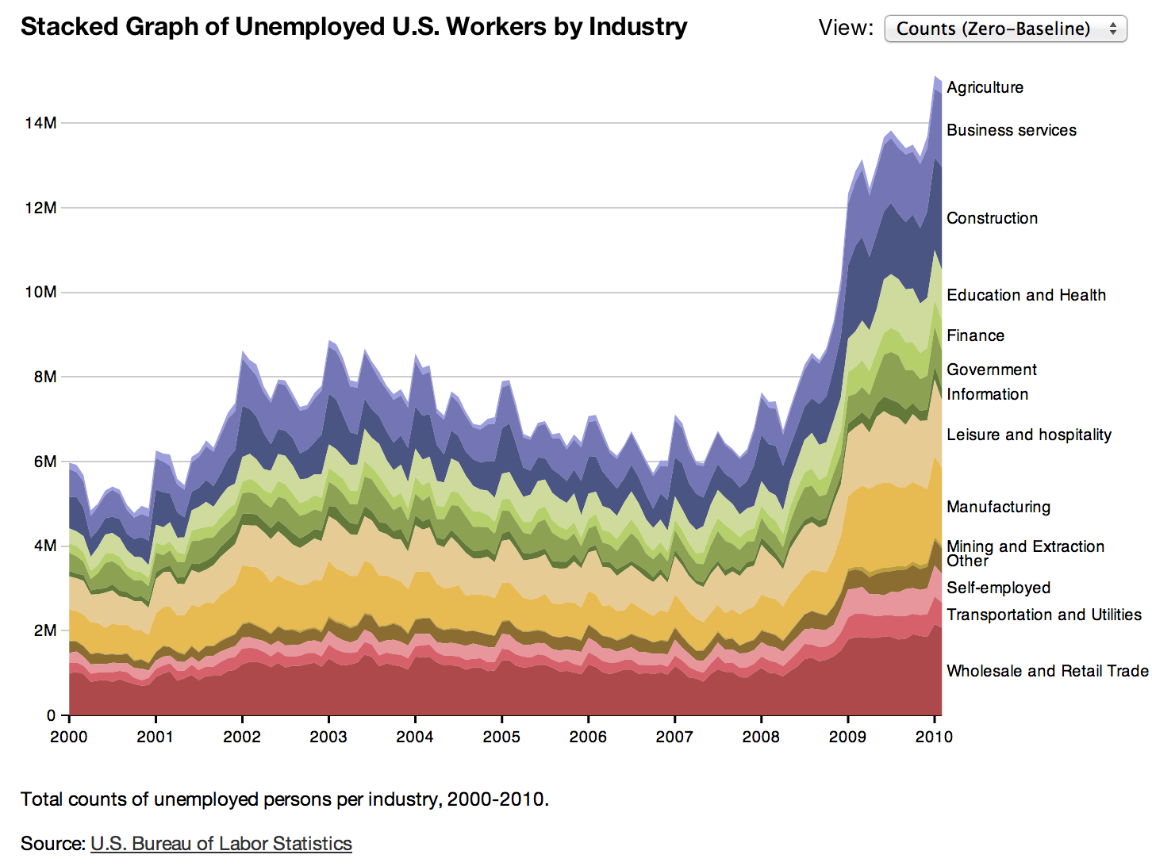
http://hci.stanford.edu/jheer/files/zoo/

Slide 17
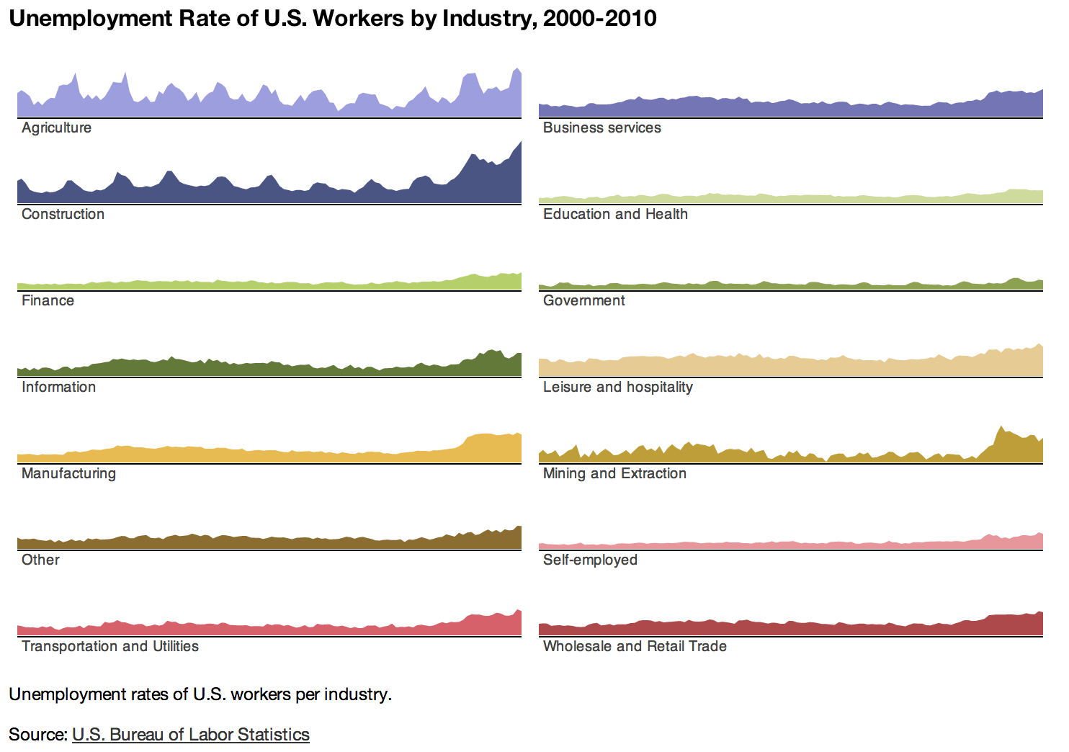
http://hci.stanford.edu/jheer/files/zoo/

Slide 18
Small Multiples
Multiple small graphs arranged in a grid
Advantages and disadvantages?

Slide 19
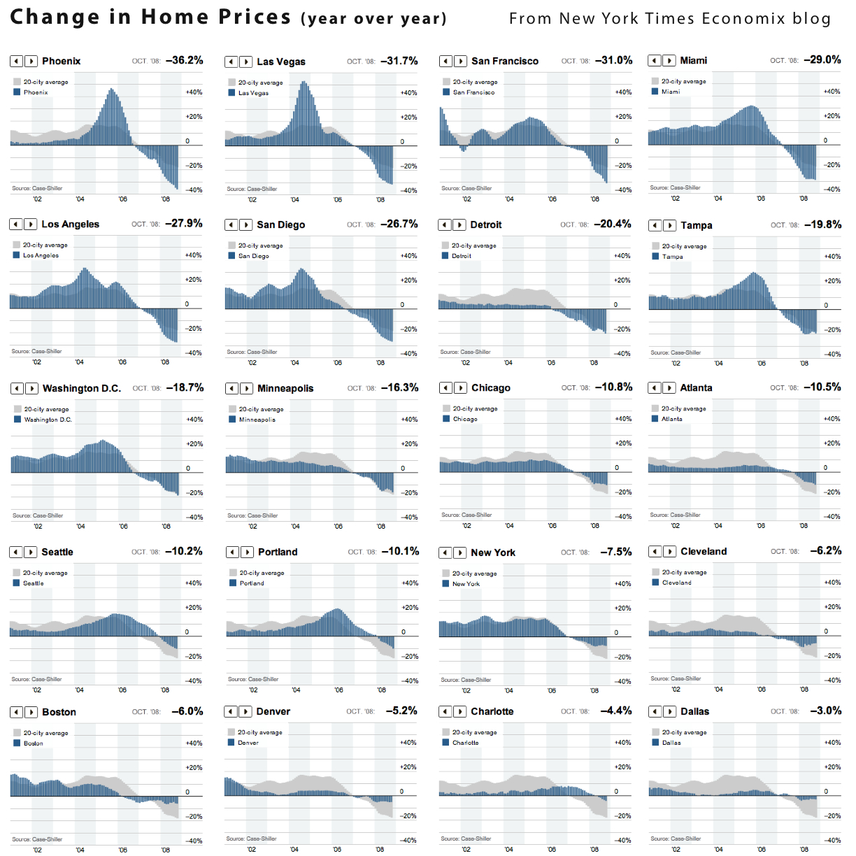
http://informationdesignmdippold.files.wordpress.com/2011/06/good-id-1.jpg

Slide 20
Spark Lines
http://www.plainlanguage.com.au/sparklines.png

Slide 21
Bar Graphs (+ Variants)
Suitable for what types of data?
Following examples from d3.js

Slide 22
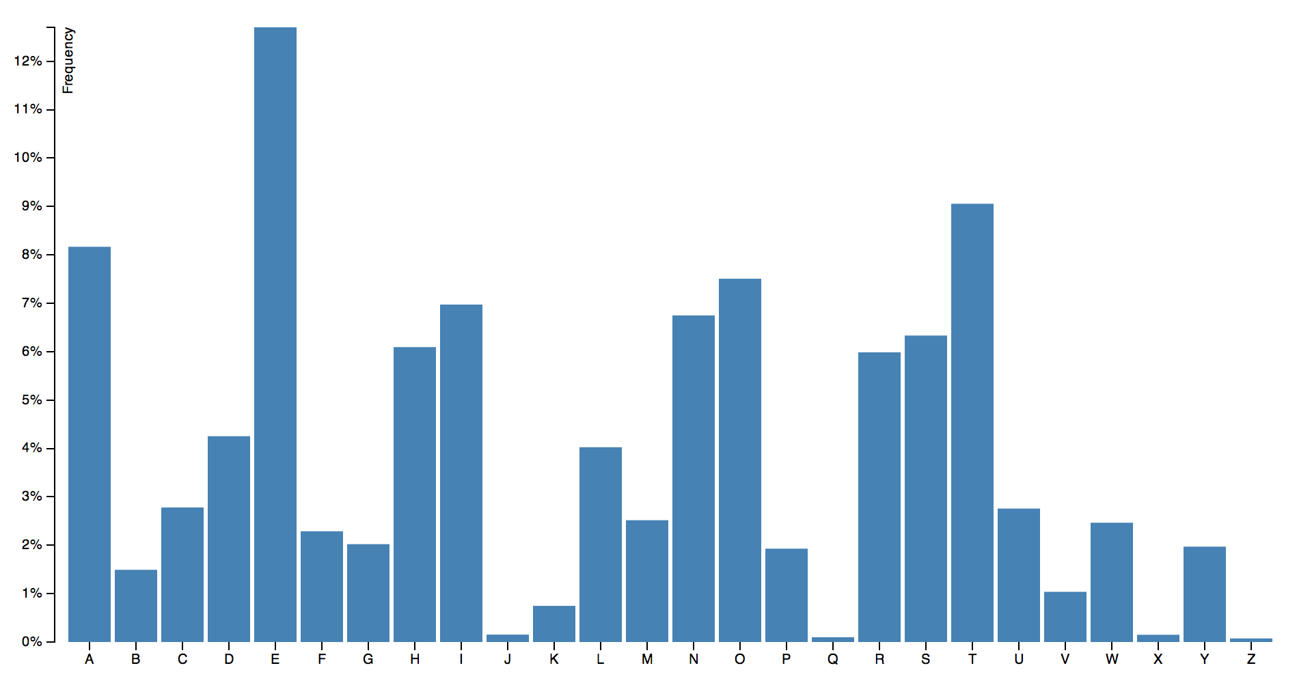

Slide 23
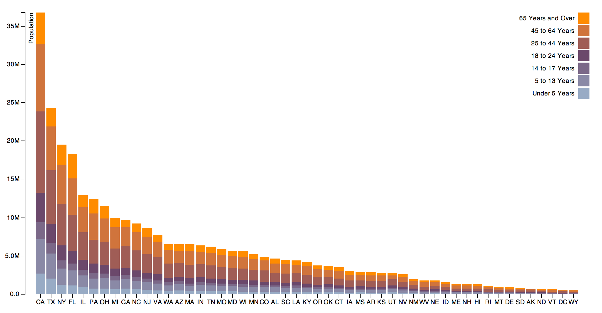

Slide 24
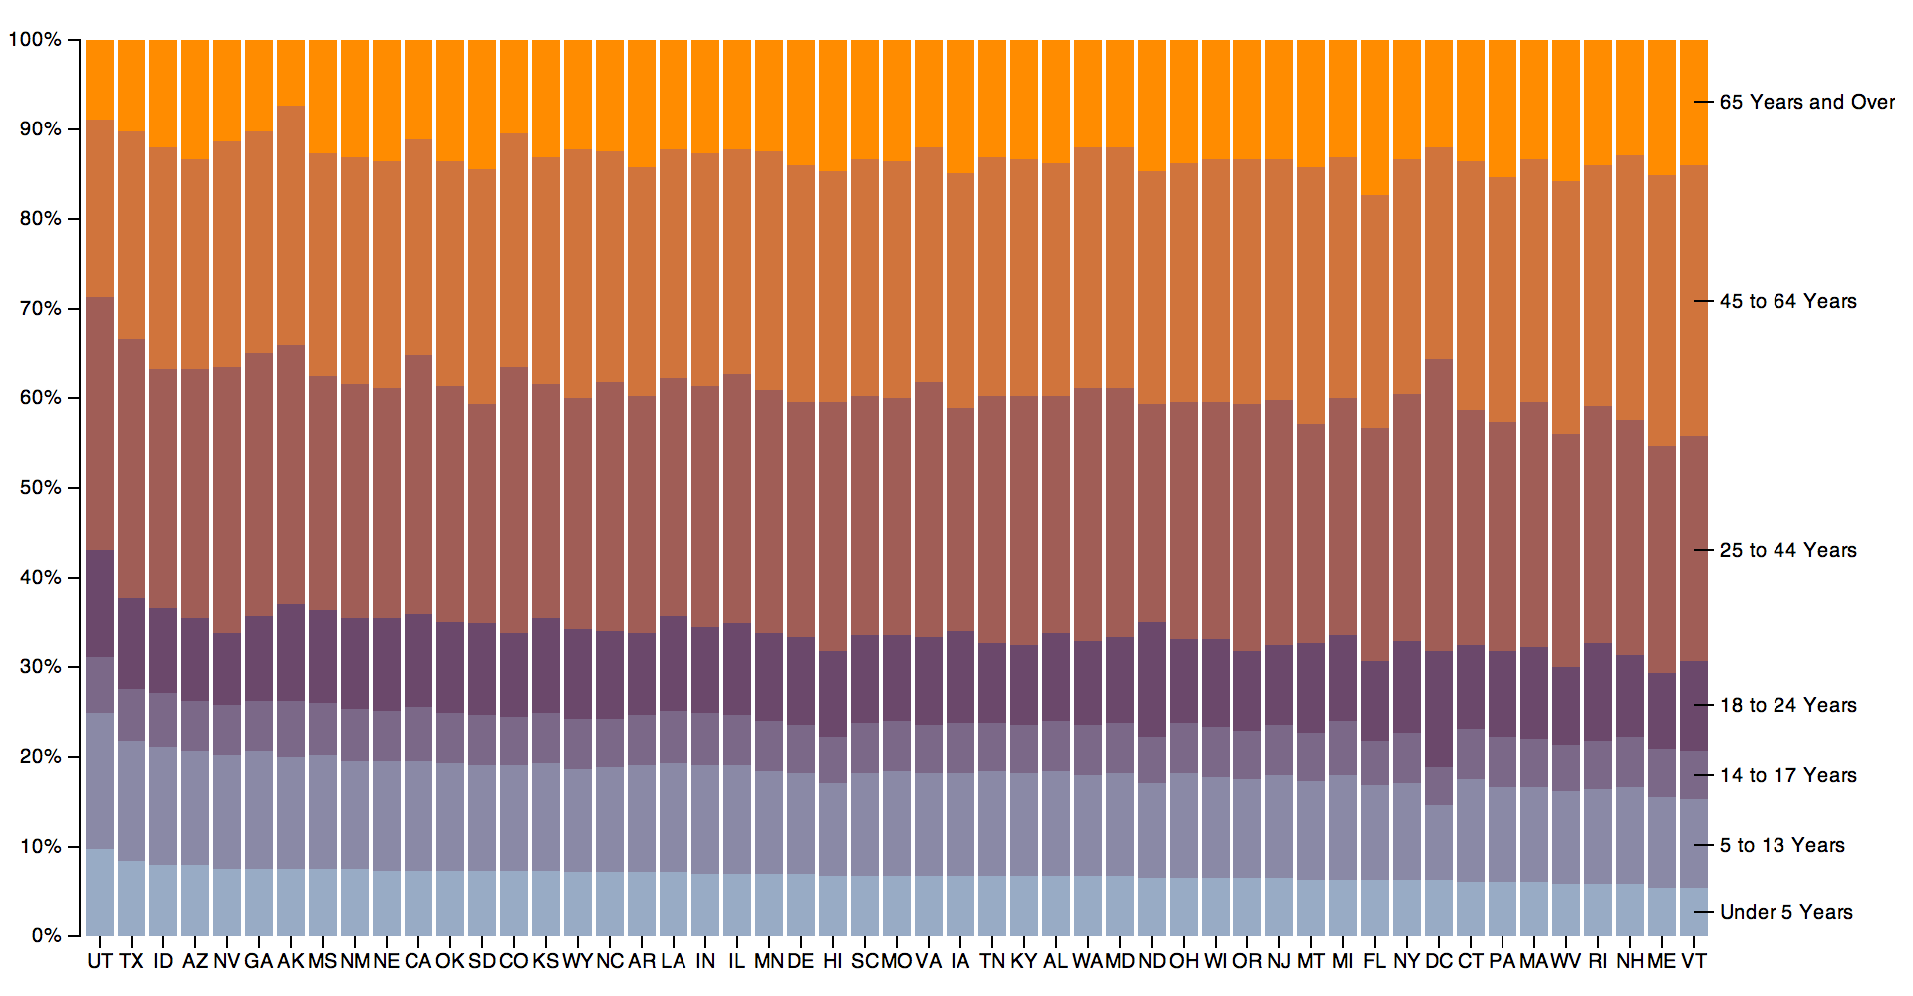

Slide 25
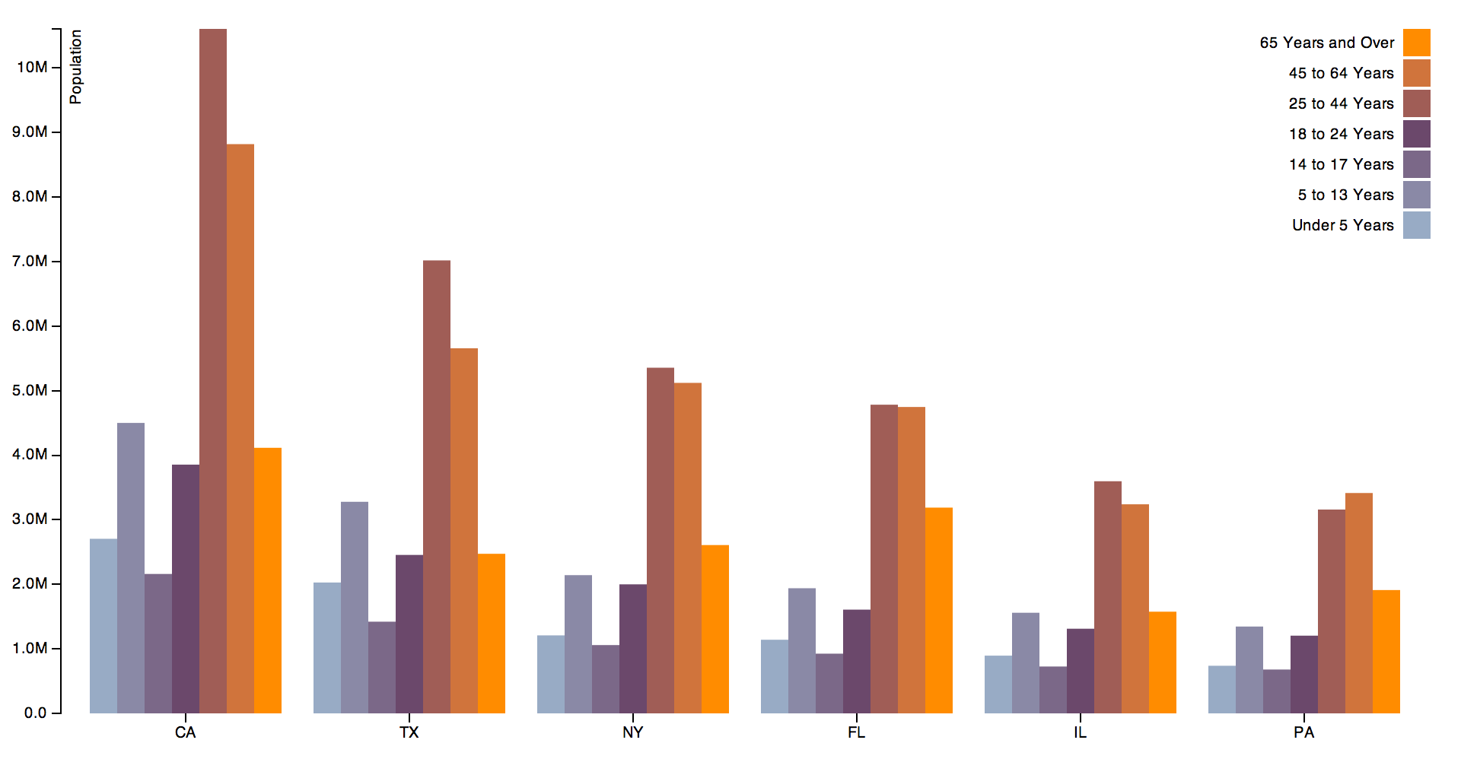

Slide 26
Scatterplots
Suitable for what types of data?
Note availability of other ways to encode data at points

Slide 27
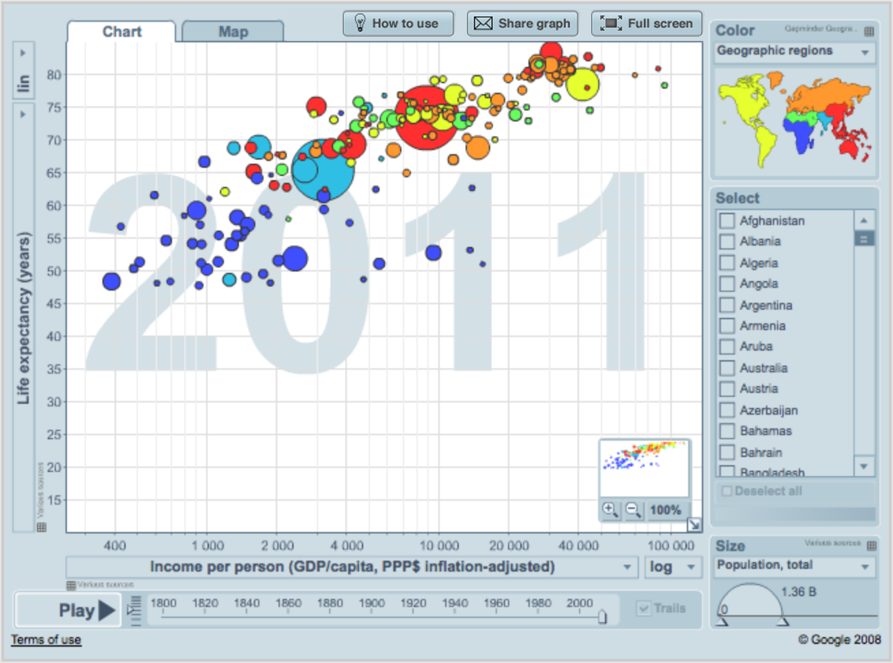
http://www.gapminder.org/

Slide 28
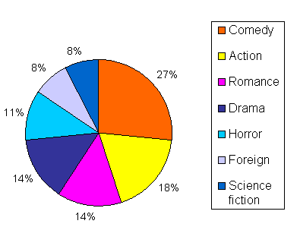
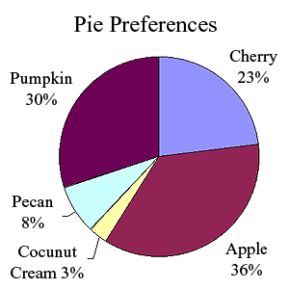
Pie Charts (+ Variants)
Suitable for what types of data?
Different ways for labeling

Slide 29
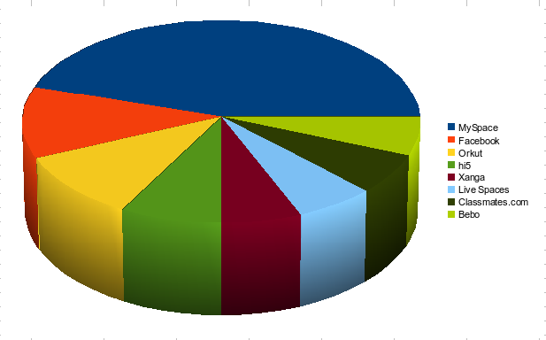
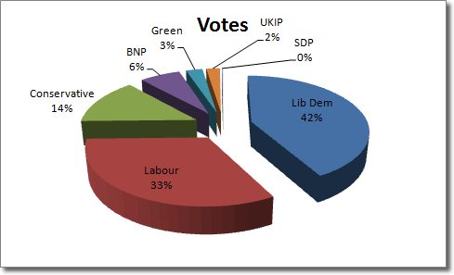
More Chart Junk

Slide 30
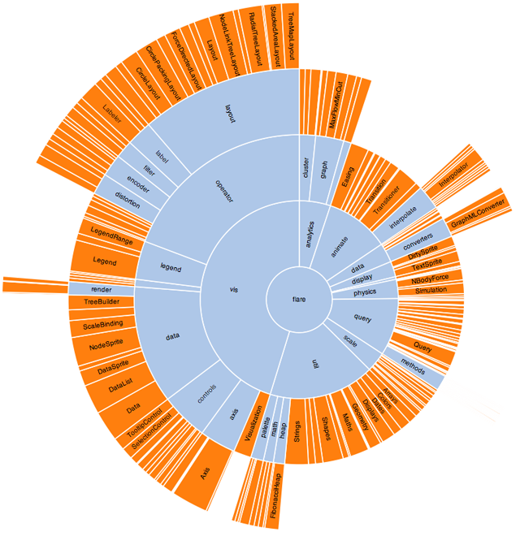
Sunburst Trees
http://hci.stanford.edu/jheer/files/zoo/

Slide 31
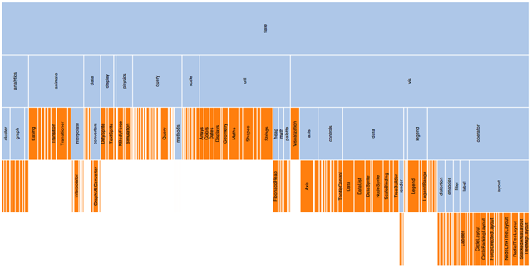
Icicle Diagrams
http://hci.stanford.edu/jheer/files/zoo/

Slide 32
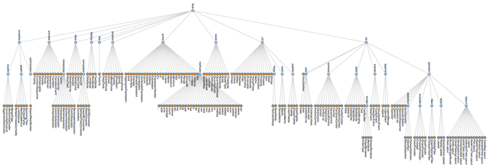
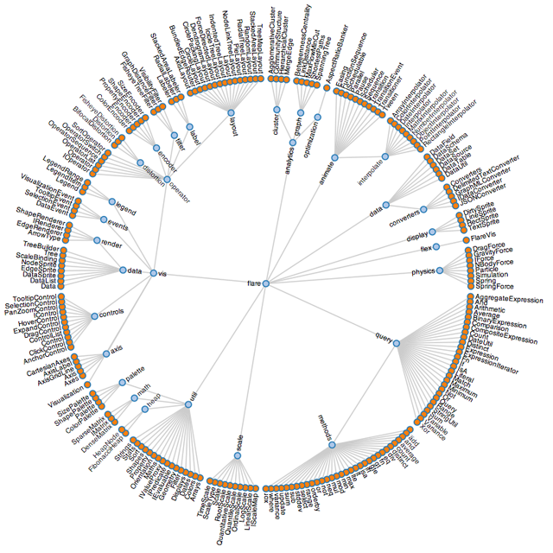
Visualizing Hierarchies
http://hci.stanford.edu/jheer/files/zoo/

Slide 33
TreeMaps
Useful for representing hierarchical relationships
Two mechanisms for coding information:
Size and Color
Physical location of boxes not usually meaningful
Requires learning to read

Slide 34
http://www.smartmoney.com/map-of-the-market/

Slide 35
Market mixed, February 8, 2008: Energy & Technology up, Financial & Health Care down

Slide 36
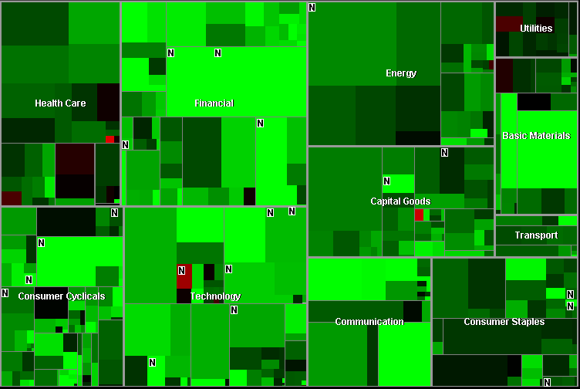
Market rises 319 points, November 13, 2007: Five exceptions

Slide 37
Heatmaps
Data represented in a matrix
Matrix values are code coded

Slide 38
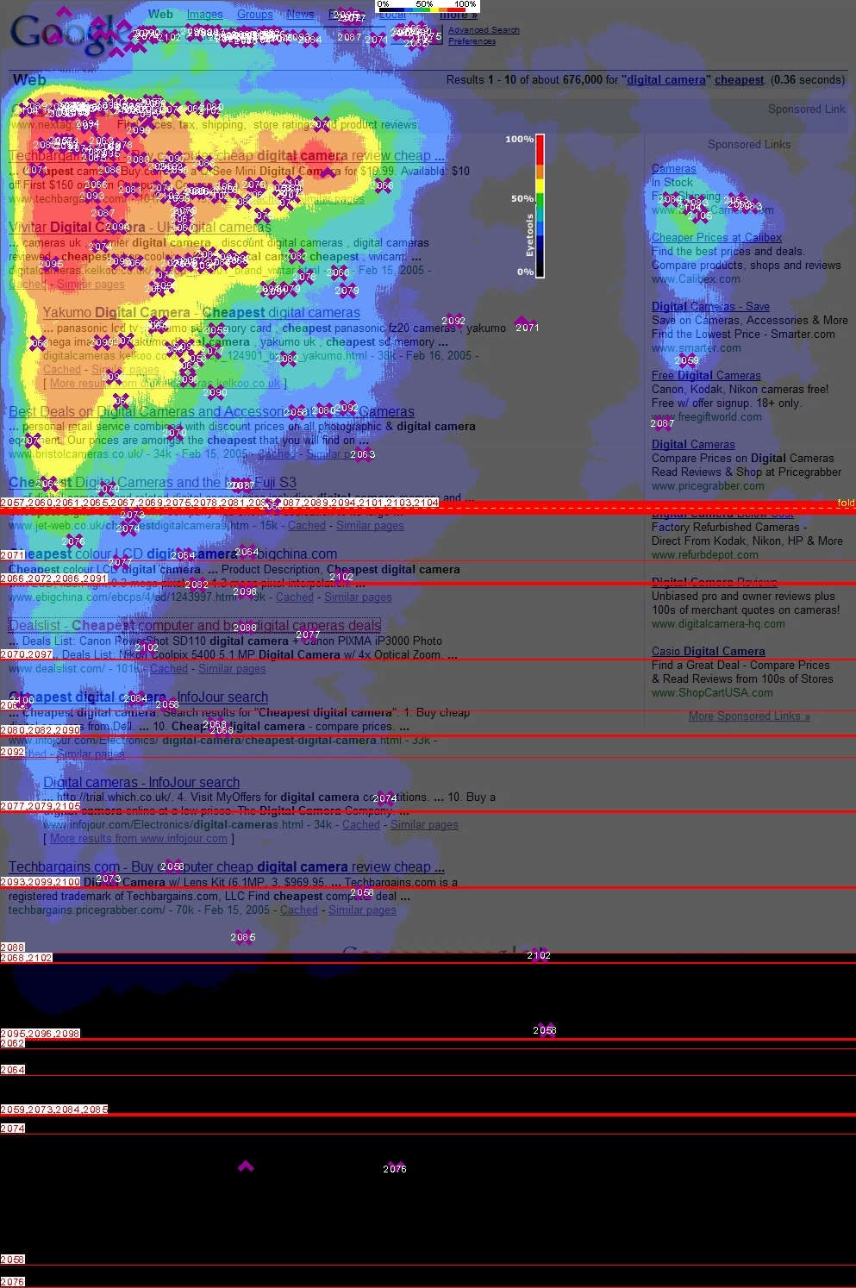
http://eyetools.com/images/blog/2/google/eyetools_google_search.jpg

Slide 39
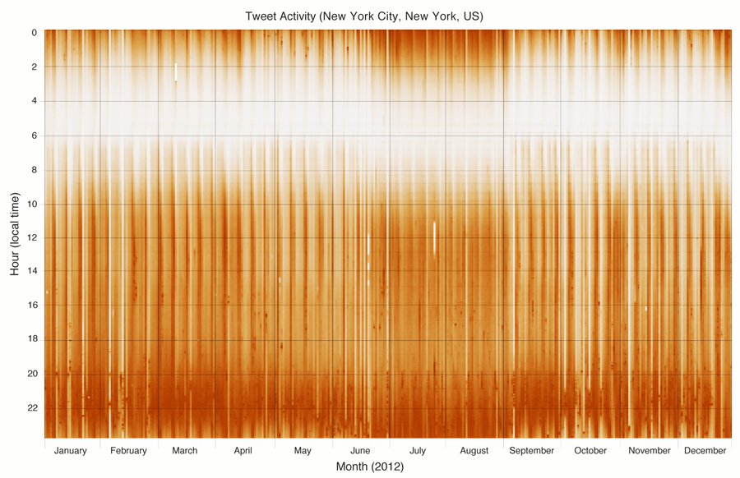
Miguel Rios and Jimmy Lin. Visualizing the “Pulse” of World Cities on Twitter. ICWSM 2013.

Slide 40
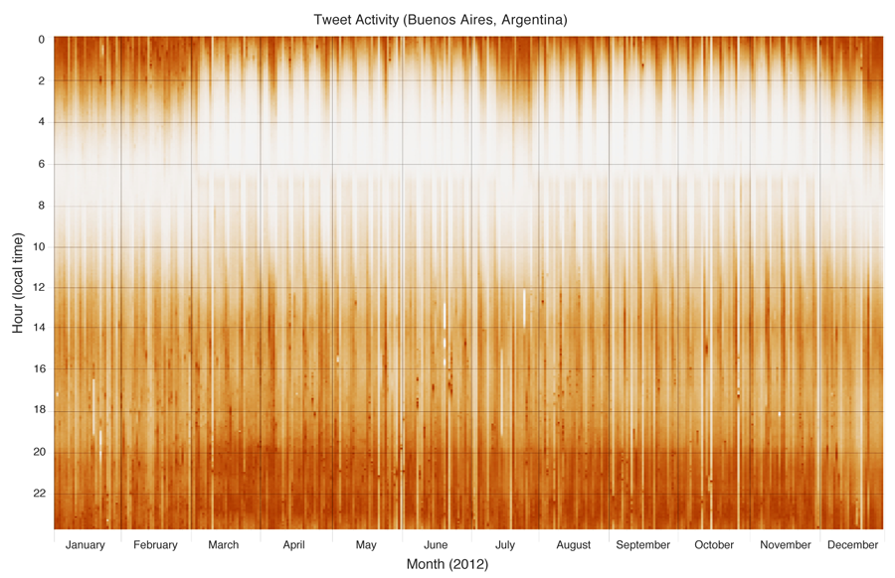
Miguel Rios and Jimmy Lin. Visualizing the “Pulse” of World Cities on Twitter. ICWSM 2013.

Slide 41
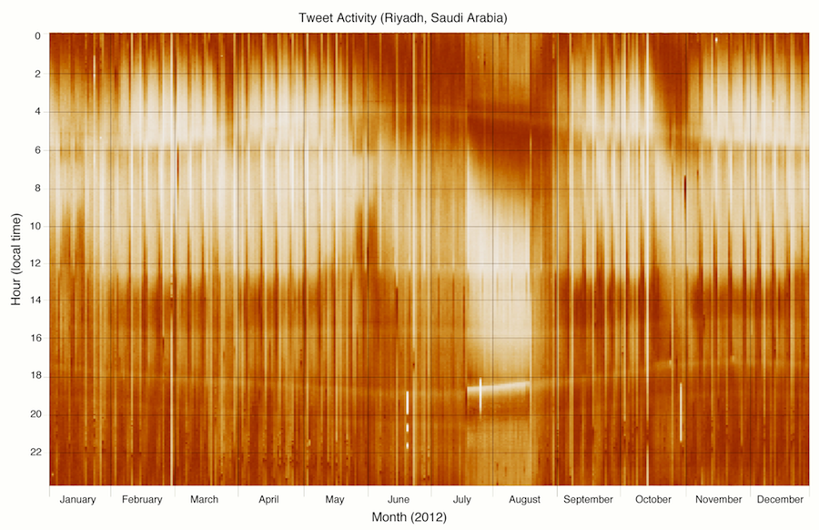
Miguel Rios and Jimmy Lin. Visualizing the “Pulse” of World Cities on Twitter. ICWSM 2013.

Slide 42
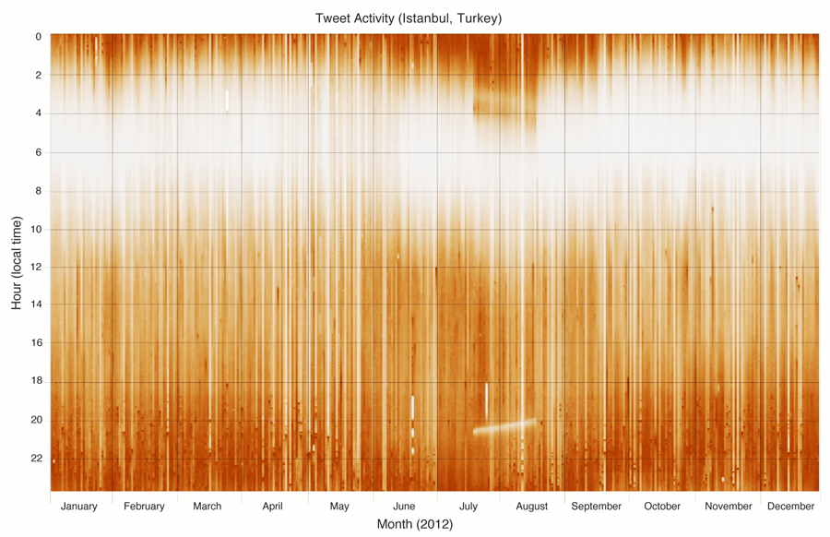
Miguel Rios and Jimmy Lin. Visualizing the “Pulse” of World Cities on Twitter. ICWSM 2013.

Slide 43
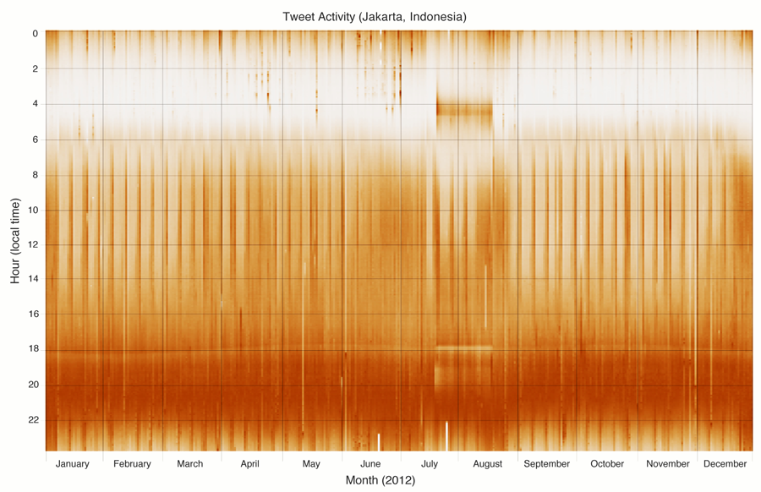
Miguel Rios and Jimmy Lin. Visualizing the “Pulse” of World Cities on Twitter. ICWSM 2013.

Slide 44
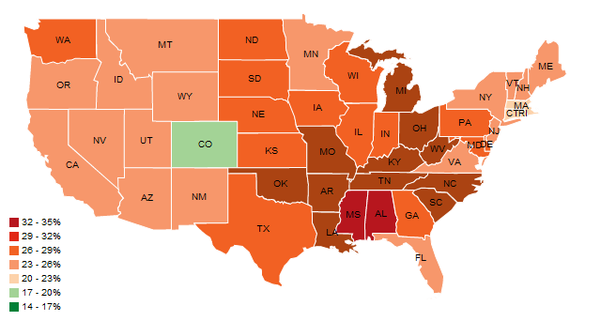
Choropleth Maps
http://hci.stanford.edu/jheer/files/zoo/

Slide 45
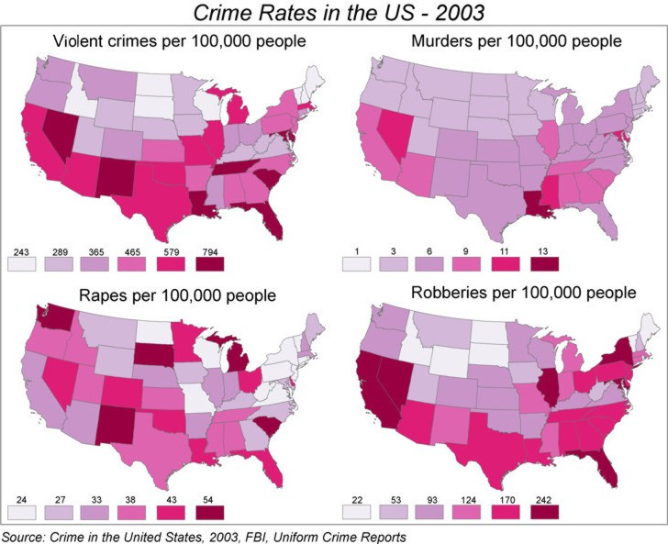
http://www.geog.ucsb.edu/~jeff/gis/choropleth_maps.html

Slide 46
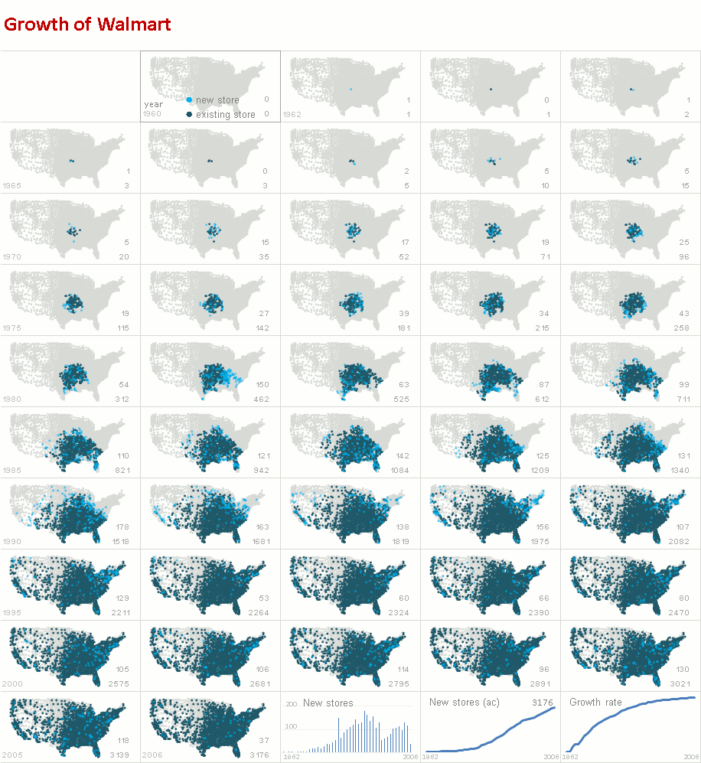
http://www.excelcharts.com/blog/animation-small-multiples-growth-walmart-excel-edition/

Slide 47
Small Multiples vs. Animations
Advantages and disadvantages?

Slide 48
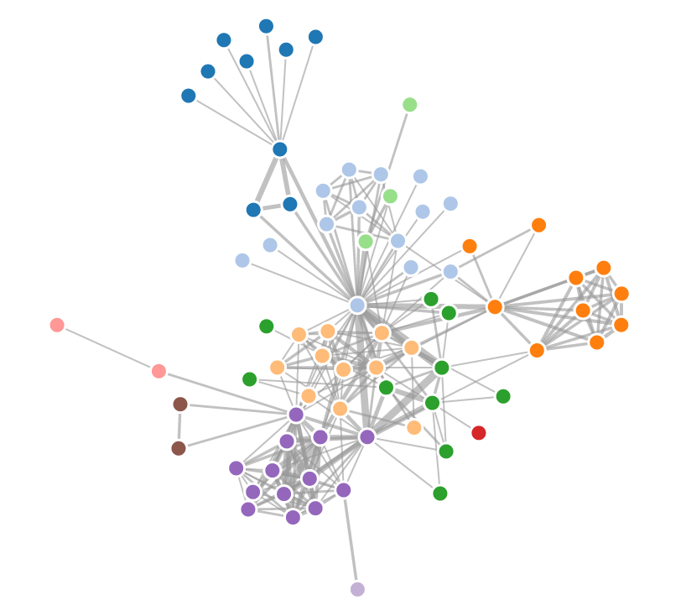
Visualizing Networks
Types of networks: social networks, interaction networks, biological networks, computer networks, etc.
Standard algorithm uses force-directed layout

