Slide 1

INFM 603: Information Technology and Organizational Context
Session 9: Visualization
Jimmy Lin
The iSchool
University of Maryland
Thursday, October 31, 2012
Material borrowed from slides by Ben Shneiderman for his visualization course

Slide 2
Visualization
Why visualizations?
  Human perceptual skills are remarkable
  Human image storage storage is fast and vast
What are visualizations for?
  A good visualization tells a story
  A great visualization delivers insight
Science as well as an art…

Slide 3
Raw Ingredients
Types of data
  Categorical data
  Ordinal data
  Numerical data
Ways of representing data
  Height
  Width
  Thickness
  Area
  Angles
  Size
  Shape
  Color

Slide 4
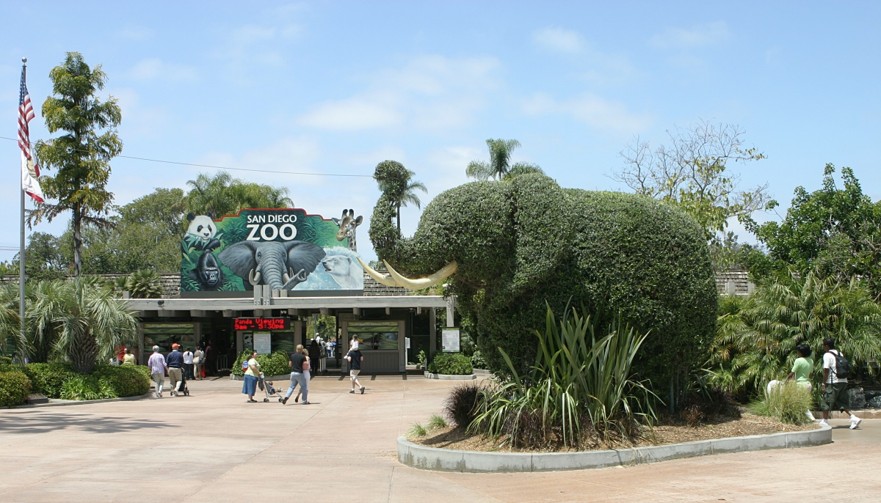

Slide 5
Static vs. Interactive
Interactive visualizations allow users to “explore” the data
  Overview
  Zoom and filter
  Details-on-demand
Brushing and linking is a powerful technique

Slide 6
Info Porn
Informative visualizations vs. info porn
Beware of infographics and chart junk

Slide 7
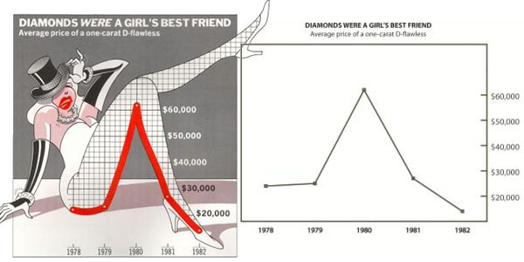
http://infosthetics.com/archives/chart_junk_effective.jpg

Slide 8
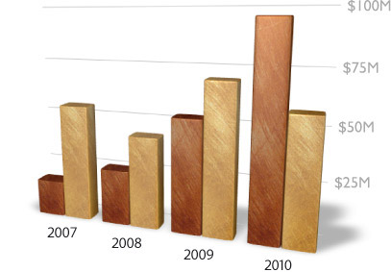
http://thedoublethink.com/wp-content/uploads/2009/07/keynote-chartjunk.jpg

Slide 9
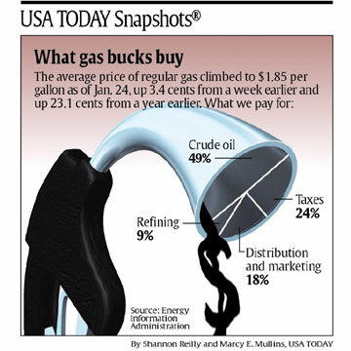
http://www.captech.org/vcp/mathmania/February/images/GasGraph.jpg

Slide 10
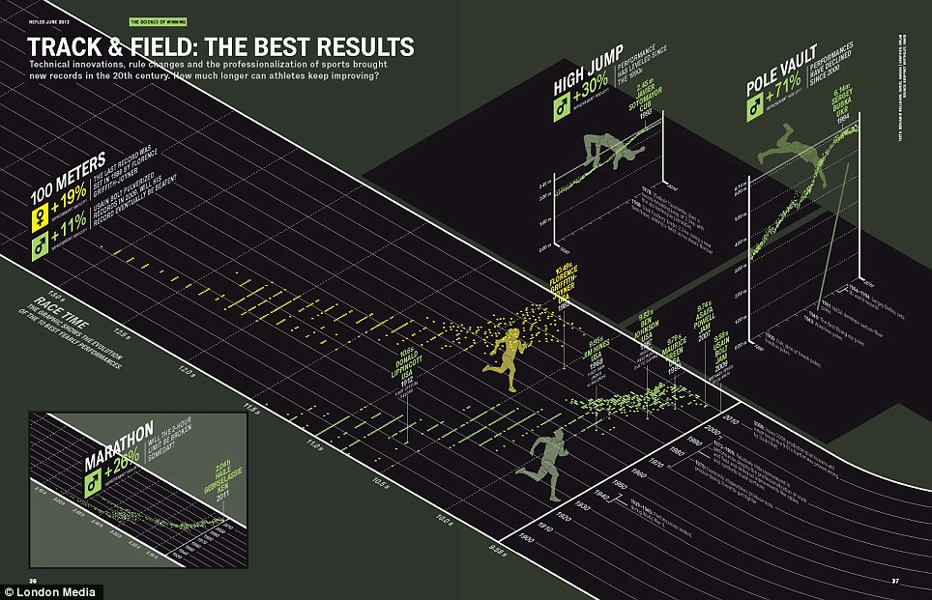
http://junkcharts.typepad.com/junk_charts/music/
Compare: New York Times interactive visualization

Slide 11
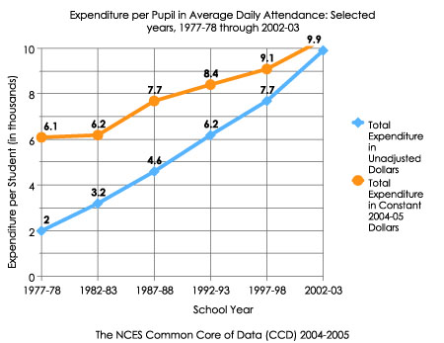
Line Graphs (+ Variants)
Suitable for what types of data?
What makes a good line graph?
http://nces.ed.gov/nceskids/help/user_guide/graph/images/line.jpg

Slide 12
Stacked Graphs
Multiple time-series data “stacked” on top of each other
  Useful for showing aggregates
Sometimes called “stream graphs”

Slide 13
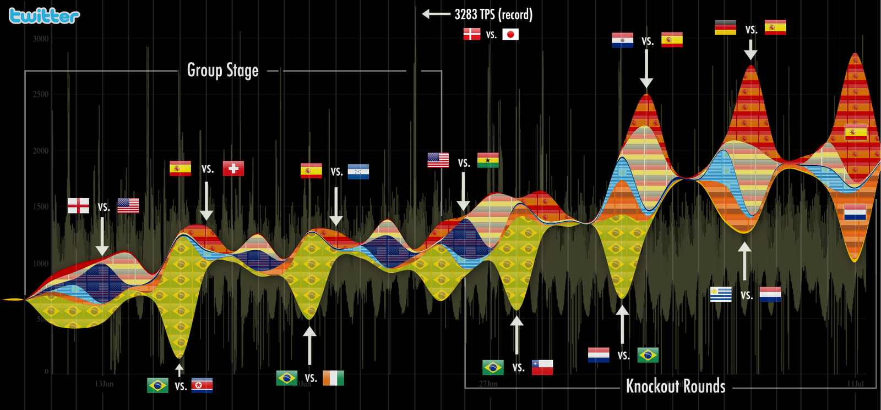

Slide 14
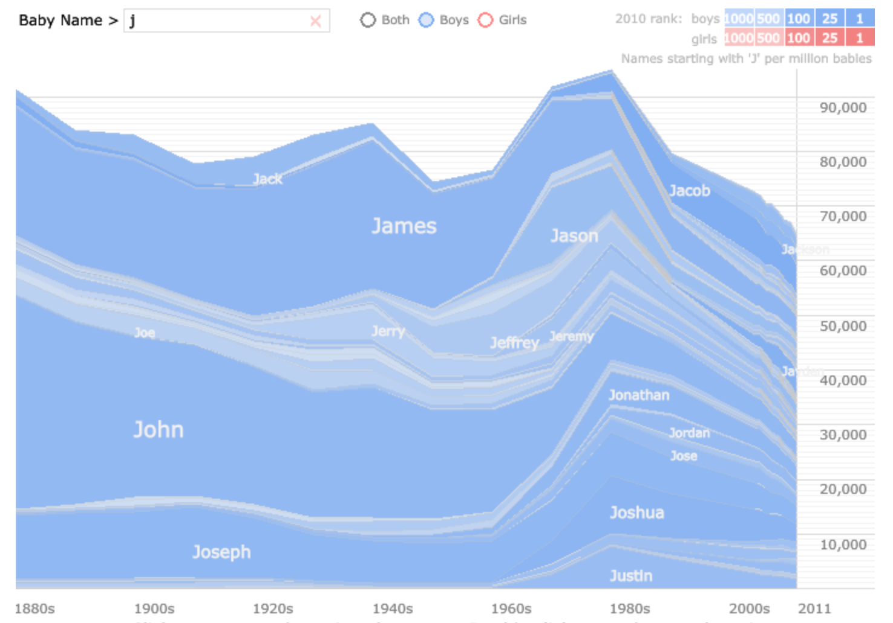
http://www.babynamewizard.com/voyager#

Slide 15
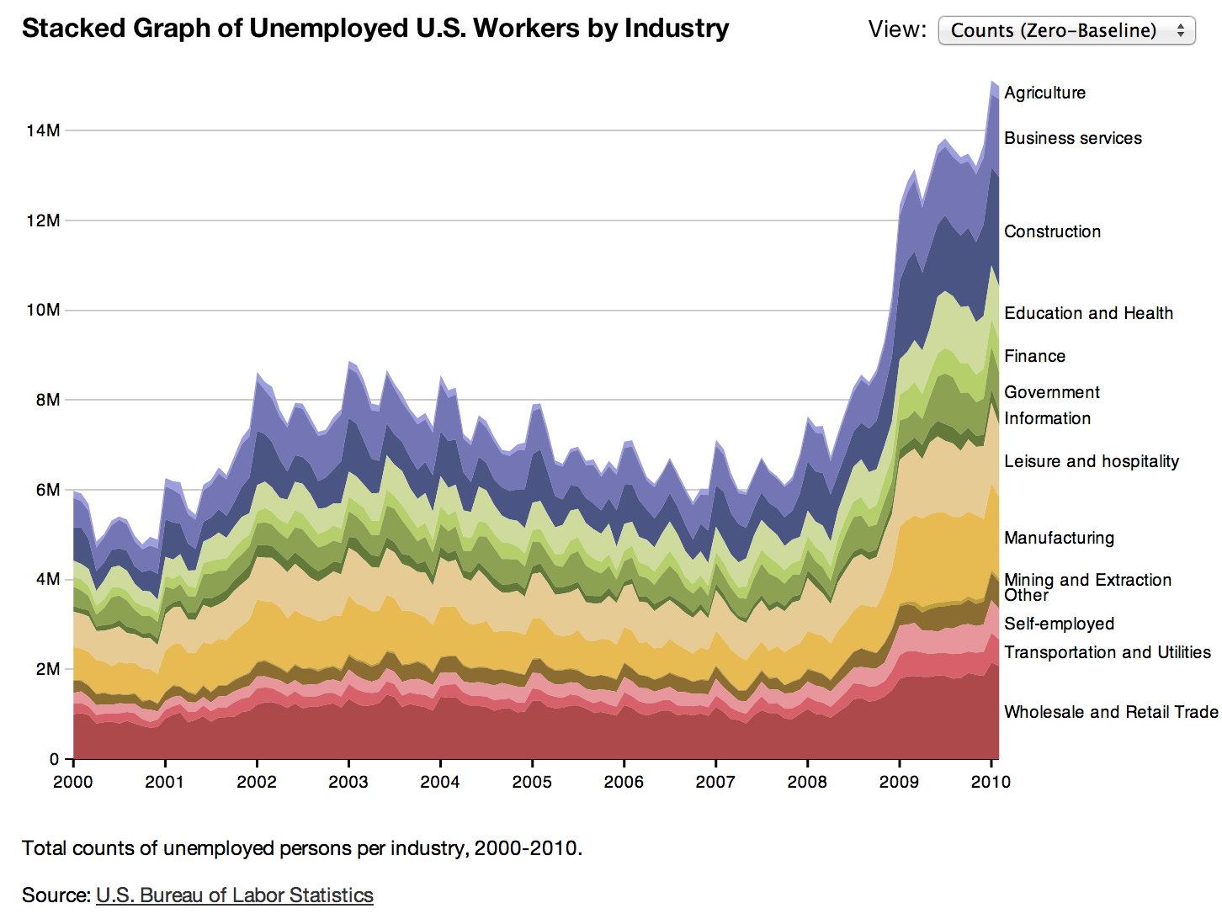
http://hci.stanford.edu/jheer/files/zoo/

Slide 16
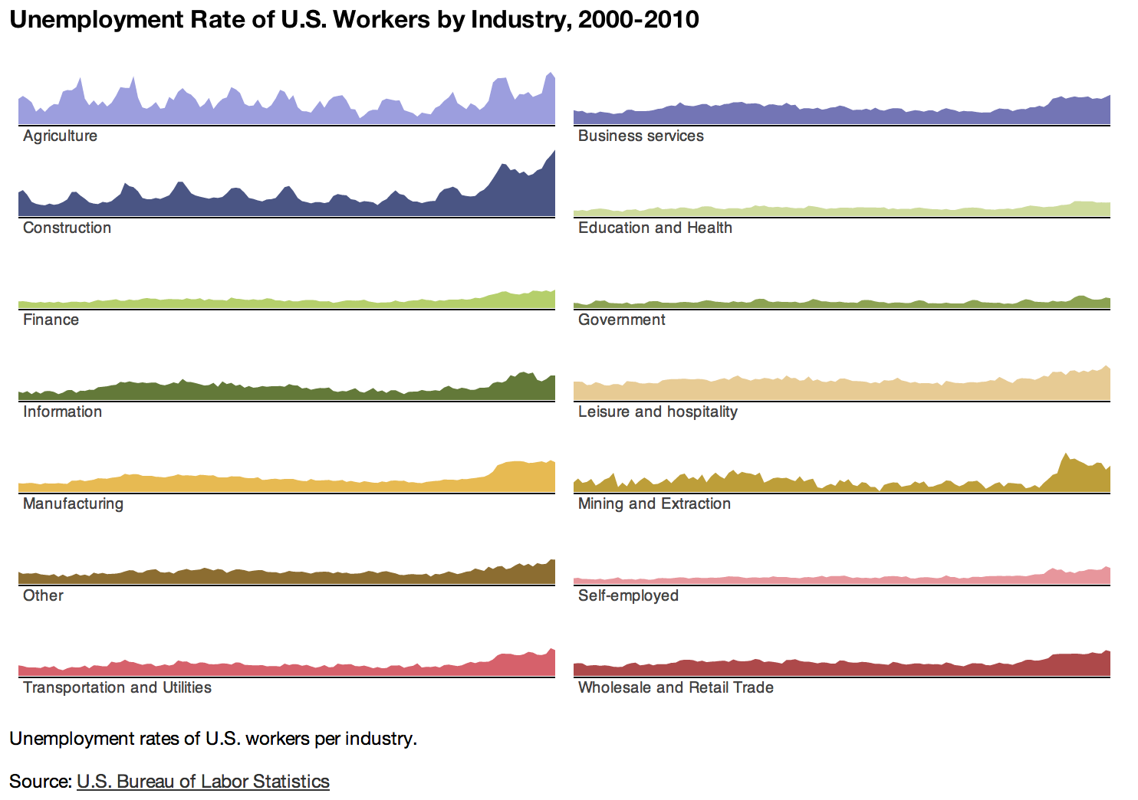
http://hci.stanford.edu/jheer/files/zoo/

Slide 17
Small Multiples
Multiple small graphs arranged in a grid
Advantages and disadvantages?

Slide 18
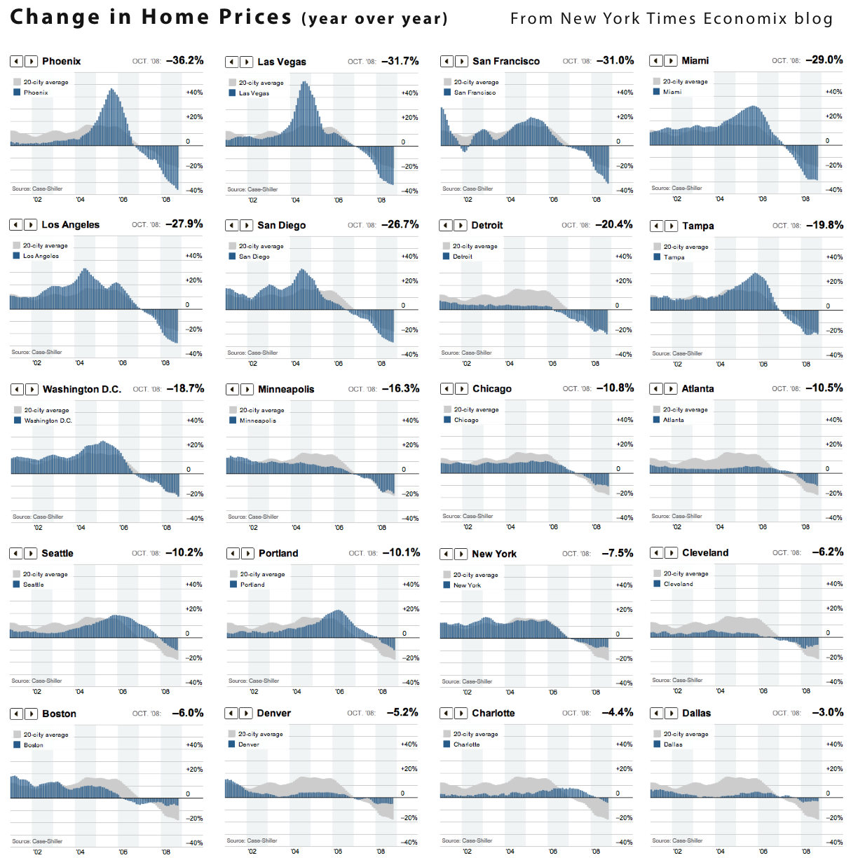
http://informationdesignmdippold.files.wordpress.com/2011/06/good-id-1.jpg

Slide 19
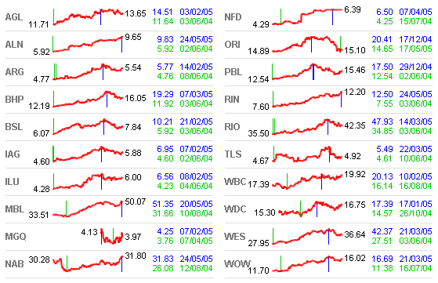
Spark Lines
http://www.plainlanguage.com.au/sparklines.png

Slide 20
Bar Graphs (+ Variants)
Suitable for what types of data?
Following examples from d3.js

Slide 21
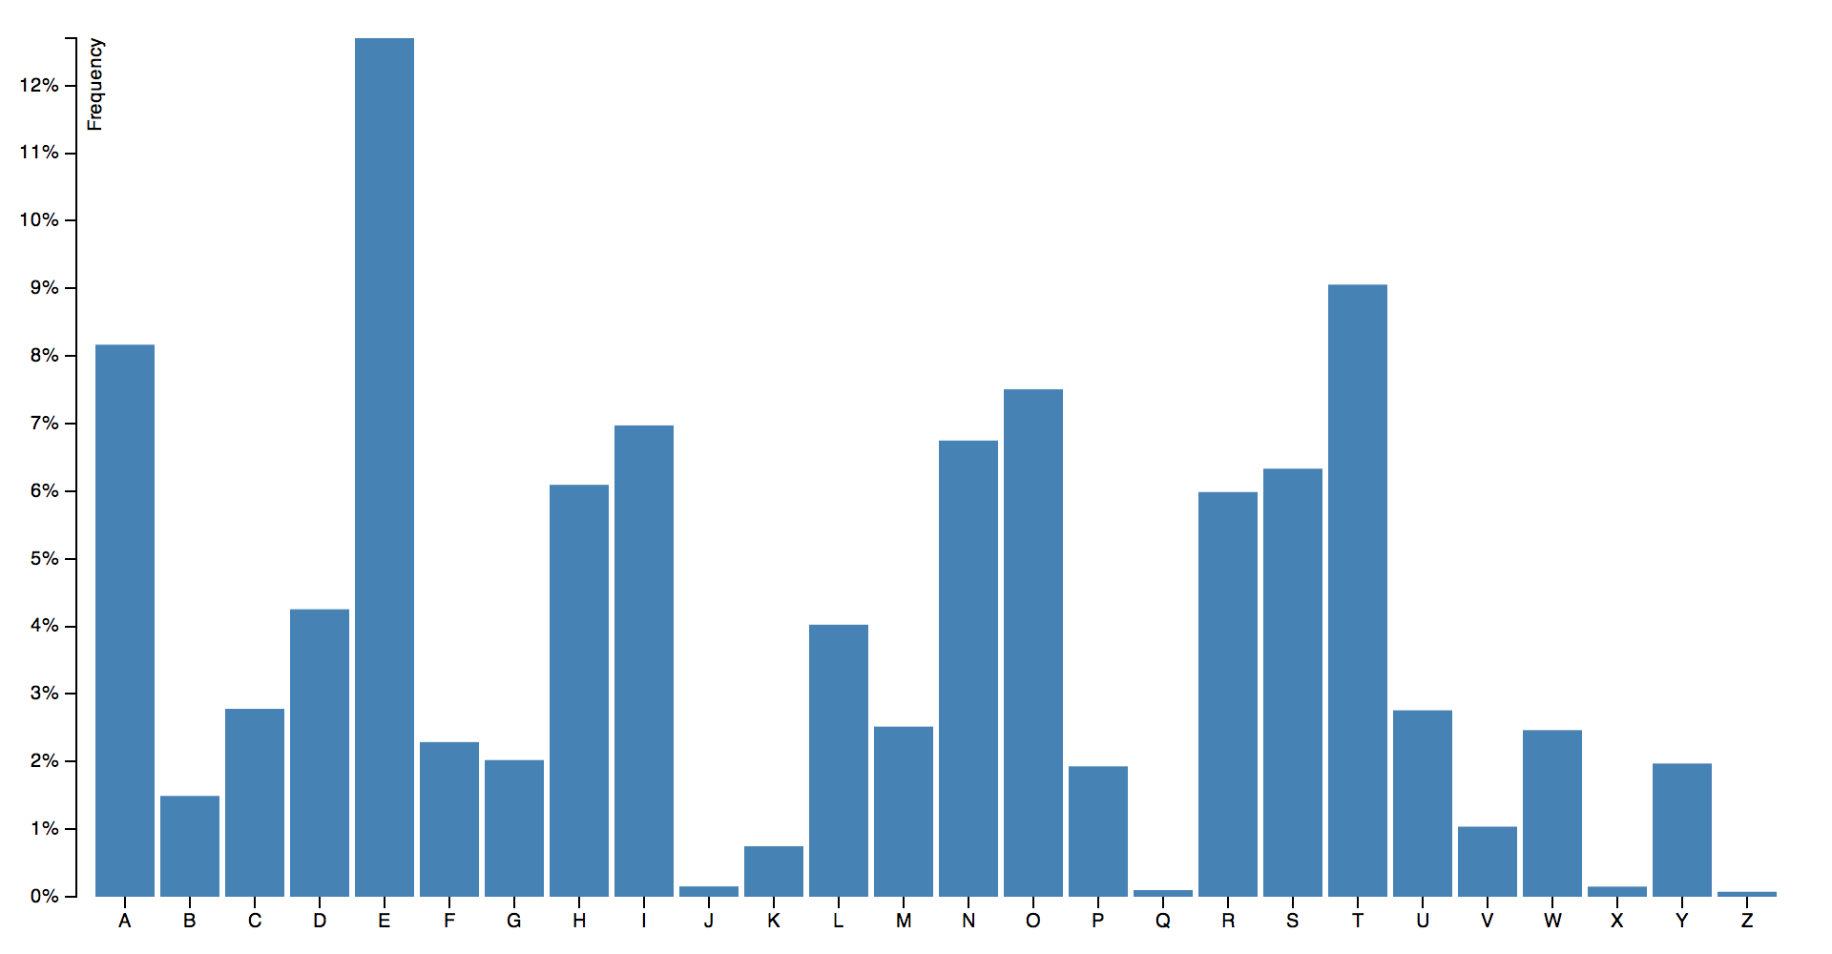

Slide 22
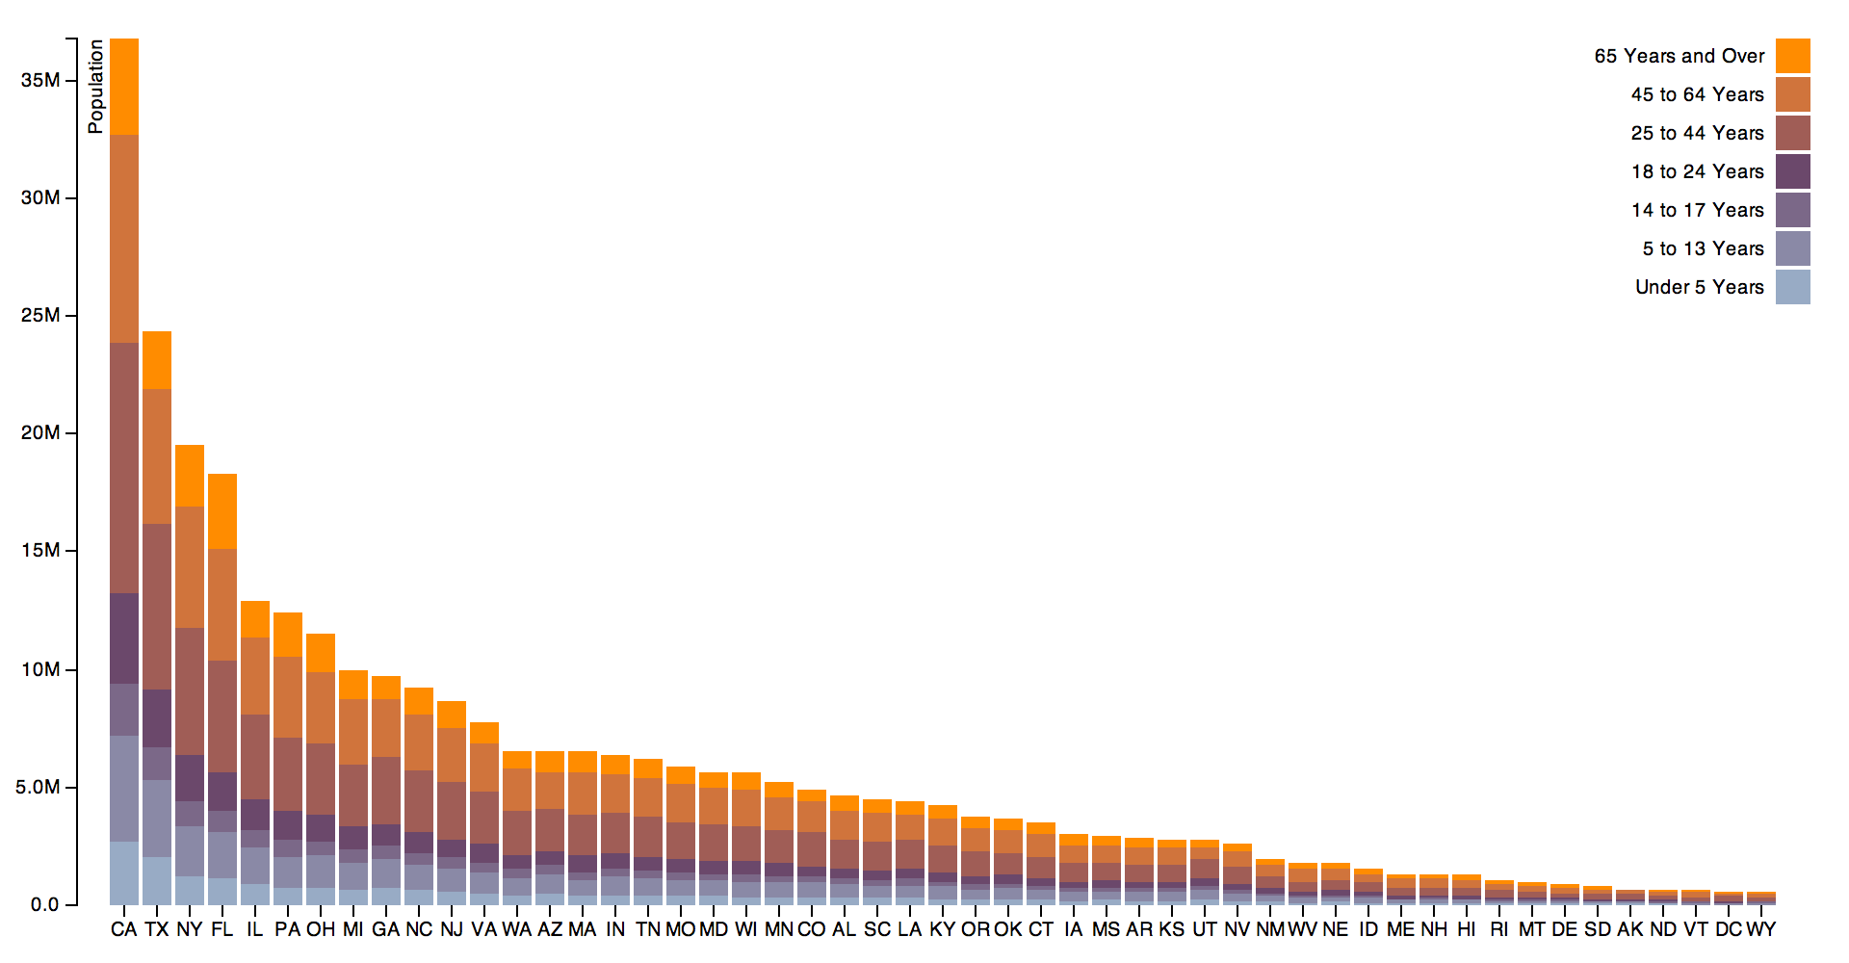

Slide 23
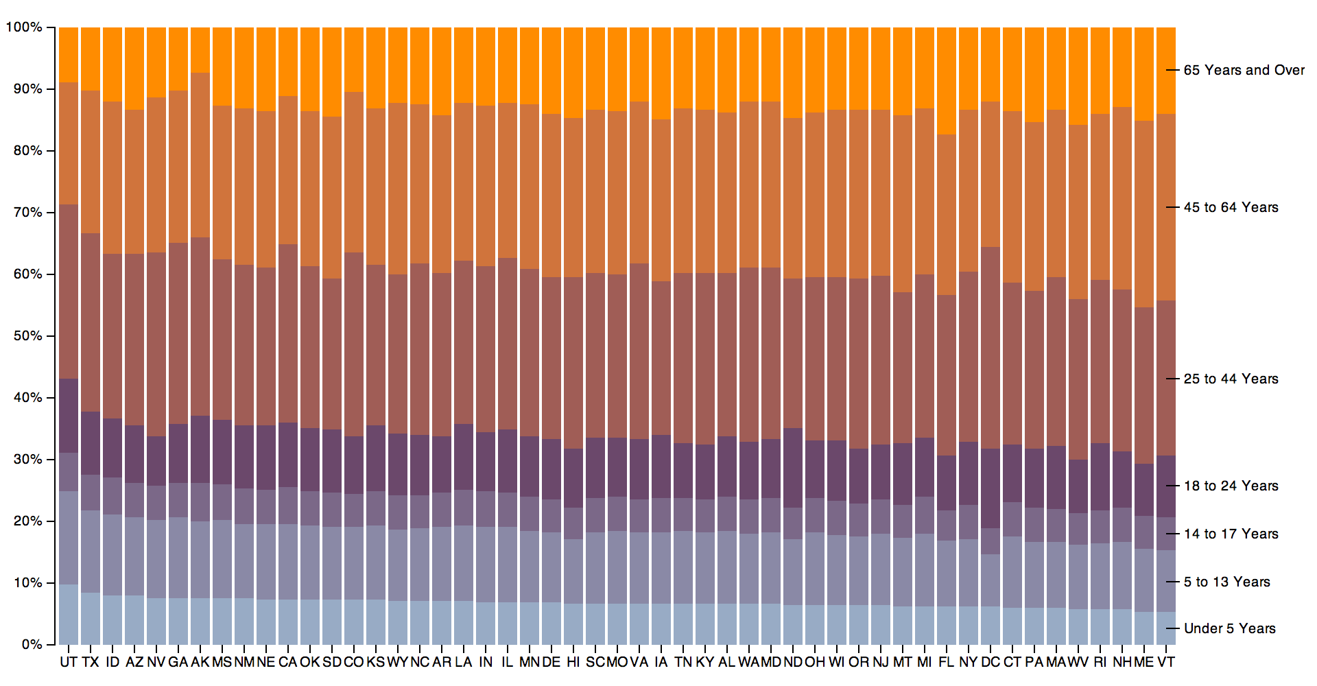

Slide 24
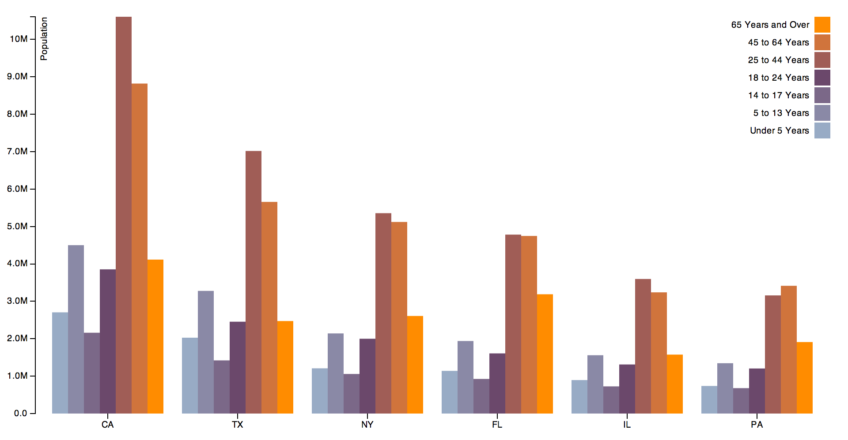

Slide 25
Scatterplots
Suitable for what types of data?
Note availability of other ways to encode data at points

Slide 26
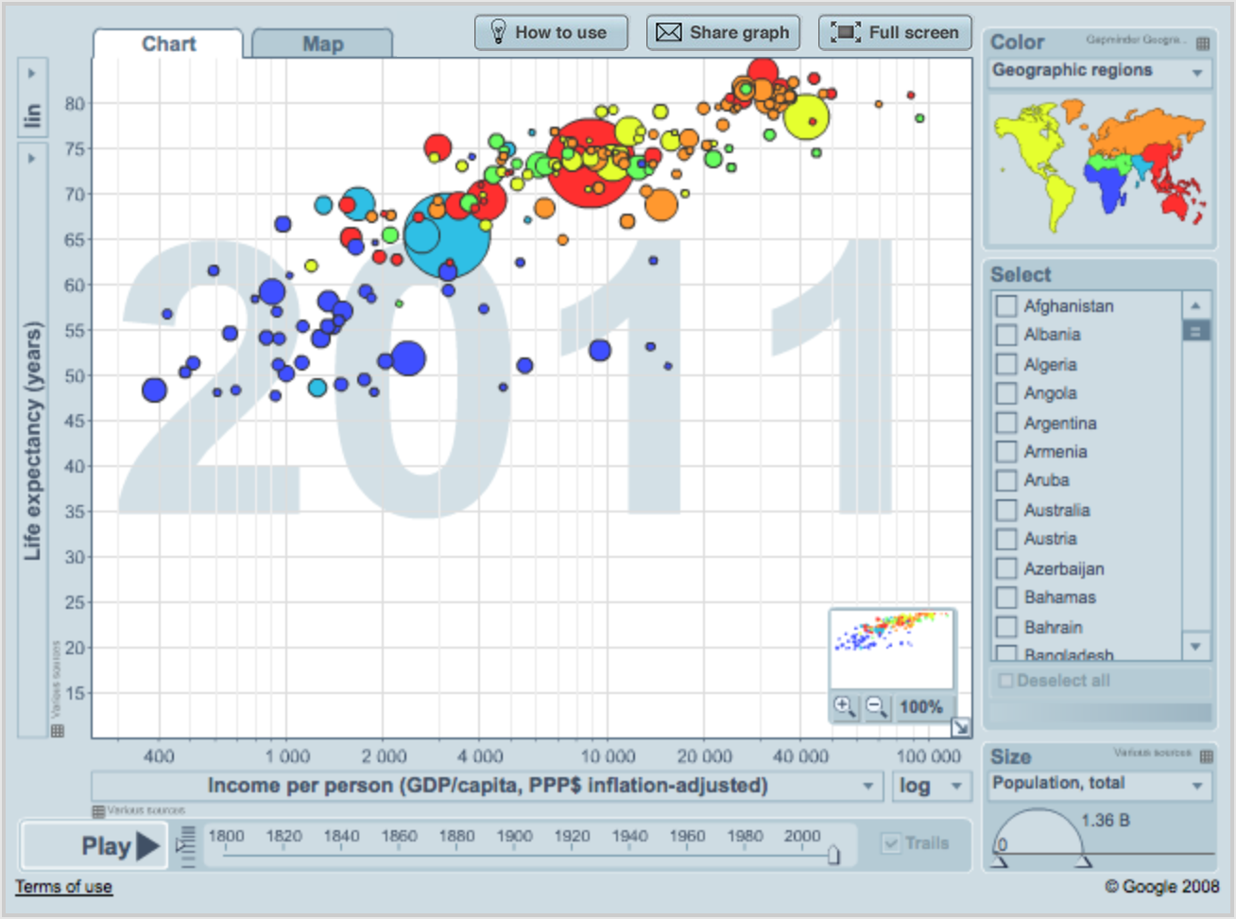
http://www.gapminder.org/

Slide 27
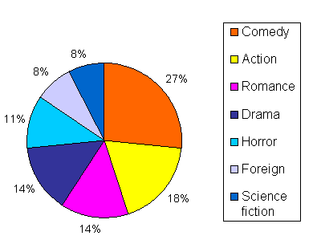
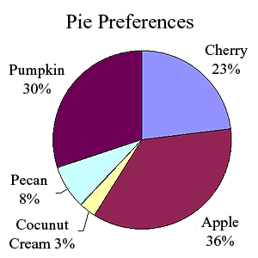
Pie Charts (+ Variants)
Suitable for what types of data?
Different ways for labeling

Slide 28
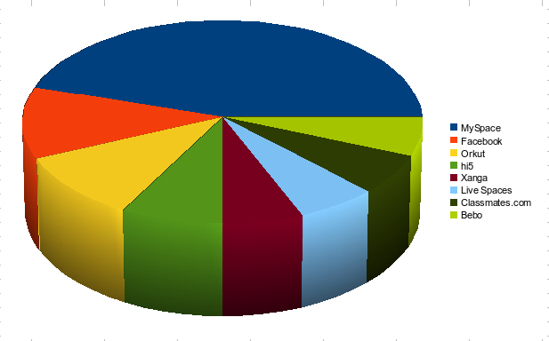
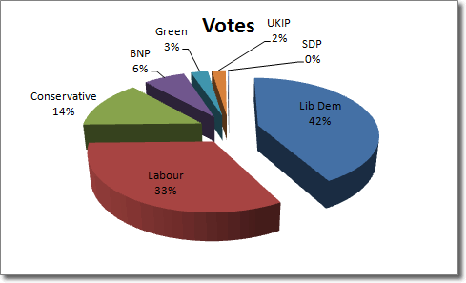
More Chart Junk

Slide 29
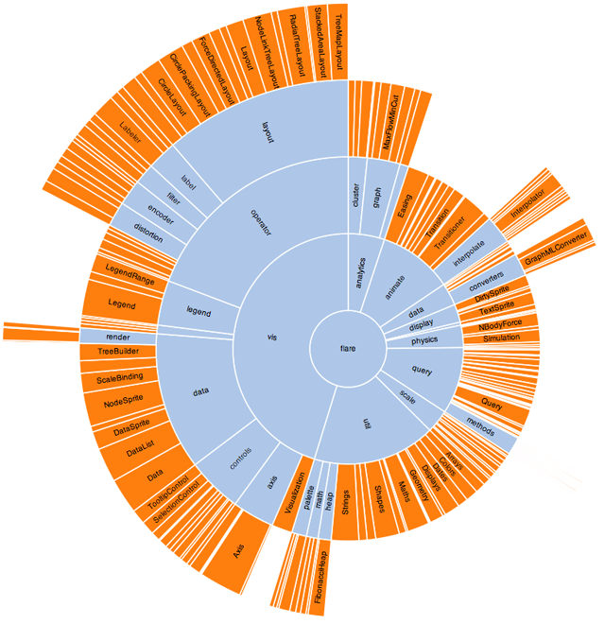
Sunburst Trees
http://hci.stanford.edu/jheer/files/zoo/

Slide 30
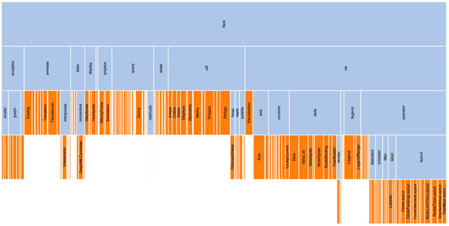
Icicle Diagrams
http://hci.stanford.edu/jheer/files/zoo/

Slide 31
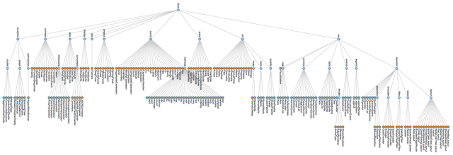
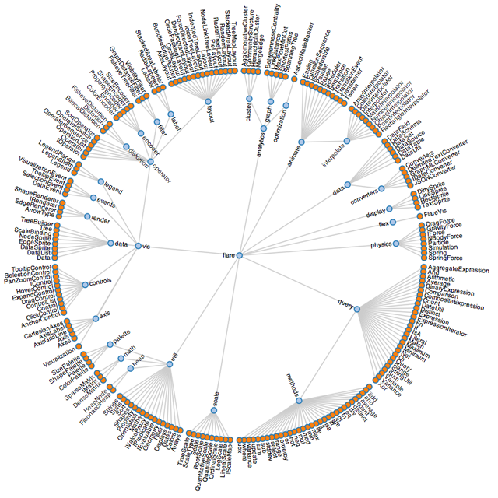
Visualizing Hierarchies
http://hci.stanford.edu/jheer/files/zoo/

Slide 32
TreeMaps
Useful for representing hierarchical relationships
Two mechanisms for coding information:
  Size and Color
  Physical location of boxes not usually meaningful
Requires learning to read

Slide 33
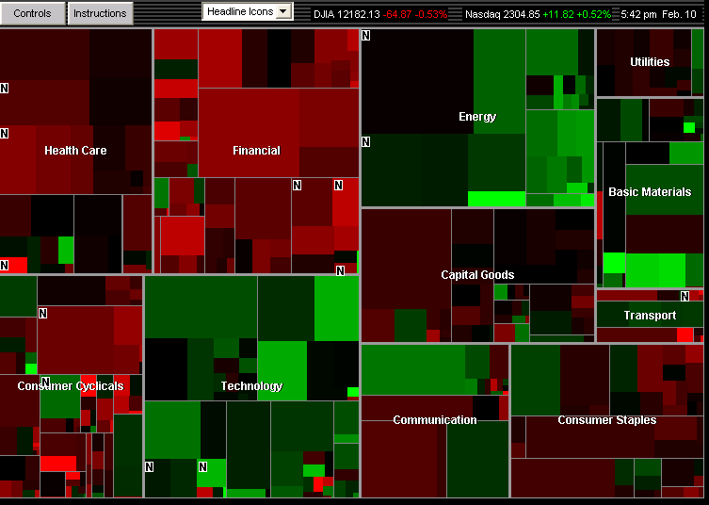
http://www.smartmoney.com/map-of-the-market/

Slide 34
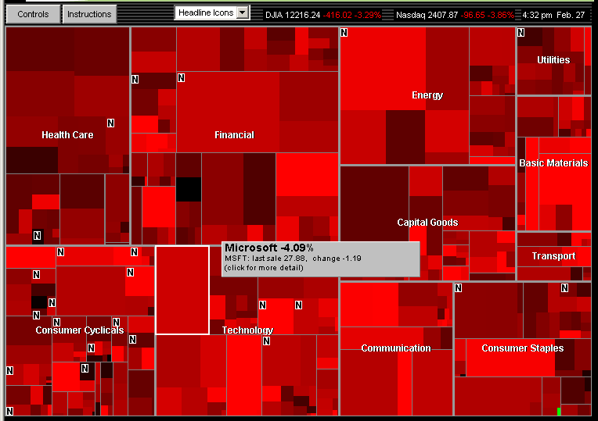
Market mixed, February 8, 2008:
Energy & Technology up, Financial & Health Care down

Slide 35
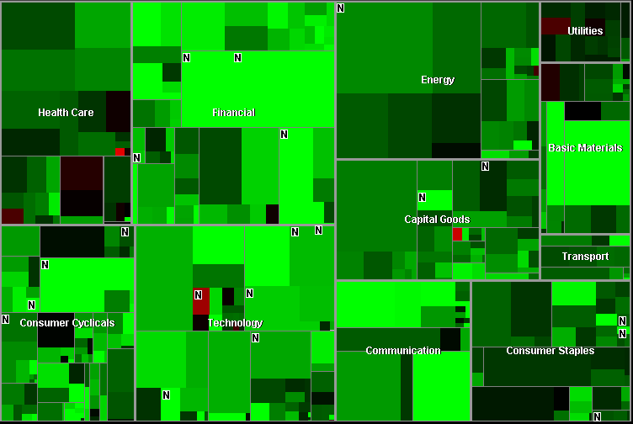
Market rises 319 points, November 13, 2007:
Five exceptions

Slide 36
Heatmaps
Data represented in a matrix
Matrix values are code coded

Slide 37
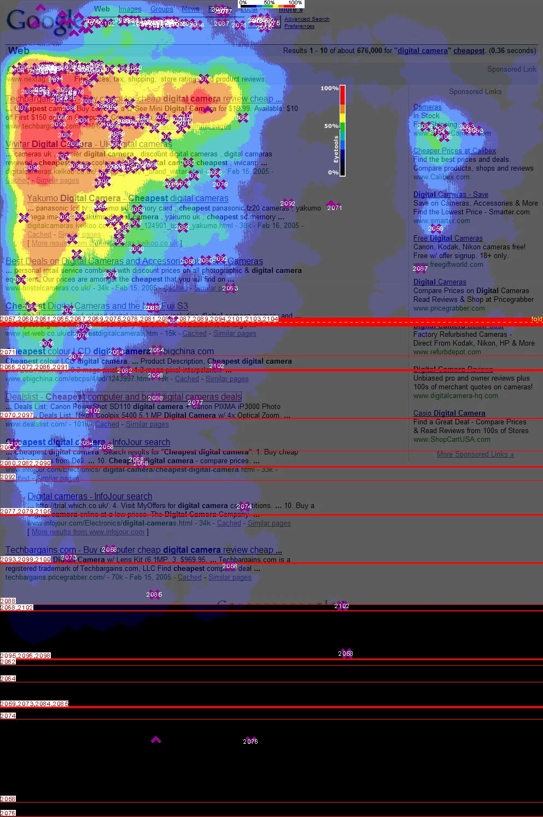
http://eyetools.com/images/blog/2/google/eyetools_google_search.jpg

Slide 38
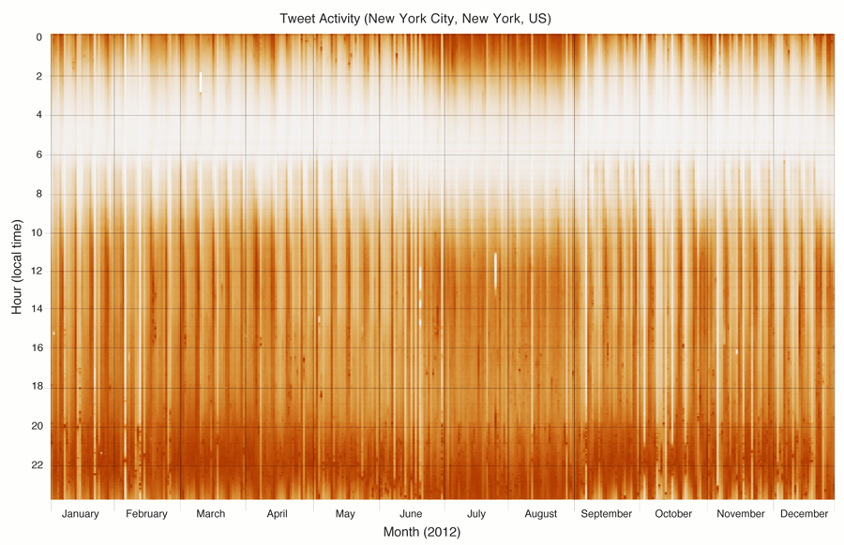
Miguel Rios and Jimmy Lin. Visualizing the “Pulse” of World Cities on Twitter. ICWSM 2013.

Slide 39
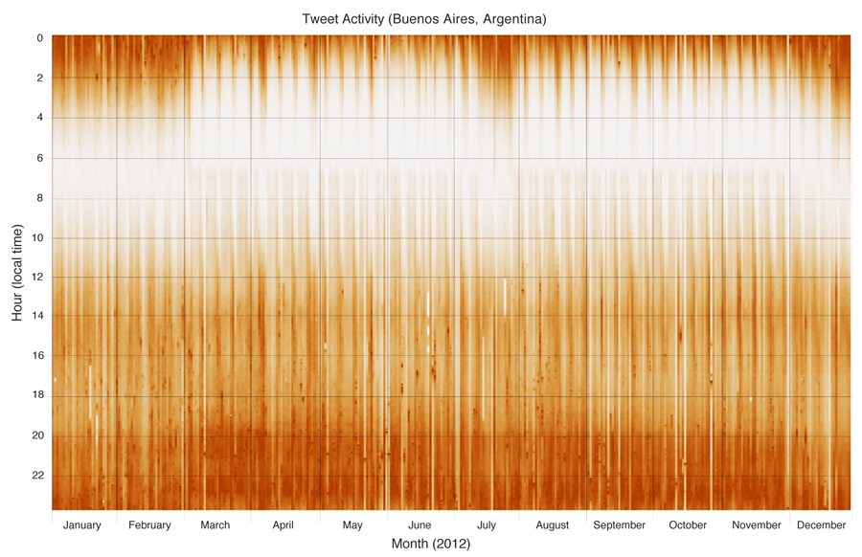
Miguel Rios and Jimmy Lin. Visualizing the “Pulse” of World Cities on Twitter. ICWSM 2013.

Slide 40
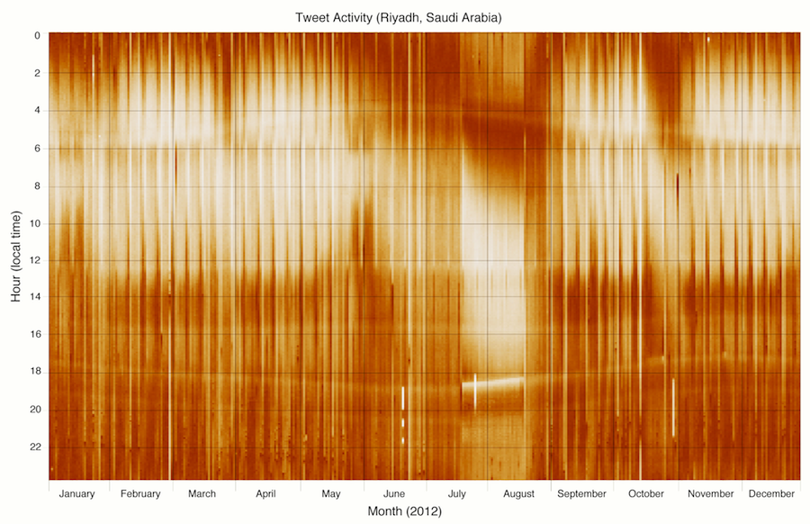
Miguel Rios and Jimmy Lin. Visualizing the “Pulse” of World Cities on Twitter. ICWSM 2013.

Slide 41
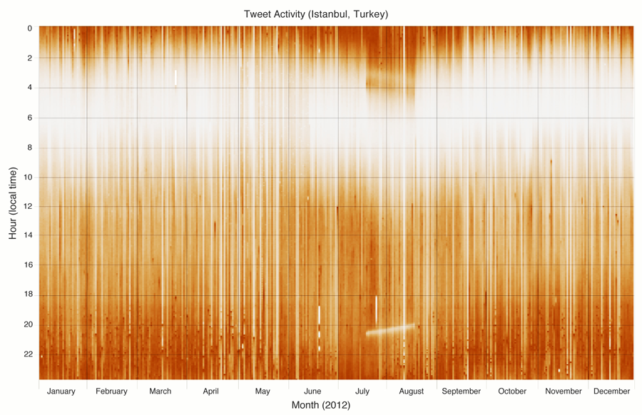
Miguel Rios and Jimmy Lin. Visualizing the “Pulse” of World Cities on Twitter. ICWSM 2013.

Slide 42
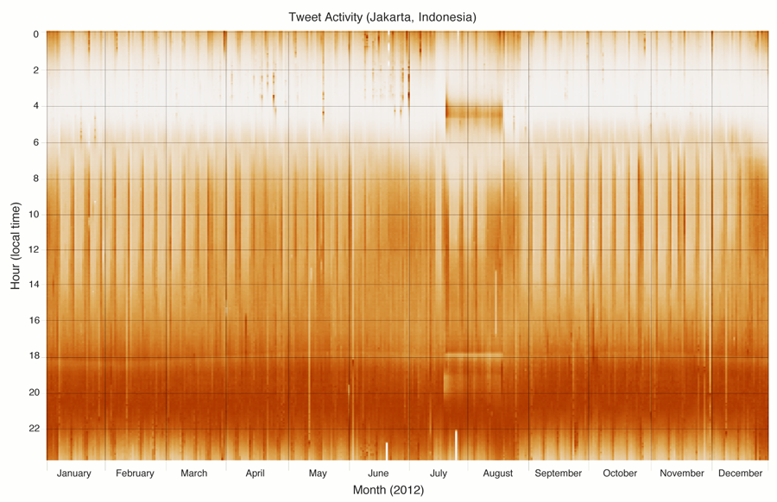
Miguel Rios and Jimmy Lin. Visualizing the “Pulse” of World Cities on Twitter. ICWSM 2013.

Slide 43
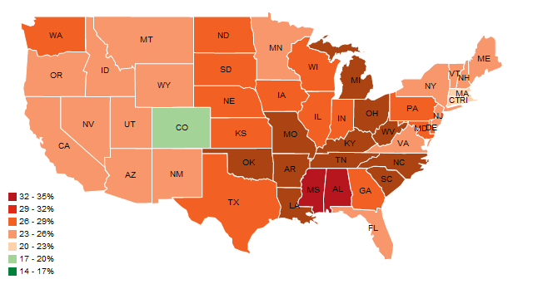
Choropleth Maps
http://hci.stanford.edu/jheer/files/zoo/

Slide 44
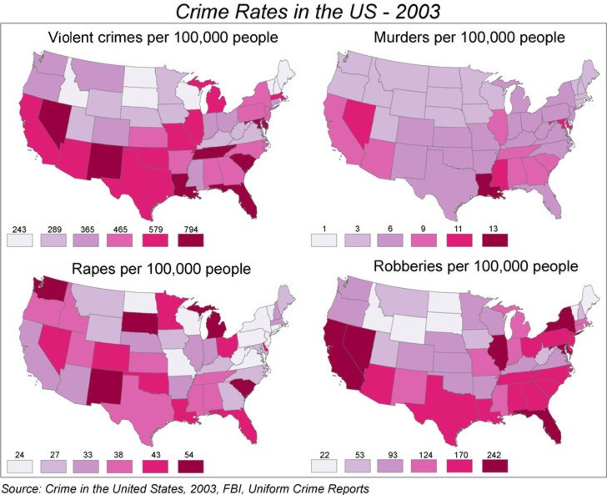
http://www.geog.ucsb.edu/~jeff/gis/choropleth_maps.html

Slide 45
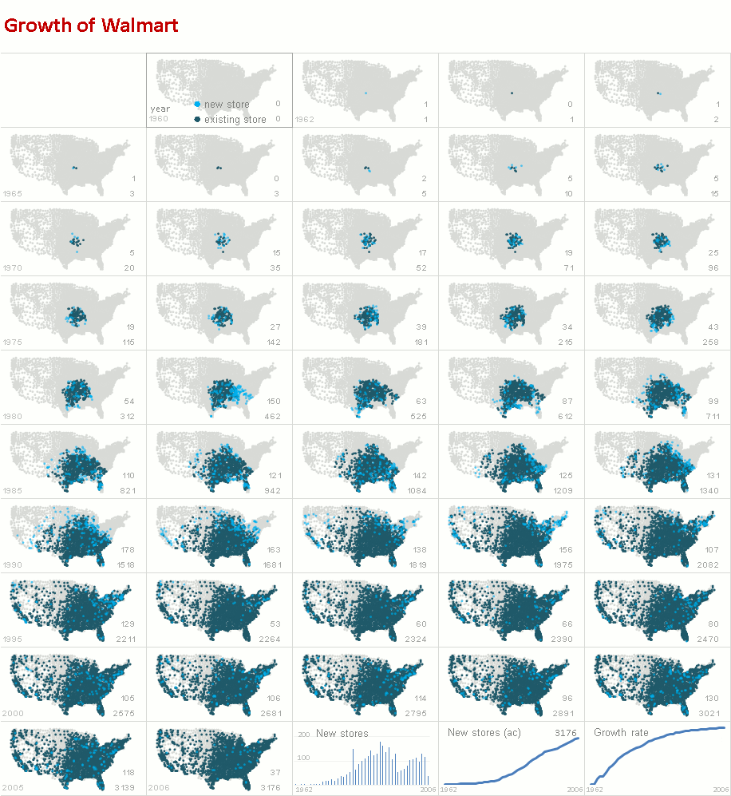
http://www.excelcharts.com/blog/animation-small-multiples-growth-walmart-excel-edition/

Slide 46
Small Multiples vs. Animations
Advantages and disadvantages?

Slide 47
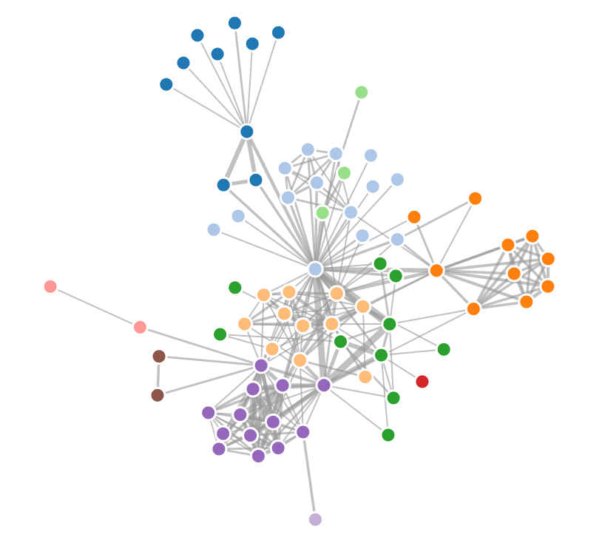
Visualizing Networks
Types of networks: social networks, interaction networks, biological networks, computer networks, etc.
Standard algorithm uses force-directed layout

