Slide 1

INFM 603: Information Technology and Organizational Context
Session 8: Ajax and Asynchronous Programming
Jimmy Lin
The iSchool
University of Maryland
Thursday, October 25, 2012

Slide 2
RideShare Exercise
Design a database to match drivers with passengers for ride sharing on long car trips:
  Drivers post available seats; they want to know about interested passengers
  Passengers come looking for rides: they want to know about available rides and can make reservations
  These things happen in no particular order
  To simplify, passengers don’t get to post “rides wanted” ads
Build a web application to accomplish the above

Slide 3
RideShare Exercise: Tasks
Design the tables you will need
  First decide what information you need to keep track of
  Then design tables to capture this information
Design SQL queries
  What happens when a passenger comes looking for a ride?
  What happens when a driver comes to find out who the passengers are?
Role play!

Slide 4
Tables
Ride: Ride ID, Driver ID, Origin, Destination, Available Seats
Passenger: Passenger ID, Name, Address, Phone Number
Driver: Driver ID, Name, Address, Phone Number
Booking: Ride ID, Passenger ID

Slide 5
Queries
Passenger searches for a ride:
  Join: Ride, Driver
  Where: Origin and Destination match request, Available Seats > 0
  Select: Name, Phone Number
Passenger “books” a ride:
  Assuming successful search above: decrease Available Seats by one
  Insert row into Booking table with Ride ID and Passenger ID
Driver ready to go: Who are my passengers?
  Join: Ride, Passenger, Booking
  Where: (Driver) Name, Origin, and Date match
  Select: (Passenger) Name, Phone Number

Slide 6
Demo
We’re going to build the RideShare web app…
Like, right now!

Slide 7
Slight Simplification
Ride table:
  RideId
  Driver (name)
  Phone
  Origin
  Destination
  Date
  Seats
Booking table:
  RideId
  Passenger (name)
  Phone

Slide 8
Today
More JavaScript!
Ajax
JSON
More PHP!

Slide 9
Synchronous vs. Asynchronous
Definitions
  Synchronous: happening, existing, or arising at precisely the same time
  Asynchronous: not synchronous
Communications
  Synchronous
  Asynchronous
Programming
  Synchronous
  Asynchronous

Slide 10
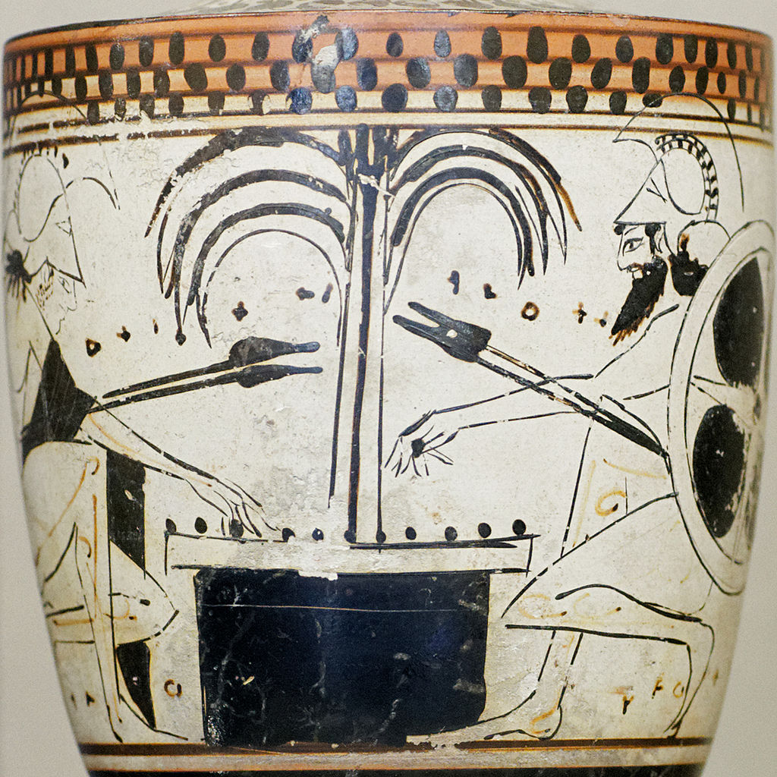
Ajax

Slide 11
What’s Ajax?
Asynchronous JavaScript and XML
The only thing you need to learn:
Get this URL
var url = "...";
var request = new XMLHttpRequest();
request.open("GET", url);
request.onload = function() {
if (request.status == 200) {
// Your code here
}
};
request.send(null);
Callback function

Slide 12

What’s at the URL?
A static file (e.g., JSON)
{
name: "Fido",
weight: 40,
breed: "Mixed",
loves: ["walks", "fetching balls"]
}

Slide 13
What’s at the URL?
An application programming interface (API)
How do we write APIs?
http://search.twitter.com/search.json?q=justin+bieber
Think of this as a function call!
argument1=value&argument2=value...

Slide 14

Got it?
Source: The Matrix

