Slide 1
Applications (2 of 2): Recognition, Transduction, Discrimination, Segmentation, Alignment, etc.
Kenneth Church
Kenneth.Church@jhu.edu

Slide 2
Solitaire → Multiplayer Games: Auctions (Ads) http://www.scienceoftheweb.org/15-396/lectures/lecture09.pdf
Right Rail
Right Rail: Avoid distortions from commercial interests
Mainline Ad

Slide 3
A Single Auction → A Stream of Continuous Auctions
Standard Example of Second Price Auction
Single Auction for a Single Apple
Theoretical Result
Second Price Auction → Truth Telling
http://en.wikipedia.org/wiki/Vickrey_auction
Optimal Strategy:
Bid what the apple is worth to you
Don’t worry about what it is worth to others
First Price Auction → Truth Telling
Does theory generalize to a continuous stream?

Slide 4
Pricing: Cost Per Click (CPC)
B_{i} = your bid
B_{i+1} = next bid
CTR_{i} = your click through rate
CTR_{i+1} = next click through rate
CPC_{i} = your price
(if we show your ad and user clicks)
Improvement: CTR → Q (Prior)
Single Auction:
CPC_{i} = B_{i+1}
Continuous Stream:
CPC_{i} = B_{i+1} CTR_{i+1} / CTR_{i}
Equilibrium
Advertisers
Awareness
Sales
New Customers
ROI
Users
Minimize pain
Obtain Value
Market Maker
Maximize Revenue
Truth Telling?

Slide 5
Multi-Player Games → Many Technical Opportunities
Economics
http://www.wired.com/culture/culturereviews/magazine/17-06/nep_googlenomics?currentPage=all
Machine Learning
Learning to Rank
Estimate CTR (Q/Priors)
Sparse Data:
What is the CTR for a new ad?
Errors can be expensive
If CTR is too low for new ad → Penalize Growth
If too high → Reward Bad Guys to do Bad Things
Truth Telling for Continuous Auctions?
Probably not, especially if participants can estimate Q better than market maker
Machine Learning: Solitaire → Multi-Player Games
Can I estimate Q better than you can? Man-eating tiger

Slide 6
Applications
Recognition: Shannon’s Noisy Channel Model
Speech, Optical Character Recognition (OCR), Spelling
Transduction
Part of Speech (POS) Tagging
Machine Translation (MT)
Parsing: ???
Ranking
Information Retrieval (IR)
Lexicography
Discrimination:
Sentiment, Text Classification, Author Identification, Word Sense Disambiguation (WSD)
Segmentation
Asian Morphology (Word Breaking), Text Tiling
Alignment: Bilingual Corpora, Dotplots
Compression
Language Modeling: good for everything

Slide 7
Speech → Language Shannon’s: Noisy Channel Model
Language
Model
Channel
Model
I → Noisy Channel → O
I΄ ≈ ARGMAX_{I} Pr(I|O) = ARGMAX_{I} Pr(I) Pr(O|I)
Trigram Language Model
Word | Rank | More likely alternatives
We | 9 | The This One Two A Three Please In
need | 7 | are will the would also do
to | 1
resolve | 85 | have know do…
all | 9 | The This One Two A Three Please In
of | 2 | The This One Two A Three Please In
the | 1
important | 657 | document question first…
issues | 14 | thing point to
Channel Model
Application | Input | Output
Speech Recognition | writer | rider
OCR (Optical Character Recognition) | all | a1l
Spelling Correction | government | goverment
Application
Independent

Slide 8
Speech → Language Using (Abusing) Shannon’s Noisy Channel Model: Part of Speech Tagging and Machine Translation
Speech
Words → Noisy Channel → Acoustics
OCR
Words → Noisy Channel → Optics
Spelling Correction
Words → Noisy Channel → Typos
Part of Speech Tagging (POS):
POS → Noisy Channel → Words
Machine Translation: “Made in America”
English → Noisy Channel → French
Didn’t have the guts to use this slide at Eurospeech (Geneva)

Slide 10
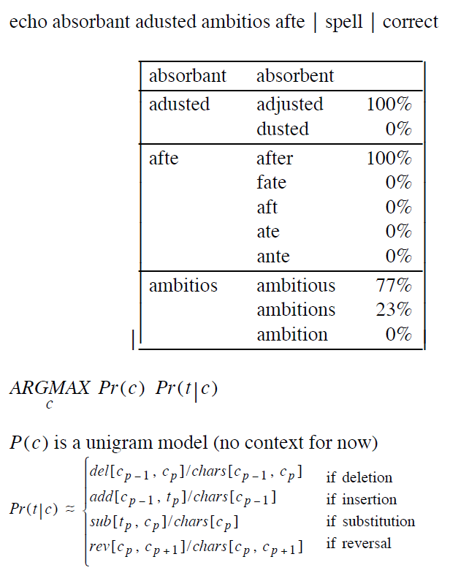
Spelling Correction

Slide 11
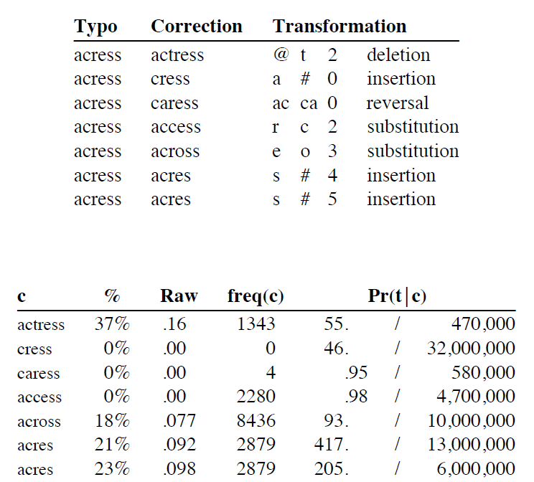

Slide 12
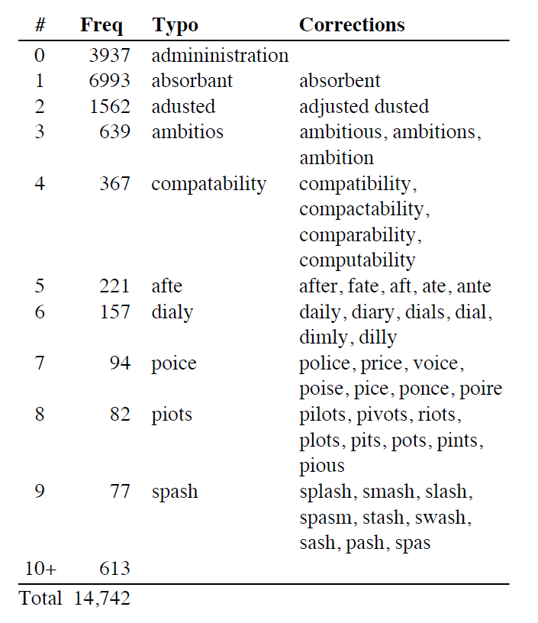

Slide 13
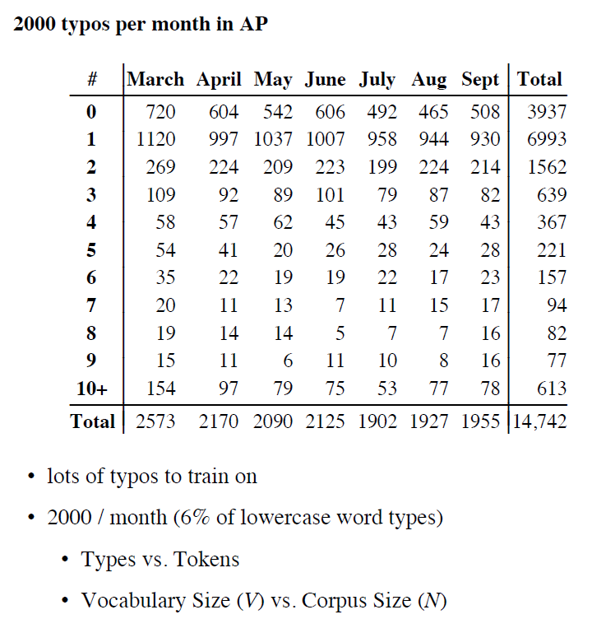

Slide 14
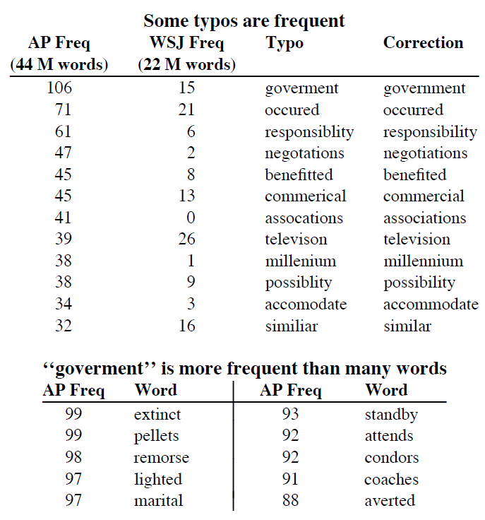

Slide 15
Evaluation

Slide 16
Performance

Slide 17
The Task is Hard without Context

Slide 18
Easier with Context
actuall, actual, actually
… in determining whether the defendant actually will die.
constuming, consuming, costuming
conviced, convicted, convinced
confusin, confusing, confusion
workern, worker, workers

Slide 19
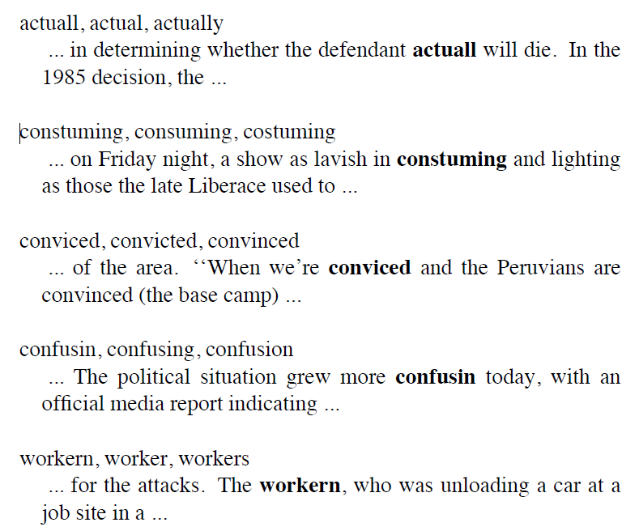
Easier with Context

Slide 20
Context Model

Slide 22
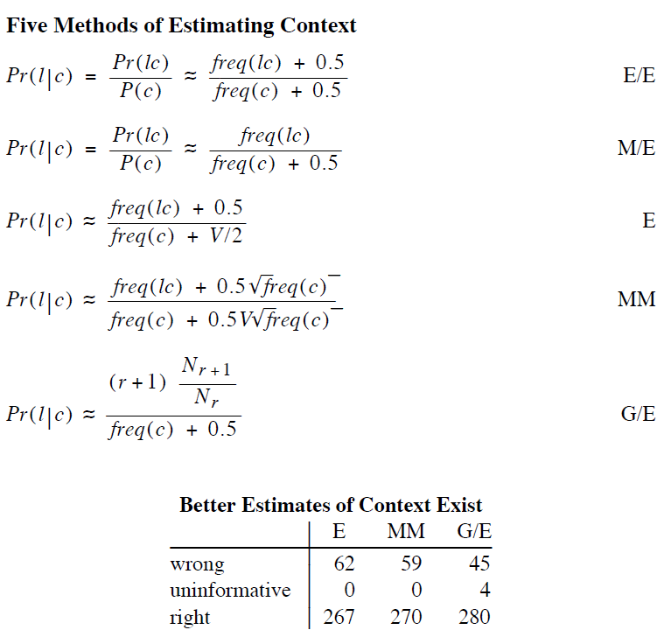

Slide 25
Future Improvements
Add More Factors
Trigrams
Thesaurus Relations
Morphology
Syntactic Agreement
Parts of Speech
Improve Combination Rules
Shrink (Meaty Methodology)

Slide 27
Conclusion (Spelling Correction)
There has been a lot of interest in smoothing
Good-Turing estimation
Knesser-Ney
Is it worth the trouble?
Ans: Yes (at least for recognition applications)

Slide 29
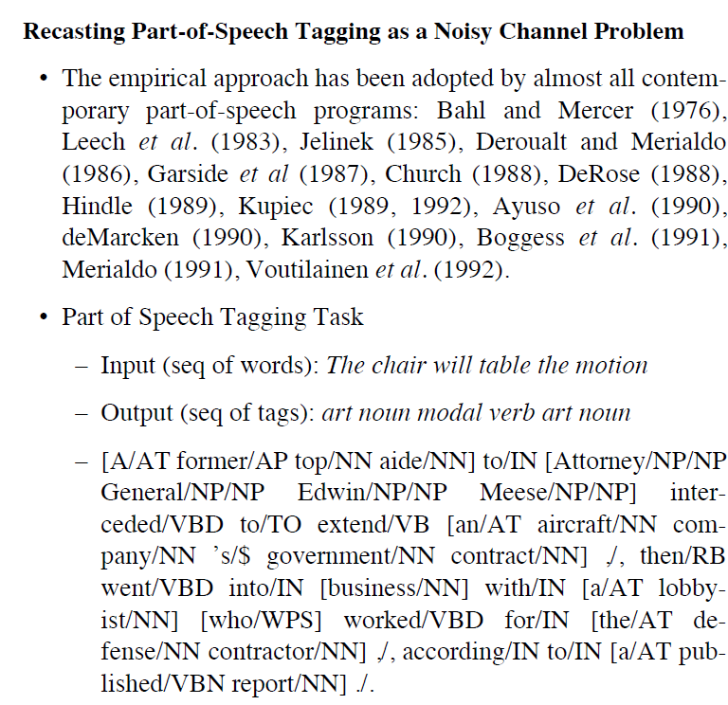

Slide 30
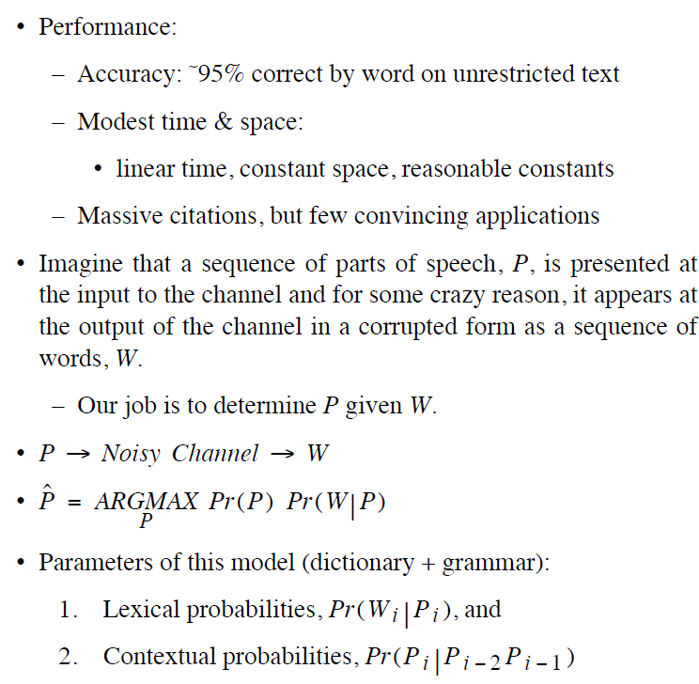

Slide 34
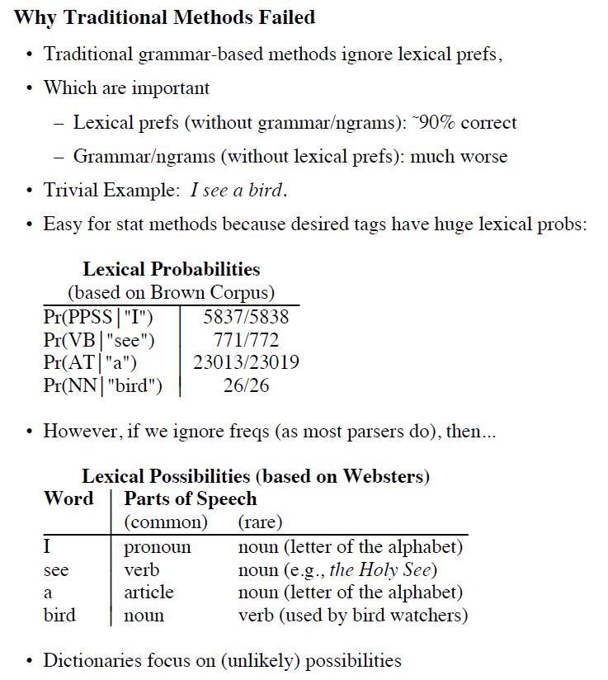

Slide 35
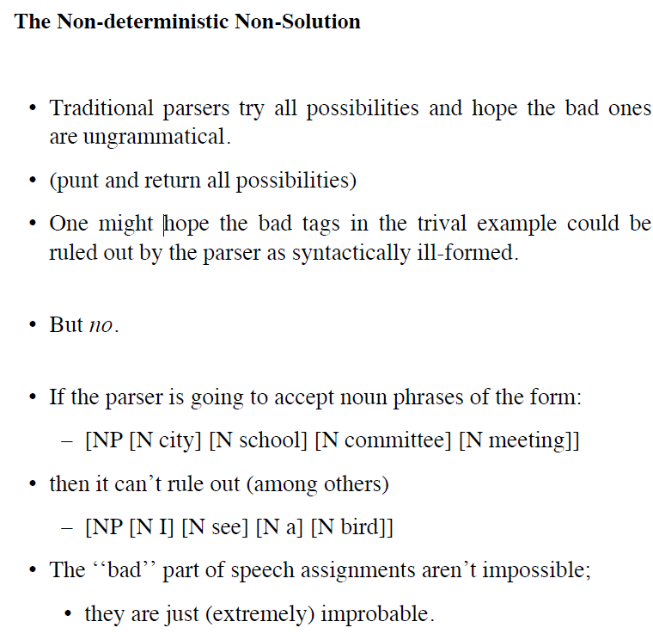

Slide 36
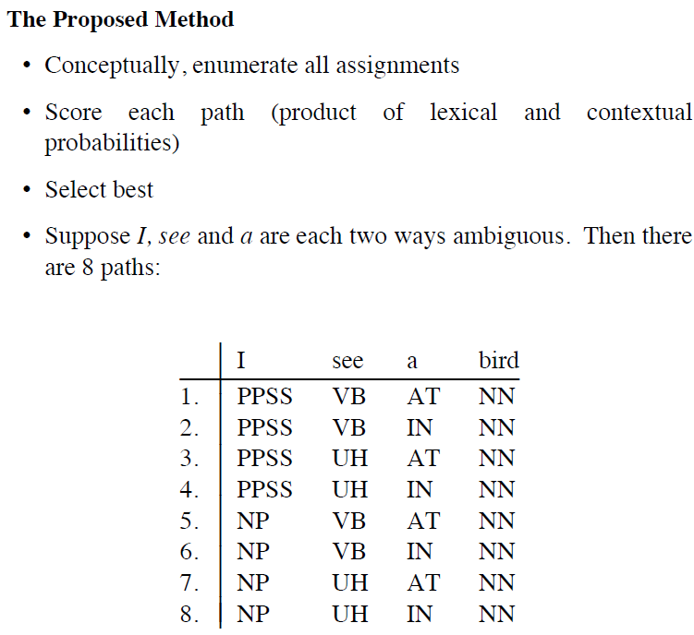

Slide 38
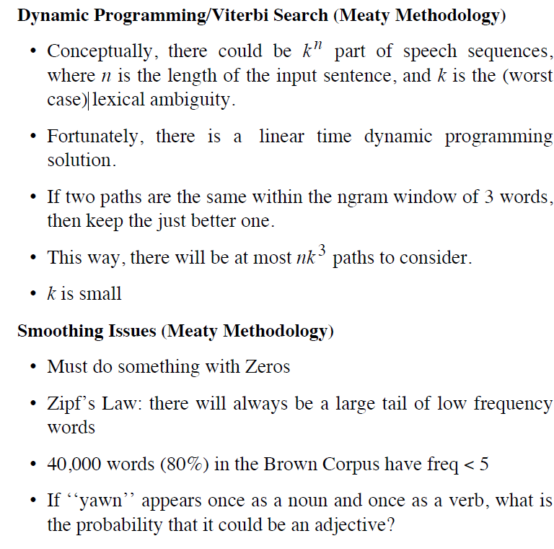

Slide 40
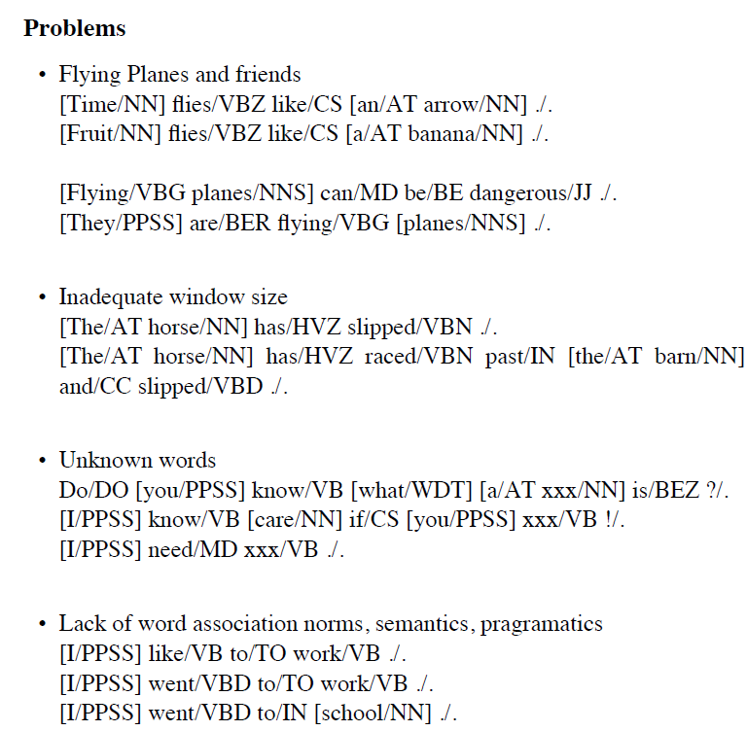

Slide 41
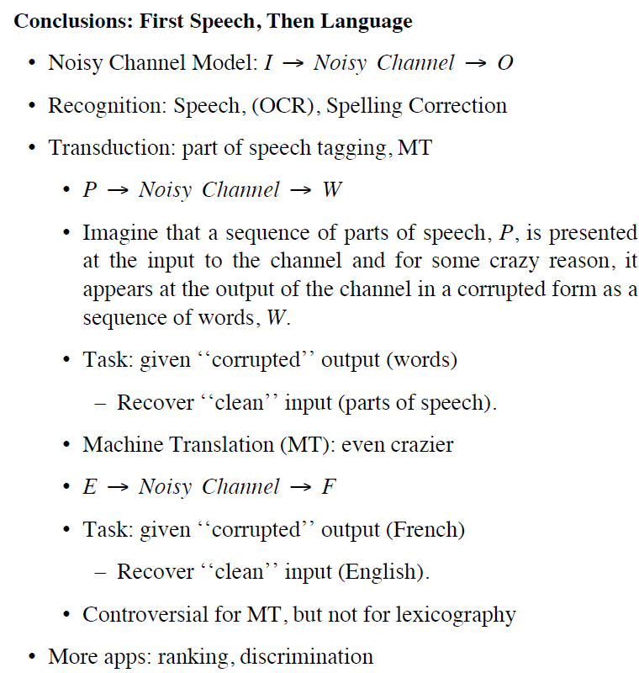

Slide 42
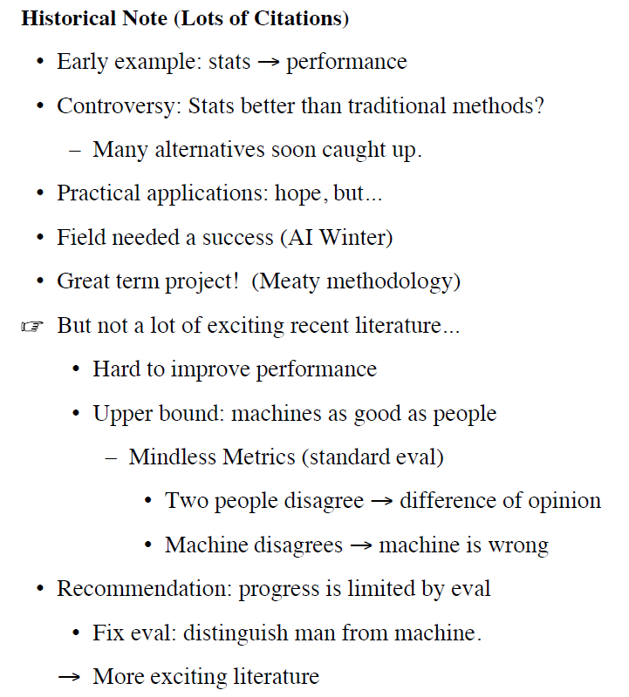

Slide 45
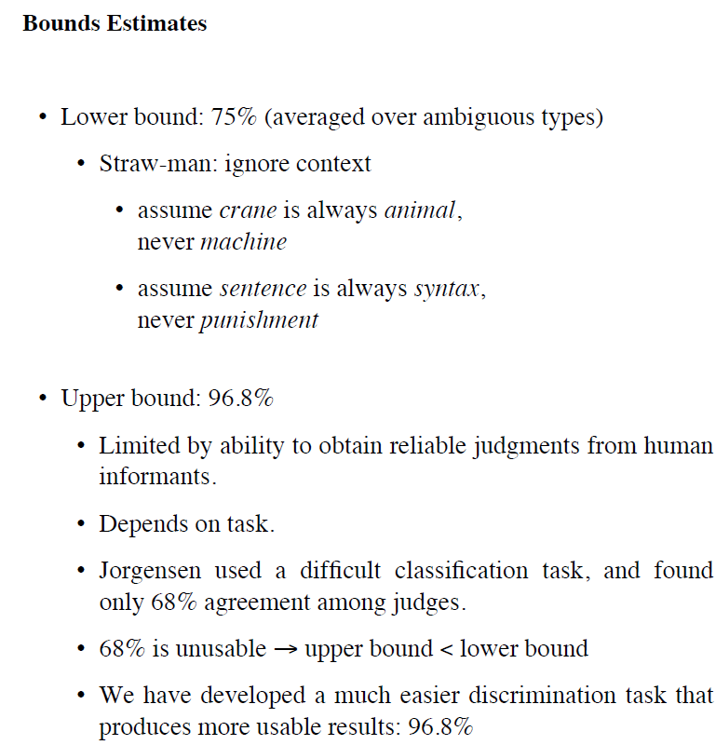

Slide 49
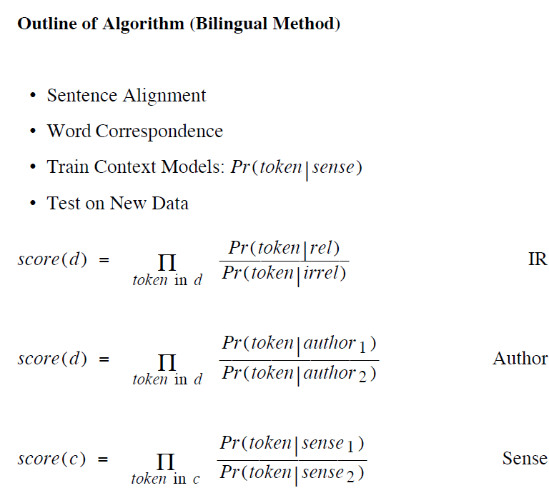

Slide 50
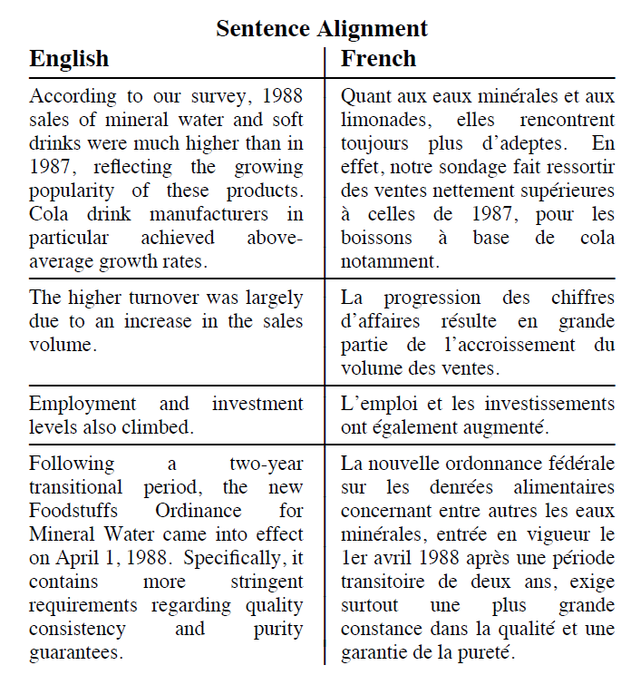

Slide 51
Aligning Words

Slide 56
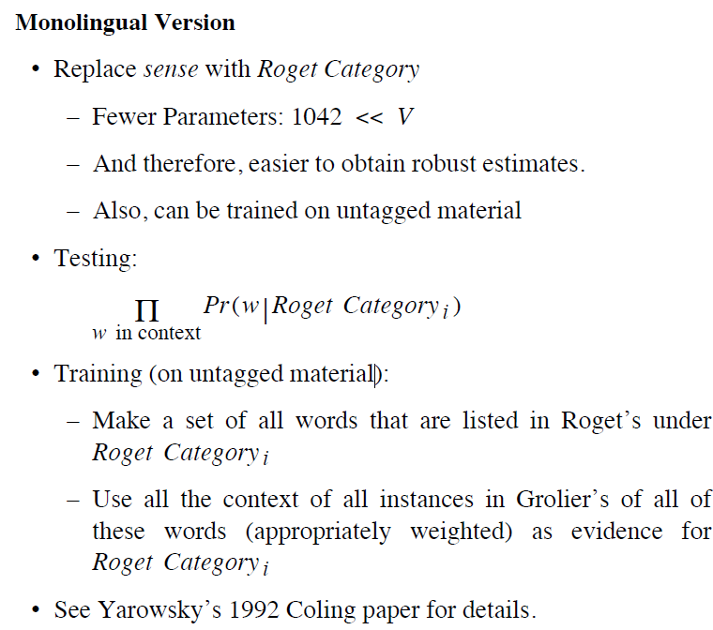

Slide 57
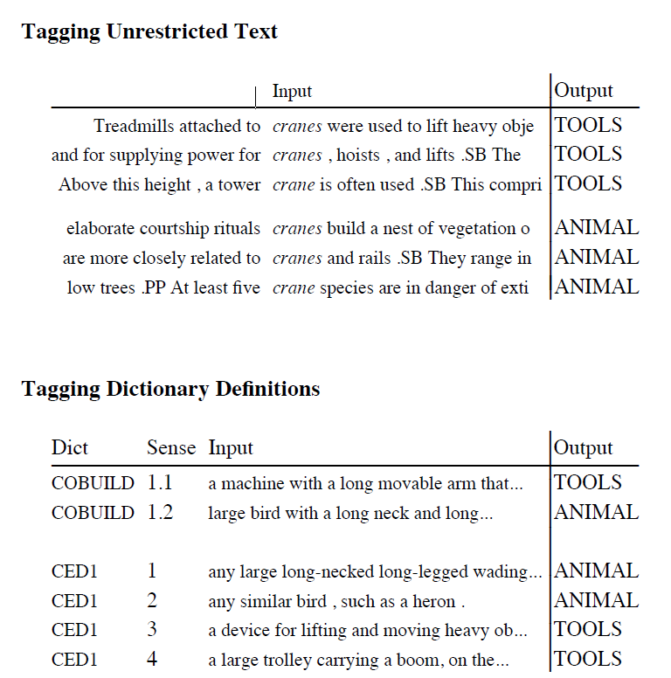

Slide 63
