Slide 1
Semantic Distance
CMSC 723: Computational Linguistics I ― Session #10
Jimmy Lin
The iSchool
University of Maryland
Wednesday, November 4, 2009
Material drawn from slides by Saif Mohammad and Bonnie Dorr

Slide 2
Progression of the Course
Words
Finite-state morphology
Part-of-speech tagging (TBL + HMM)
Structure
CFGs + parsing (CKY, Earley)
N-gram language models
Meaning!

Slide 3
Today’s Agenda
Lexical semantic relations
WordNet
Computational approaches to word similarity

Slide 4
Lexical Semantic Relations

Slide 5
What’s meaning?
Let’s start at the word level…
How do you define the meaning of a word?
Look it up in the dictionary!
Well, that really doesn’t help…

Slide 6
Approaches to meaning
Truth conditional
Semantic network

Slide 7
Word Senses
“Word sense” = distinct meaning of a word
Same word, different senses
Homonyms (homonymy): unrelated senses; identical orthographic form is coincidental
Example: “financial institution” vs. “side of river” for bank
Polysemes (polysemy): related, but distinct senses
Example: “financial institution” vs. “sperm bank”
Metonyms (metonymy): “stand in”, technically, a sub-case of polysemy
Examples: author for works or author, building for organization, capital city for government
Different word, same sense
Synonyms (synonymy)

Slide 8
Just to confuse you…
Homophones: same pronunciation, different orthography, different meaning
Examples: would/wood, to/too/two
Homographs: distinct senses, same orthographic form, different pronunciation
Examples: bass (fish) vs. bass (instrument)

Slide 9
Relationship Between Senses
IS-A relationships
From specific to general (up): hypernym (hypernymy)
Example: bird is a hypernym of robin
From general to specific (down): hyponym (hyponymy)
Example: robin is a hyponym of bird
Part-Whole relationships
wheel is a meronym of car (meronymy)
car is a holonym of wheel (holonymy)

Slide 10
WordNet Tour
Material drawn from slides by Christiane Fellbaum

Slide 11
What is WordNet?
A large lexical database developed and maintained at Princeton University
Includes most English nouns, verbs, adjectives, adverbs
Electronic format makes it amenable to automatic manipulation: used in many NLP applications
“WordNets” generically refers to similar resources in other languages

Slide 12
WordNet: History
Research in artificial intelligence:
How do humans store and access knowledge about concept?
Hypothesis: concepts are interconnected via meaningful relations
Useful for reasoning
The WordNet project started in 1986
Can most (all?) of the words in a language be represented as a semantic network where words are interlinked by meaning?
If so, the result would be a large semantic network‏…

Slide 13
Synonymy in WordNet
WordNet is organized in terms of “synsets”
Unordered set of (roughly) synonymous “words” (or multi-word phrases)
Each synset expresses a distinct meaning/concept

Slide 14
WordNet: Example
Noun
{pipe, tobacco pipe} (a tube with a small bowl at one end; used for smoking tobacco)
{pipe, pipage, piping} (a long tube made of metal or plastic that is used to carry water or oil or gas etc.)
{pipe, tube} (a hollow cylindrical shape)
{pipe} (a tubular wind instrument)
{organ pipe, pipe, pipework} (the flues and stops on a pipe organ)
Verb
{shriek, shrill, pipe up, pipe} (utter a shrill cry)
{pipe} (transport by pipeline) “pipe oil, water, and gas into the desert”
{pipe} (play on a pipe) “pipe a tune”
{pipe} (trim with piping) “pipe the skirt”
Observations about sense granularity?

Slide 15
The “Net” Part of WordNet

Slide 16
WordNet: Size
Part of speech | Word form | Synsets
Noun | 117,798 | 82,115
Verb | 11,529 | 13,767
Adjective | 21,479 | 18,156
Adverb | 4,481 | 3,621
Total | 155,287 | 117,659
http://wordnet.princeton.edu/

Slide 17
MeSH
Medical Subject Headings: another example of a theasuri
http://www.nlm.nih.gov/mesh/MBrowser.html
Thesauri, ontologies, taxonomies, etc.

Slide 18
Word Similarity

Slide 19
Intuition of Semantic Similarity
Semantically close
bank–money
apple–fruit
tree–forest
bank–river
pen–paper
run–walk
mistake–error
car–wheel
Semantically distant
doctor–beer
painting–January
money–river
apple–penguin
nurse–fruit
pen–river
clown–tramway
car–algebra

Slide 20
Why?
Meaning
The two concepts are close in terms of their meaning
World knowledge
The two concepts have similar properties, often occur together, or occur in similar contexts
Psychology
We often think of the two concepts together

Slide 21
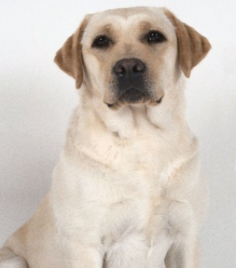
Two Types of Relations
Synonymy: two words are (roughly) interchangeable
Semantic similarity (distance): somehow “related”
Sometimes, explicit lexical semantic relationship, often, not

Slide 22
Validity of Semantic Similarity
Is semantic distance a valid linguistic phenomenon?
Experiment (Rubenstein and Goodenough, 1965)
Compiled a list of word pairs
Subjects asked to judge semantic distance (from 0 to 4) for each of the word pairs
Results:
Rank correlation between subjects is ~0.9
People are consistent!

Slide 23
Why do this?
Task: automatically compute semantic similarity between words
Theoretically useful for many applications:
Detecting paraphrases (i.e., automatic essay grading, plagiarism detection)
Information retrieval
Machine translation
…
Solution in search of a problem?

Slide 24
Types of Evaluations
Intrinsic
Internal to the task itself
With respect to some pre-defined criteria
Extrinsic
Impact on end-to-end task
Analogy with cooking…

Slide 25
Evaluation: Correlation with Humans
Ask automatic method to rank word pairs in order of semantic distance
Compare this ranking with human-created ranking
Measure correlation

Slide 26
Evaluation: Word-Choice Problems
Identify that alternative which is closest in meaning to the target:
accidental
wheedle
ferment
inadvertent
abominate
imprison
incarcerate
writhe
meander
inhibit

Slide 27
Evaluation: Malapropisms
Jack withdrew money from the ATM next to the band.
band is unrelated to all of the other words in its context…

Slide 28
Evaluation: Malapropisms
Jack withdrew money from the ATM next to the bank.
Wait, you mean bank?

Slide 29
Evaluation: Malapropisms
Actually, semantic distance is a poor technique…
What’s a simple, better solution?
Even still, task can be used for a fair comparison

Slide 30
Word Similarity: Two Approaches
Thesaurus-based
We’ve invested in all these resources… let’s exploit them!
Distributional
Count words in context

Slide 31
Word Similarity: Thesaurus-Based Approaches
Note: In theory, applicable to any hierarchically-arranged lexical semantic resource, but most commonly applied to WordNet

Slide 32
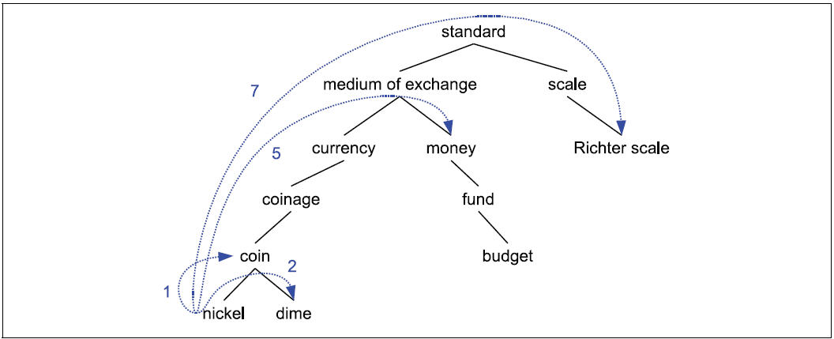
Path-Length Similarity
Similarity based on length of path between concepts:

Slide 33
Concepts vs. Words
Similarity based on length of path between concepts
But which sense?
Pick closest pair:
Similar techniques applied to all concept-based metrics

Slide 34
Wu-Palmer Method
Similarity based on depth of nodes:
LCS is the lowest common subsumer
depth(c) is the depth of node c in the hierarchy
Explain the behavior of this similarity metric…
What if the LCS is close? Far?
What if c₁ and c₂ are at different levels in the hierarchy?

Slide 35
Edge-Counting Methods: Discussion
Advantages
Simple, intuitive
Easy to implement
Major disadvantage:
Assumes each edge has same semantic distance… not the case?

Slide 36
Resnik Method
Probability that a randomly selected word in a corpus is an instance of concept c:
words(c) is the set of words subsumed by concept c
N is total number of words in corpus also in thesaurus
Define “information content”:
Define similarity:

Slide 37
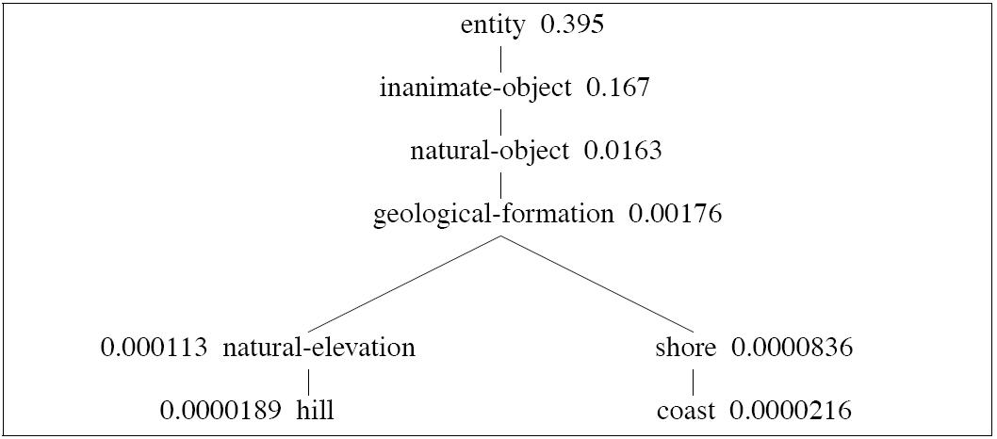
Resnik Method: Example
Explain its behavior…

Slide 38
Jiang-Conrath Distance
Can we do better than the Resnik method?
Intuition (duh?)
Commonality: the more A and B have in common, more similar they are
Difference: the more differences between A and B, the less similar they are
Jiang-Conrath Distance:
Note: distance, not similarity!
Generally works well
Explain its behavior…

Slide 39
Thesaurus Methods: Limitations
Measure is only as good as the resource
Limited in scope
Assumes IS-A relations
Works mostly for nouns
Role of context not accounted for
Not easily domain-adaptable
Resources not available in many languages

Slide 40
Quick Aside: Thesauri Induction
Building thesauri automatically?
Pattern-based techniques work really well!
Co-training between patterns and relations
Useful for augmenting/adapting existing resources

Slide 41
Word Similarity: Distributional Approaches

Slide 42
Distributional Approaches: Intuition
“You shall know a word by the company it keeps!” (Firth, 1957)
Intuition:
If two words appear in the same context, then they must be similar
Watch out for antonymy!
Basic idea: represent a word w as a feature vector
Features represent the context…
So what’s the context?

Slide 43
Context Features
Word co-occurrence within a window:
Grammatical relations:

Slide 44
Context Features
Feature values
Boolean
Raw counts
Some other weighting scheme (e.g., idf, tf.idf)
Association values (next slide)
Does anything from last week applicable here?

Slide 45
Association Metric
Commonly-used metric: Pointwise Mutual Information
What’s the interpretation?
Can be used as a feature value or by itself

Slide 46
Cosine Distance
Semantic similarity boils down to computing some measure on context vectors
Cosine distance: borrowed from information retrieval
Interpretation?

Slide 47
Jaccard and Dice
Jaccard
Dice

Slide 48
Information-Theoretic Measures
Kullback-Leibler divergence (aka relative entropy)
See any issues?
Note: asymmetric
Jenson-Shannon divergence

Slide 49
Distributional Approaches: Evaluation
Same as thesaurus-based approaches
One additional method: use thesaurus as ground truth!

Slide 50
Distributional Approaches: Discussion
No thesauri needed: data driven
Can be applied to any pair of words
Can be adapted to different domains

Slide 51
Distributional Profiles: Example

Slide 52
Distributional Profiles: Example

Slide 53
What’s the problem?

Slide 54
Distributional Profiles of Concepts

Slide 55
Semantic Similarity: “Celebrity”
Semantically distant…

Slide 56
Semantic Similarity: “Celestial body”
Semantically close!

Slide 57
Solution?
We need word sense disambiguation!
Stay tuned for next week…

Slide 58
Recap: Today’s Agenda
Lexical semantic relations
WordNet
Computational approaches to word similarity

